Slide 1
Primary Care Enhancement Program
How to use these slides
Notes:
S1C Explanatory slide – How to use these slides and the speaker notes
Do not include this slide in your presentation.
Ensure you have read the training manual which accompanies these slides. It gives valuable information to assist you in preparing to facilitate the workshop, including tips on how to support a person with intellectual disability to co-facilitate the workshop.
There is also an Easy Read co-facilitator guide for the co-facilitator with intellectual disability and a supporter to work through to understand the material.
This file is password protected. You must save a new copy before you make any changes to it.
This PowerPoint file contains slides for multiple audiences in the one master file. Separate files for different workshops are also available.
All materials can be used flexibly.
Some slides have animations. If a slide has animations, there is a little star next to it in the left hand slides menu.
If you prefer to present without animations, follow these instructions to turn them off:
Go to Slide show menu at the top of the screen
Select the Set up Slide Show button
Check the box that says “Show without animation”.
To turn animation back on just uncheck the box.
To turn off animation on a single slide, select everything on the slide, then go to Animations menu and select “None”.
Videos of how to do this are here: https://www.howtogeek.com/407396/how-to-disable-or-delete-powerpoint-animations/
Some slides are “hidden”. This means they will not show on a presentation. To unhide a slide, right click on it and select “Unhide”. To hide a different slide, right click and select “hide”.
You must tailor some slides with images of the workshop facilitators. If you have a co-facilitator who has intellectual disability, there is a space to include their photo in the corner of most slides. This serves as a reminder to participants to speak in an accessible manner for these sections of the training.
The suggested time for each slide is on the slide. If aiming for a 1 hour workshop, keep to the shorter the amount of time participants can share in small groups on each case study, remove the small group discussions for at least one case study (i.e. go straight to larger group sharing) and choose shorter options for any videos used.
Another approach to allow more time for all 3 case studies is a 1.5 hour workshop which includes a 10 - 15 minute panel discussion and a 10 minute break.
Format of the speaker notes:
For most slides, the notes page includes both brief speaker notes and an optional suggested script.
It is suggested that you read through the script in full when preparing to run the session, to ensure you understand the slide content. When presenting, you may edit the script as you please. One approach to ensure a natural style for facilitation is to use the full script to understand the content but then work from the key points, using your own words.
Case examples should be read as it is written (in full) to ensure all the clinical information is conveyed. These parts are written in italics.

Slide 2
Primary Care Enhancement Program
PHN Logo
Welcome
Notes:
S2C Welcome to workshop
Suggested time: 1 min.
Notes:
The co-facilitator with intellectual disability can do the welcome.
But only if they want to.
Key points:
Tell people you are starting the session.
Thank them for coming.
Tell them your name.
Tell the other co-facilitators’ names.
What you could say:
Hello. Welcome to the workshop. Thank you for coming along today.
My name is [insert speaker’s name].
This is [other facilitator’s name].
We will be running this workshop together today.

Slide 3
Photo of co-facilitator
Acknowledgement of Country
Notes:
S3C Acknowledgement of Country
Suggested time: 1 minute.
Notes:
The co-facilitator with intellectual disability can do the Acknowledgement of Country.
But only if they want to.
Key points:
Acknowledge the first owners of the Country you are on.
What you could say:
I would like to acknowledge the Aboriginal lands which we are all on.
I are meeting on the land of [insert name of land you are on].
I want to pay our respects to Elders past, present and emerging.
Let us remember that Aboriginal people have been living on this land for a very long time.

Slide 4
Who we are
This is [person’s name]
This is [person’s name]
Insert picture here
Insert picture here
Notes:
S4C Co-facilitators introduce themselves (with 2)
Suggested time: 3-5 minutes (if aiming for a 1 hour workshop with 3 case studies, keep this to 3 minutes or less)
Notes:
Tailor the slide with your pictures and names.
It is best if a co-facilitator with intellectual disability introduces themselves first.
Key points:
Tell people why you are involved in this training.
Tell them you have lived experience of intellectual disability
Tell them you have experience using health care.
The other co-facilitator should introduce themselves too.
What you could say:
We have not provided a script for this slide.

Slide 5
Who we are
This is [person’s name]
This is [person’s name]
This is [person’s name]
Insert picture here
Insert picture here
Insert picture here
Notes:
S5C Co-facilitators introduce themselves (with 3)
Suggested time: 3 -6 minutes (if aiming for a 1 hour workshop with 3 case studies, keep this to 3 minutes or less)
Notes:
Tailor the slide with your pictures and names.
It is best if a co-facilitator with intellectual disability introduces themselves first.
Key points:
Tell people why you are involved in this training.
Tell them you have lived experience of intellectual disability
Tell them you have experience using health care.
Other facilitators should introduce themselves too.
What you could say:
We have not provided a script for this slide.

Slide 6
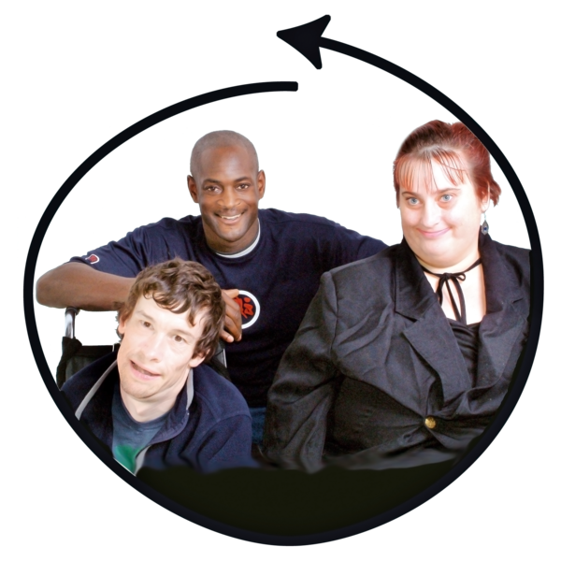
House keeping
Photo of co-facilitator
Please do not use jargon or acronyms
Speak slowly
Notes:
S6C Housekeeping - webinar
Suggested Time: 2 minutes
Notes:
Either co-facilitator can present this slide. Adapt as needed.
Refer to the Easy Read guide explanations of “jargon” and “acronyms”.
If you want, “jargon” can be swapped with “hard words”.
This slide is for a webinar.
Even though “Housekeeping” is usually one word, in Easy Read it works better as two.
Delete whichever “Optional script” part you are not using.
Key points:
Cameras on
Mute unless talking
How to raise your hand
Speak in an accessible way – explain the photo of the co-facilitator is a reminder
OK to use medical terms to discuss the case studies.
What you can say:
I will be running some of this training.
I have an intellectual disability.] Modify as needed if the other facilitator presents this slide.
So that we can all understand, please do not use jargon or acronyms.
And please speak slowly if you are sharing or asking a question.
Please do not be worried about making a mistake.
Sometimes we might not understand each other.
It is OK for us all to ask each other to explain something.
To help remind you, my photo is in the corner of all the slides where I am involved in running it.
There is one part of the training where it is OK to use words I might not understand.
That is when you talk about the case studies.
We want you to share your ideas with each other then.
That is why this is a workshop.
For those parts it is OK to share your ideas in the way you would normally speak to your co-workers.
But it is also OK if you want to ask someone to explain what they mean.

Slide 7
House keeping
Photo of co-facilitator
Please do not use jargon or acronyms
Speak slowly
Notes:
S7C Housekeeping – Face to Face
Suggested Time: 2 minutes
Notes:
Either co-facilitator can present this slide. Adapt as needed.
Refer to the Easy Read guide explanations of “jargon” and “acronyms”.
If you want, “jargon” can be swapped with “hard words”.
This slide is for a face to face session.
Even though “Housekeeping” is usually one word, in Easy Read it works better as two.
Delete whichever “Optional script” part you are not using.
Key points:
Bathrooms
Car park
Fire escapes
Speak in an accessible way – explain the photo of the co-facilitator is a reminder
OK to use medical terms to discuss the case studies.
What you can say:
There are some things you need to know about the building we are in.
The bathrooms are [describe location]
If the fire alarm goes off you have to leave through [point to exit]
[Insert any other information about the venue such as the carpark or refreshments here].
I will be running some of this training.
I have an intellectual disability.] Modify as needed if the other facilitator presents this slide.
So that we can all understand, please do not use jargon or acronyms.
And please speak slowly if you are sharing or asking a question.
Please do not be worried about making a mistake.
Sometimes we might not understand each other.
It is OK for us all to ask each other to explain something.
To help remind you, my photo is in the corner of all the slides where I am involved in running it.
There is one part of the training where it is OK to use words I might not understand.
That is when you talk about the case studies.
We want you to share your ideas with each other then.
That is why this is a workshop.
For those parts it is OK to share your ideas in the way you would normally speak to your co-workers.
But it is also OK if you want to ask someone to explain what they mean.

Slide 8
What do you hope to learn?
Photo of co-facilitator
Notes:
S8C What do you hope to learn?
Suggested time: 2 minutes
Notes:
This is a hidden slide. Whether it is helpful to use it depends on the number of people in the workshop / webinar, and whether you have time and capacity to modify what you deliver based on the input you receive from people.
If using it, it’s suggested that you tie the responses received to the outline in the next slide where possible, and again when reaching specific content that relates to what people have said here.
Although the picture of the co-facilitator with intellectual disability is in the corner, this is just to remind participants to consider their language. We suggest the PHN co-facilitator present this slide, if using,
Key points:
As this is early in the workshop, let people discuss with someone next to them first as an ice breaker.
Then ask them to share amongst the broader group.
You could also suggest people consider what they wrote in their pre-workshop reflection and activity and whether that gives clues as to what they hope to learn.

Slide 9
Workshop outline
Photo of co-facilitator
Photo of co-facilitator
Health care for people with intellectual disability
Case examples
What we can learn
Photo of physician or facilitator
Photo of co-facilitator
Notes:
S9C Workshop outline
Suggested time: 1 minute
Notes:
See the words list for an easy read explanation of “case examples”.
This can be presented by either co-facilitator.
Key points:
Health care for people with intellectual disability
Case examples (say how many)
What we can learn from those case studies
What you can say:
I am going to tell you what we will cover today.
We will talk about health in people with intellectual disability
We will talk about some things that make it harder for people to get good health care.
Then you all will get a chance to talk about some case examples.
And then I am going to talk about what you can learn from those case examples.
I will talk about the things you can do with anyone you see.
Things that will make their health care better.

Slide 10
Health care for people with intellectual disability
Photo of co-facilitator
Complex
Harder to get good health care
Health professionals are not confident
Notes:
S10C Health care for people with intellectual disability: Introductory information
Suggested time: 1-2 minutes
Notes:
Key points:
1 – 2 % of people have intellectual disability.
Health outcomes are not equal
Barriers in health care access
What you can say:
Australia’s health system is one of the best in the world.
Most Australians feel they have good health,
But health outcomes are much worse for people like me, living with intellectual disability.
1 to 2 percent of people have intellectual disability.
We have worse physical and mental health.
Many of us use lots of medications.
We have double the number of deaths that could be avoided.
An Australian study found that on average we die 27 years younger.
We can have trouble getting good health care.
We have lower rates of thing like vaccines.
Many of us have complex health conditions that are difficult to diagnose.
And sometimes the signs of illness are not so clear.
Communication can be harder in both directions.
But we want to be healthy.
We have right to good healthcare.

Slide 11
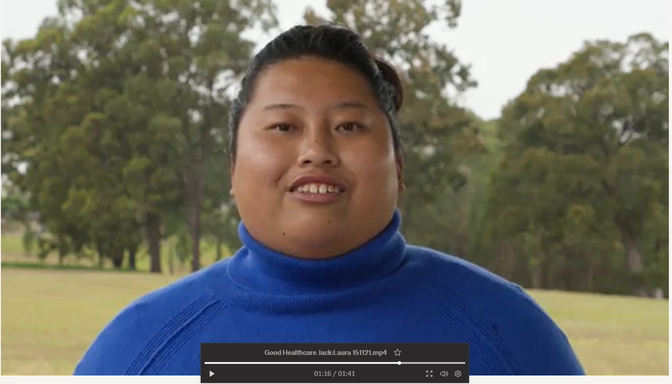
Health care for people with intellectual disability
Photo of co-facilitator
Notes:
S11V Health care for people with intellectual disability - Video placeholder
Suggested time: 1-2 minutes
Notes:
This is a video placeholder. If your co-facilitator with intellectual disability does not want to deliver this content, you may use a video instead.
Links to suitable videos made by CID are in the Training Guide.
Alternately, you can deliver this content yourself and use a video for the next part (a personal health care story).
Key points:
1 – 2 % of people have intellectual disability.
Health outcomes are not equal
Barriers in health care access exist

Slide 12
Good health care
Photo of co-facilitator
Insert an image or video here
Notes:
S12C Good health care
Suggested time: 1-2 minutes
Notes:
This can be a personal story from the co-presenter with intellectual disability, or a video.
Links to suitable videos made by CID are in the Training Guide.
If using a personal story, you can put in a picture or some key words
The PHN co-facilitator should work with the co-facilitator with intellectual disability to create a suitable script. The Easy Read co-facilitator guide includes information about choosing to tell your story and what makes a good story.
The point is to:
Give a person-centred account of a health journey
Showcase that good health care is possible to achieve for people with intellectual disability
Key point:
Even though there are the barriers to health care, good health care is still possible.
What you can say:
But it is possible to get good health care.
Here is my story of getting good health care.
Then tell the story.
Put your own notes here.
Or you can say:
But it is possible to get good health care.
Here is [person in video’s name] talking about their experience of good health care.

Slide 13
Case Studies
Notes:
S13C Intro to case examples
Suggested Time: 1 minute
Notes:
This divider slide is useful for orienting participants to the change from co-facilitator-led slides to case based learning.
The co-facilitator with intellectual disability is not involved in presenting the case studies. The Trainer’s guide and Easy Read co-facilitator guide gives details to understand this. The co-facilitator with intellectual disability can take a break during this time.
In the Trainer’s guide appendices are notes for each case study. Within the slides, we have suggested suitable audiences for that case study. Where the same case example is used for multiple audiences, the specific information given has been tailored to that audience.
You may wish to send the case descriptions to your participants ahead of the workshop. See the appendix to the Trainers guide, which includes this as a handout.
Breaking people into small groups (2 or 3) for the first case is likely to result in greater sharing than keeping them in larger groups. Break out rooms can be used if in a Webinar.
Key points:
If the co-facilitator with intellectual disability prefers to take a break during the case examples, thank them for their introduction to the topic and tell people that they will be back later, before they leave the room.
Encourage participants to contribute to the discussion, emphasise there is no one correct answer in most instances.
The point is to discuss the types of issues that can arise and what we can learn through reflecting on both positive aspects of the care provided and the challenges.
Many of the examples are conglomerates across several similar, real-life cases. In all cases, identifying information has been changed. The photos are not of these specific people.

Slide 14
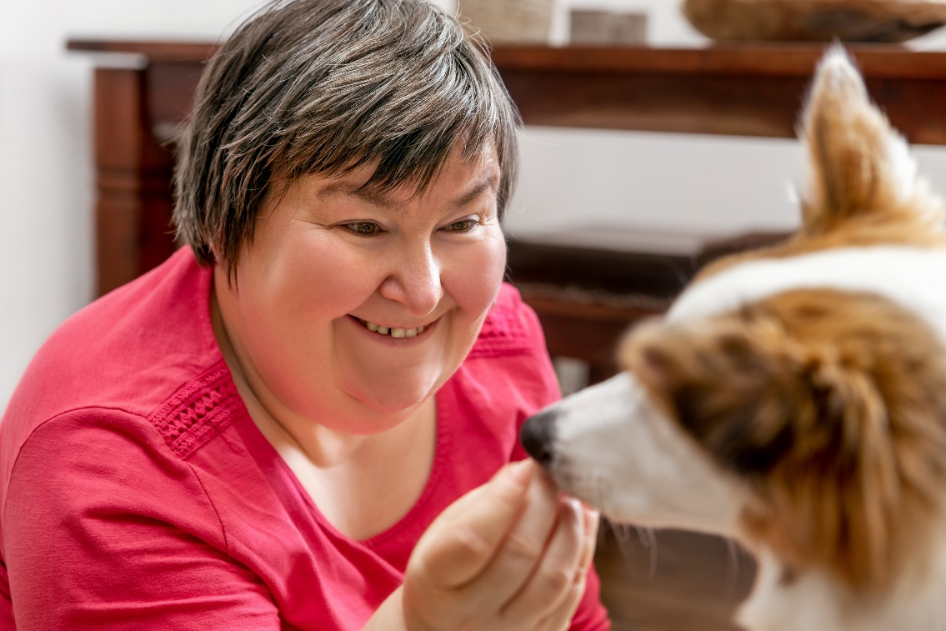
Stacey
Early 30’s, lives with family and dog
Works as a mail clerk and actor
Moderate intellectual disability, speaks
Mouth breathing
Gagging
Bruxes teeth
Recent vertical root fracture of an unresolved premolar tooth
Fears needles
Notes:
S93P Stacey - Dentists
Suggested time: 1.5 minutes:
Notes:
Read the case study as it is written.
See the appendix to the Training guide for detailed information about this case and the clinical and practical points it highlights, including appropriate reasonable adjustments.
Remind participants that the case is also available in their notes pack.
Suggested script:
Stacey is a young woman who lives with her family and has a companion dog. She works as a mail clerk and occasionally as an actor. She has an intellectual disability and needs support across several areas of life.
Stacey communicates using simple speech and can mostly be understood well. She is well supported by her mum, Anna, who attends all appointments with Stacey.
Stacey is a mouth breather and often gags. She also has bruxism but cannot wear a splint due to gagging. She has a phobia of needles and so won’t tolerate regular muscle relaxant injections, they make her extremely anxious.
Recently, she had a vertical root fracture of an unrestored premolar tooth.

Slide 15
Stacey – your turn
How would you address Stacey’s oral health needs?
What are some things that might help her cope with dental work?
Notes:
S94P Stacey – Dentists, your turn
Suggested time: 8 minutes:
Notes:
Give people around 4 minutes to discuss in small groups with a 30 second warning before you end.
Then ask the groups to share some of the insights they shared. (2 - 4 minutes).
The next slide is about communication and reasonable adjustments. If groups raise these topics in response here, encourage it and simply summarise additional points in the next slide.
Key points:
Regular scaling
Breaks
Relaxation techniques including calming things from home
Manage the risk of vomiting through scheduling
Optional script: (what to say when depends on what answers arise, but potential answers to emphasise are below)
Ask people to get into small groups (2 – 4 people) to discuss:
How you would address Stacey’s oral health needs?
Come up with ideas of what might help Stacey to cope with dental work?
Answers to highlight:
How would you address Stacey’s oral health needs?
Focus on regular scaling in small sections, with regular breaks,
Schedule appointments at least 2 hours after food to reduce risk of vomiting.
Ask the GP for a care plan summary (the one from the GP Management plan or GP Team Care arrangement plan) to appraise yourself of any relevant medical issues and medications.
Would people suggest a maxillary splint to combat bruxing?
She is unlikely to tolerate it due to gagging (the real life Stacey does not tolerate it).
Focus on good maintenance and refer to a psychologist for further assistance if bruxing increases.
What things might help her to cope?
Schedule appointments that minimise waiting times and even allow her to wait away from other patients where she may be more relaxed
Give her time to settle in at the start of the appointment.
Make conversation – ask about other things in her life (get to know her a bit).
Regular breaks focused on breathing and relaxation exercises, the dentist can do this along with her.
Have a way for her to communicate the need to stop (due to gagging or for any reason).
Count upwards or downwards to indicate when she will next get a break (and stick to it).
Allow her to bring things from home that assist her to relax, e.g. a weighted blanket or any sensory toys that help relax her.
Tell and show her what you are going to do, use models, images and videos.
Good communication – covered in more detail in the next slide.
Ask her how it went at the end so you can adjust things next time if something could be better.
Other answers you can share from the real life Stacey:
Salt on her tongue helped her tolerate scaling without gagging.
Counting down from 20 to the next break.
Instruct her to relax her shoulders (the dentist does it too).
Bringing in a weighted blanket.
Stacey raises her finger if she needs to stop for any reason.

Slide 16
Stacey – further reflections
How would you adjust your communication with Stacey?
Other adjustments?
Notes:
S95P Stacey – Dentists – Further reflections
Suggested time: 6 minutes:
Notes:
These points may have already come out through group feedback from the last slide. If that is the case, direct workshop participants to consider and discuss other adjustments, or simply summarise any additional points not yet discussed.
Key points:
Tell her what you are going to do; check she is OK
Pay attention to communication and reasonable adjustments
Speak to Stacey
Quiet space
One thing at a time, simple words
Give time to think
Scheduling – let her mum know the date and time too
Optional script: (what to say when depends on what answers arise, but potential answers to emphasise are below)
Get people to share in pairs or groups again, discussion about how they would adjust their communication.
Would you need to adjust communication? If yes, what are some ideas for enhancing communication?
What else would you do for someone like Stacey to maximise the success of the appointment?
Answers to emphasise:
Communication:
Speak to Stacey – not her mum, unless she says it is OK to. (And then still involve Stacey too – respect that she is an adult).
Make sure you ask questions of Stacey, not her mum.
Give her information in a quiet place when she is ready to listen.
Talk about one thing at a time.
Use plain, everyday language.
Give Stacey time to think about what you have said. Be comfortable with silence, don’t feel the need to fill it.
Especially important to give time if Stacey needs to make a decision.
Always tell and show her what will happen, then
Check understanding both ways. Use the teach-back method.
Listen carefully when Stacey speaks to you.
Give her time to think if she has any questions.
If recommending that Stacey does something, ask if she would like you to give the information to her mum too. You can provide it in writing or verbally.
What about when you are making appointments for Stacey?
Give her a phone call, not a reminder letter.
If she asks you to, tell mum when the appointment is too.
Asking your reception staff to ask someone how they prefer to receive reminders and if there is anyone else they’d like you to communicate with about appointments, is a really easy and practical adjustment to make.

Slide 17
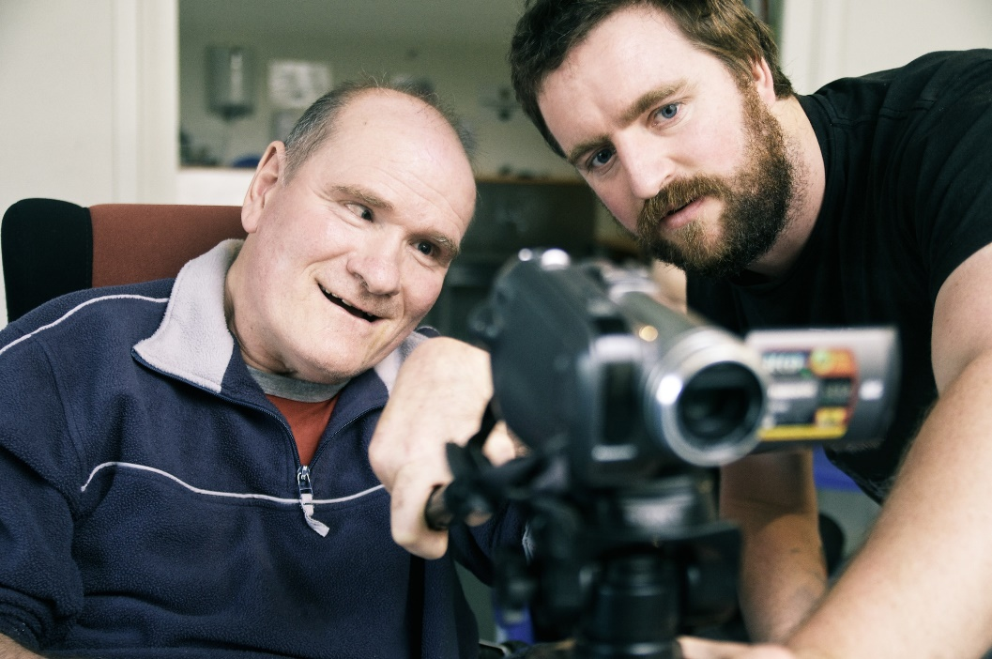
Leon
Late 30’s
Severe intellectual disability, no words, uses wheelchair
Lives in a group home, stays with dad every second weekend
Enjoys watching home videos
Dysphagia, epilepsy
6 years ago: comprehensive evaluation under GA
Referred by GP: – commencing bisphosphonates
- may need extractions
Notes:
S97P Leon - Dentists
Suggested time: 1.5 minutes:
Notes:
Read the case study as it is written.
See the appendix to the Training guide for detailed information about this case and the clinical and practical points it highlights, including appropriate reasonable adjustments.
Bisphosphonates are a type of drug used to treat osteoporosis. They can place a person at a higher risk of adverse effects following tooth extraction.
Suggested script:
Leon is a man in his late 30’s who enjoys watching home videos. He has a severe intellectual disability and requires support for most activities. Leon relies on non-verbal forms of communication. He also has a physical disability and uses a wheelchair.
He lives in a group home but stays with his father every second weekend.
Leon’s medical history includes dysphagia and epilepsy which is not well controlled. He tolerates having someone brush his teeth. His tolerance for dental work is lower – in the past he’s been able to manage small sections of scaling with good suctioning. However, he opens his mouth very wide making it hard to access the buccal surfaces.
His last comprehensive dental evaluation was 6 years ago, under general anaesthetic.
His GP has referred him to you for an assessment and possible extractions prior to commencing bisphosphonates.

Slide 18
Leon – your turn
How would you assess Leon’s oral health?
How would you address his dental needs?
Risks to manage?
Adjustments to standard practice?
Communication?
Notes:
S98P Leon – Dentists – Your turn
Suggested time: 6-7 minutes:
Notes:
An Orthopantomagram is an x-ray of the whole jaw, upper and lower, in one go
This case, and the answers, came from a special care dentist and is based on a real case. If people find it challenging (you will know because small groups will be very quiet), use the answers below to prompt discussion.
Give people about 5 minutes to discuss and 4 to share
Key points:
Focus on what Leon can tolerate – a toothbrush examination
Demonstrate, check in, give breaks
Consider scheduling to suit the person and minimise waiting
Optional script: (what to say when depends on what answers arise, but potential answers to emphasise are below)
In the same small groups, discuss the following questions:
How would you assess Leon’s oral health?
Would you go straight to general anaesthetic?
Is there anything else you could try? How would you work out what to do?
How would you address his dental needs?
Are there risks you need to manage?
Are there any adjustments you could make to your standard practice?
How to do you about communicating with Leon?
Give groups 5 minutes to discuss then bring them together to share with the larger group.
Answers to emphasise include:
Assessment:
Toothbrush examination – work with what he is used to
Leon stays in his wheelchair, with a strap to stay secure
Orthopantomagram (OPG) can be done in a wheelchair but you might need a lifter
Addressing:
Small sections of scaling, good suctioning
Give breaks
Demonstrate on one tooth before doing the rest
Risks:
Dysphagia = risk of gagging
Be aware of how much recline there is – he has
Epilepsy meds = risk of interaction with pre-meds
Also a risk for GA – so you want to avoid it if you can.
If extractions are needed – GA will be needed.
Adjustments:
Suggest he bring distractions with him
Organise pre-meds before a procedure
For someone with intellectual disability it can be really hard to sit in a waiting room. So if they are going to need pre-meds, consider whether it’s something they could take at home, to minimise the wait time
Scheduling appointments:
Minimise wait
A time that works for the person, the group home, etc..
Longer appointment = time to communicate, time to go slow
Communication:
Talk to Leon even though he can’t talk
Tell him that you are going to ask his supporters for information and for them to help you understand him
Ask those supporters how Leon may indicate yes/no or any distress – actively check with them during the procedure, and stop immediately if there is any distress
Show and tell him what you are going to do before you do it
You can demonstrate on your own hand, on a model of teeth, or on his hand so he has an idea of how the tool feels

Slide 19
Leon – pragmatic considerations
Liaise with GP
- Care plan summary
- Optimise general anaesthetic
Referral
Public hospital
Private dentist within hospital
Adjustments
Consent? Payment?
Notes:
S99P Leon – Dentists – Pragmatics
Suggested time: 4 minutes
Notes:
After 2 minutes ask people to share answers
Key points:
For work under GA – liaise with GP early – maximise opportunity
If referring – include info on adjustments that help
Consent and payment may come from another person
Optional script: (what to say when depends on what answers arise, but potential answers to emphasise are below)
There are some other pragmatic considerations in Leon’s case that can only be addressed through having great communication with others involved in his care.
Ask groups to consider what information you need to get from Leon’s doctor and what you should share with the GP
Also discuss what you will do if Leon needs referral for a GA
What are the options and importantly, what can you do to make that process smoother for Leon?
And finally, how are you getting paid for your work with Leon?
Answers to emphasise:
Liaison with GP:
Ask for the care plan summary so you know all the major things going on for Leon
Communicate with the GP that it would be good to get dental done IF Leon is having GA for any other reason.
And if extractions are needed, and this will be done under GA, give the GP sufficient notice to arrange other investigations he is due for. There is any number of preventative and routine checks that he could be overdue for so it makes sense to take full advantage of that GA and get them all done together.
If you refer to a public hospital, ask if there is a process by which a generalist or a rehab physician can arrange these extra investigations.
Referral options:
Public hospital
Private dentist who is able to do this in a well-equipped hospital – Leon is at high risk from a GA so it needs to be in a hospital with sufficient equipment.
Adjustments to the referral process:
Check their accessibility if it’s a practice – Leon is in a wheelchair
If you know of adjustments that assist Leon to cope, tell the person you are referring him to. One of our resources that we’ve shared is a tips sheet focused on communication and reasonable adjustments to optimise health appointments. You could simply asterisk which ones you use and then send it with the referral.
Include the request for other opportunistic evaluations
Another adjustment to make is to check the service’s eligibility before making a referral. In Leon’s case, he clearly has supports around him. But for people with few or no supports, taking this step can help them not fall through cracks.
Ask your staff to make the appointment before they leave your service, and to forward a copy of the referral directly to the practice – it all increases the likelihood that they will actually get there.
Payment?
- In the real life Leon’s case, the dentist phones his parents for consent and payment on the day, for example when the OPG was ordered.

Slide 20
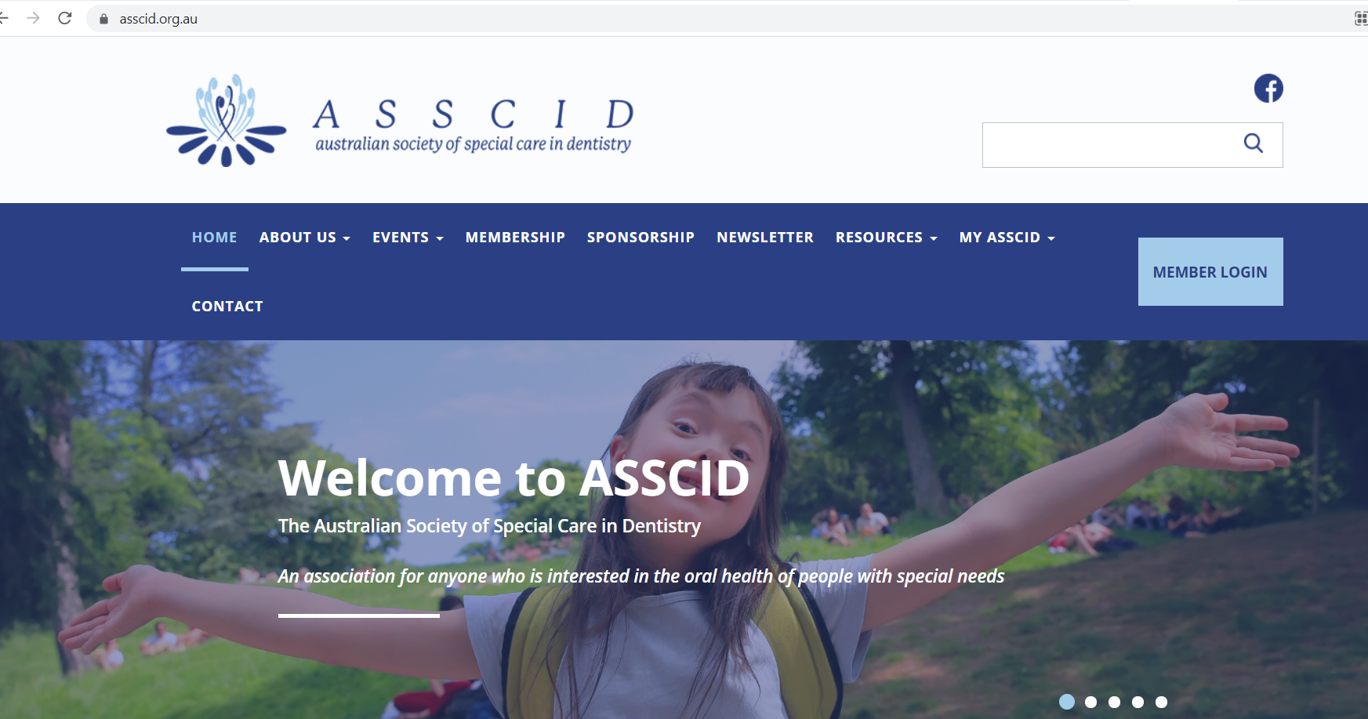
Resources – Special Care Dentistry
www.asscid.org.au/
Notes:
S100P Dentists – Resources special care
Suggested time: 1 minutes
Key point:
Showcase The Association of Special Care Dentistry as a source of information and referral options.
Optional script:
The Association of Special Care Dentistry is a source of information and referral options.
They run professional development for dentists and they can probably also help you find a special care dentist if your patient requires GA or has additional needs that you can’t meet.

Slide 21
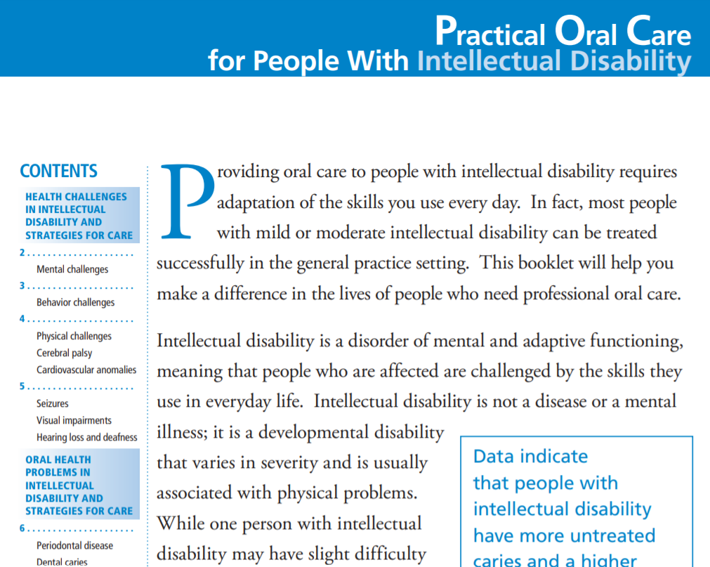
Other resources
https://www.nidcr.nih.gov/sites/default/files/2017-09/practical-oral-care-intellectual-care.pdf
Notes:
S101P Dentists –Resources
Suggested time: 1 minutes
Key point:
Inclusion Australia has produced an excellent resource for dentists.
The NIH paper shown here is one in a series of papers about oral health care and developmental disabilities. They are short and practical.
NICE guidelines from the UK are also available but are specific to people living in residential care settings. The link is on the slide.

Slide 22
Reasonable adjustments
Photo of co-facilitator
Your ideas?
Notes:
S14C Reasonable adjustments definition – share
Suggested time – 1 – 2 minutes.
Notes:
This slide can be co-led with a co-facilitator with intellectual disability. The lead in should come from the PHN co-facilitator who has covered case studies.
Below is an example of the sort of way this topic could be introduced. However, it is important to support a co-facilitator to use their own words if they prefer. If using the “What you can say” script, ensure the co-facilitator with intellectual disability has a copy of that script without the other notes on it.
See the Easy Read co-facilitator guide for information about reasonable adjustments.
Key points:
Welcome back co-facilitator
This is an opportunity for the group to share their thoughts.
Brief speaker notes:
Welcome back co-facilitator
Ask for ideas of what Reasonable adjustments means
Small adaptations to practice = reasonable adjustments
Optional script for PHN co-facilitator:
Welcome back to [co-facilitator’s name].
Throughout the case examples, we have identified ways that clinicians can make really small adaptations in order to health care better for people with intellectual disability. Many of these things fall under the umbrella of “reasonable adjustments”. To explain what reasonable adjustments are and talk about their impact, I am going to ask [co-facilitator’s name] to come back and lead us again.
For co-facilitator with intellectual disability:
What you can say:
So, what is a reasonable adjustment?
Firstly can I hear from you guys.
What do you think a reasonable adjustment is?
Listen to ideas.

Slide 23
Reasonable adjustments
Photo of co-facilitator
Takes away barriers that would stop someone getting good health care
Notes:
S15C Reasonable adjustments definition
Suggested time – 1 - 2 minutes.
Notes:
This slide can be presented by a co-facilitator with intellectual disability.
See the Easy Read co-facilitator guide for information about reasonable adjustments.
Key points:
Reasonable adjustments are small adaptations to practice
They can have a big impact on a person’s health care.
Give an example.
What you can say:
I think reasonable adjustments are things you do which takes away barriers that would stop someone getting good health care
The easiest way to tell you what a reasonable adjustment is with an example.
One of the pre-workshop activities was to gather the forms you ask people to do when they come to see them.
Put your hand up if you did that.
If you did not do it, then think about the forms new people do when they see you.
Put your hand up if you can think of your forms.
Now, keep your hand up if you are able to think of one thing that your practice does to help someone who needs help doing that form.
It does not have to be you that does it.
It might be some one who works with you.
Congratulations to people with their hands still up.
What you are doing to support someone with your forms - that’s a reasonable adjustment.
That is the sort of thing that makes it easier for someone like me to get health care when I need it.
And it means when I see you, I can give you the same info as other people.

Slide 24
Before I see you
Photo of co-facilitator
Forms
Booking times - reminders
Ask me what I need
Notes:
S16C Before I see you:
Suggested time: 1 - 2 minutes
Notes:
This slide can be led by a co-facilitator with intellectual disability.
On this slide or one that follows, if the person co-facilitating wants to share a personal experience, the text and flow can be modified to suit.
Brief notes:
Reasonable adjustments can happen before you see someone.
They might be done by the health worker or other people working there.
Things like
Booking visits at good times
Asking what you need
Help with forms
What you can say:
Some adjustments can be made before I see you
Like if your receptionist helps me with a form over the phone
Or sending a form out really early so I have enough time to do with my support worker, who only visits once a week
Or letting someone book a time slot that is going to work for them/
Or Booking a long appointment, or even coming to my house
Or knowing that it might take 5 appointments before we can do an assessment, before I can feel OK with that.
Or checking who should be at the appointment
Ask me what I need – like, who should be at the appointment with me?
I don’t have a computer, don’t send me forms through email.
And if I can’t read very well, don’t send me some 5 page letter. Phone me about it.

Slide 25
After I see you
Photo of co-facilitator
What I need to do
Send Referrals
Notes:
S17C After I see you:
Suggested time: 1 minute
Notes:
This slide can be led by a co-facilitator with intellectual disability.
Key points:
Adjustments can happen after you see someone.
Write things down
Make referrals easy for me.
What you can say:
At the end of my visit, write down for me what I need to do.
Try to make it neat!
If you send me to another doctor, can you please tell them about my disability?
Tell them what they can do to help me.
And send the referral straight to them.
Don’t hand it to me because I might not have a computer
So I can not email it to them.
Ask your staff to make my appointment with the other doctor while I am there.

Slide 26
When I see you
Photo of co-facilitator
Quiet waiting space
Health record
Notes:
S18C When I see you
Suggested time: 1 minute
Notes:
This slide can be led by a co-facilitator with intellectual disability.
The speaker notes can be adjusted as desired. See the manual for this information in Easy Read so as to support the co-facilitator to use their own words.
Key points
Wait where it is quiet
Use health records.
What you can say:
When someone comes to see you, you can let them wait outside.
Or wait in another room.
Where it is quiet.
You can help me to use a personal health record.
A lot of people with intellectual disability see a lot of different doctors
A record can help us communicate with all of them.
The my health record is one type.
But not every one uses it.
There are also other ones made for people with intellectual disability.
Like this one, the My Health Matters folder.
After the workshop we are going to email you a link to it.

Slide 27
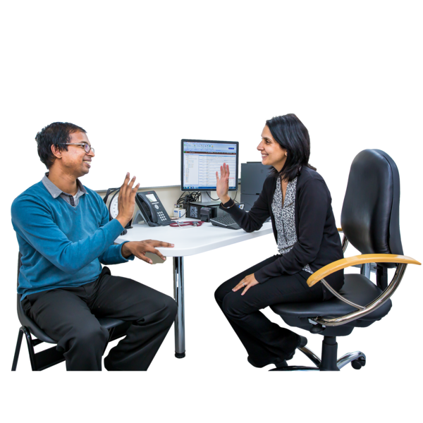
Talk to me
Photo of co-facilitator
Break down info
Use easy words
Listen carefully
Check we understand each other
Notes:
S19C Talk to ME
Suggested time: 1 - 2 minutes
Notes:
This slide can be led by a co-facilitator with intellectual disability.
Key points:
Talk to ME
Ask before you touch me
Use easy words
Check we understand
What you can say:
The most important thing you can do when I see you is to talk to me.
Not just my support person.
It does not matter whether someone can speak, you still say Hi to them.
This is not a reasonable adjustment – it is what you would do for everyone else.
So please do it for me, too.
And then ask me if you can talk to my support person.
Tell me what you want to do before you touch me.
Ask me if it is OK.
When you talk to me:
Break it down into smaller bits
Use easy words
Talk about 1 point at a time
Check we understand each other
Another thing:
Explain why you need to ask something if it is personal.

Slide 28
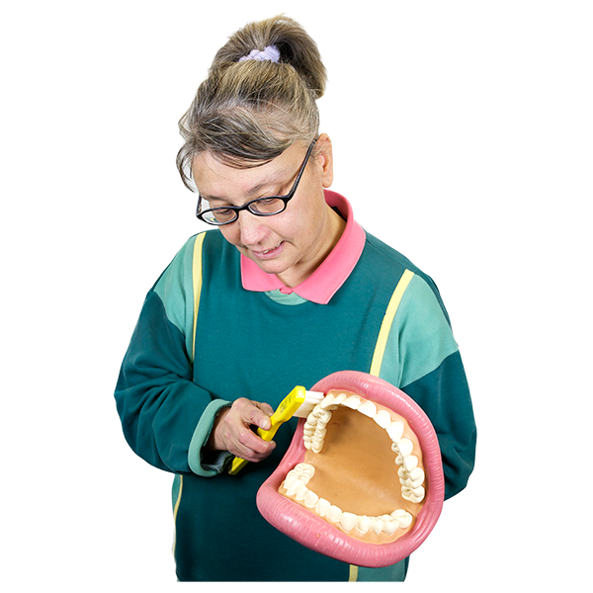
Visual aids
Photo of co-facilitator
3D Models
Show me on your hand
- Then my hand
Notes:
S103P Visual aids
Suggested time: 1 minute
Notes:
This slide can be led by a co-facilitator with intellectual disability. The speaker notes can be adjusted as desired.
This slide is an alternative to the Visual aids slide used with other health professionals. If the co-facilitator with intellectual disability presents this slide, they will need to do additional preparation to create their script for it, or use the optional script below. See the Easy Read co-facilitator guide for this information in easy read so as to support the co-facilitator as needed.
If it is a challenge to use this slide, it is also acceptable to use the script for slide S20C.
Brief Speaker notes:
Models, pointing to self
Optional script:
You can also use visuals to communicate.
Here is an example.
You can use a model to show me.
It does not have to be big.
You can also show me what you will do to my teeth, but on your hand.
Then on my hand so I know what it feels like.
We will send you links to where you can find resources like these.

Slide 29
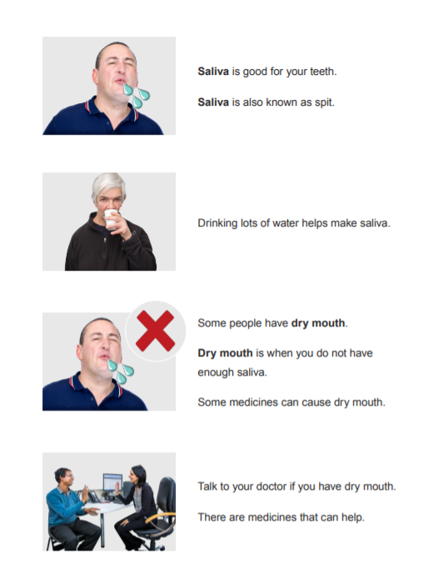
Communication aids
Photo of co-facilitator
Easy read
Social stories
Notes:
S104P Communication aids
Suggested time: 1 minute
Notes:
This slide can be led by a co-facilitator with intellectual disability. The speaker notes can be adjusted as desired. See the Easy Read co-facilitator guide for this information in easy read so as to support the co-facilitator to use their own words.
This slide is an alternative to the communication aids slide used with other health professionals. The script is identical but the image is tailored for dentists.
If it is a challenge to use this slide, it is acceptable to use slide S21C.
Brief Speaker notes:
Easy read
Optional script:
Easy read sheets are terrific.
They use easy-to-understand language.
They have pictures to explain information.
They are a great conversation tool.
This is a picture of a page of easy read.
It is about dry mouth.
Some people also use social stories which are short stories explain a social situation
They can be individualised to a person.

Slide 30
Panel discussion
Photo of co-facilitator
Raise your hand
Say your name
Say who your question is for
Speak clearly and slowly
Notes:
S25C Panel discussion
Suggested time: 15 minutes, or longer with a longer workshop and longer break time.
Notes:
If having an expert panel, it should include a person with lived experience of intellectual disability, an experienced health professional from each of the professions the workshop is targeting (e.g. GPs, practice nurses, allied health professionals etc.), and a person from the Primary Health Network.
The Easy Read co-facilitator guide has information to help someone prepare to answer questions and be on a panel.
The PHN co-facilitator should run this part of the session.
However, we suggest you keep the photo up to remind participants to speak in an accessible way.
Speaker notes – key points:
Introduce panel and say why they are there.
Remind people of how to ask a question
Optional script
I’d like to welcome our panel members.
We have … [insert name and details of panellists here].
You can ask any of our panel members a question.
When you do, please remember to raise your hand [and someone will come to you with the microphone]
Say your name
Say who your question is for
Please speak clearly and slowly.

Slide 31
Questions?
Photo of co-facilitator
Say your name
Say who your question is for
Speak clearly and slowly
Notes:
S26C Question time
Suggested time: 5 - 10 minutes – depending on the workshop length.
Notes:
In a 1 hour workshop there may only be a few minutes for questions, depending on how long other parts ran for.
Do not include this slide if you are having a panel discussion.
See the section in the manual about supporting a co-facilitator to be involved in question time.
The PHN co-facilitator should moderate the questions.
Keep the photo of the co-facilitator as a reminder to use accessible language, even if they are not presenting this slide. However, it is a good idea to repeat all questions into the microphone, even in a small workshop. This allows you to naturally rephrase any questions to use accessible and person-centred language.
Optional script
Are there any questions?
If you have a question please raise your hand [and someone will come to you with the microphone]
Say your name
Say who your question is for
Please speak clearly and slowly.

Slide 32
6 Key points
Photo of co-facilitator
Talk to me
Ask me what I need
Ask what helps me to cope
Go slow
Communicate with my GP
Be aware of my complex health needs
Notes:
S106P 6 key points: Dentists
Suggested time: 1 minute
Notes:
We suggest this is presented by the co-facilitator with intellectual disability
Brief speaker notes / Optional script:
These are the 6 key points from this training.
Talk to me
Ask me what I need
Ask what helps me to cope
Go slow
Communicate with my GP
Be aware of my complex health needs

Slide 33
Thank you
Photo of co-facilitator
Evaluation survey
Links coming via email:
NDIS resources
Medicare item number
Post-workshop reading – What not to miss
Easy read health fact sheets and other resources.
Notes:
S107P Dentists - Thank you and wrap-up
Suggested time: 1 – 2 minutes
Notes:
Speaker notes - key point:
Remind participants that links to the evaluation survey and helpful resources will be sent via email following the workshop.
Optional script:
Thank you for being part of this workshop.
Thank you for sharing your ideas.
We are trying to make these workshops as good as they can be.
So we will be emailing you a link to a survey.
Please do the survey.
We will also email you a post-workshop pack.
It has helpful information for you.
It also has links to accessible resources that you can share with people with intellectual disability.

