Slide 1
Primary Care Enhancement Program
How to use these slides
Notes:
S1C Explanatory slide – How to use these slides and the speaker notes
Do not include this slide in your presentation.
Ensure you have read the training manual which accompanies these slides. It gives valuable information to assist you in preparing to facilitate the workshop, including tips on how to support a person with intellectual disability to co-facilitate the workshop.
There is also an Easy Read co-facilitator guide for the co-facilitator with intellectual disability and a supporter to work through to understand the material.
This file is password protected. You must save a new copy before you make any changes to it.
This PowerPoint file contains slides for multiple audiences in the one master file. Separate files for different workshops are also available.
All materials can be used flexibly.
Some slides have animations. If a slide has animations, there is a little star next to it in the left hand slides menu.
If you prefer to present without animations, follow these instructions to turn them off:
Go to Slide show menu at the top of the screen
Select the Set up Slide Show button
Check the box that says “Show without animation”.
To turn animation back on just uncheck the box.
To turn off animation on a single slide, select everything on the slide, then go to Animations menu and select “None”.
Videos of how to do this are here: https://www.howtogeek.com/407396/how-to-disable-or-delete-powerpoint-animations/
Some slides are “hidden”. This means they will not show on a presentation. To unhide a slide, right click on it and select “Unhide”. To hide a different slide, right click and select “hide”.
You must tailor some slides with images of the workshop facilitators. If you have a co-facilitator who has intellectual disability, there is a space to include their photo in the corner of most slides. This serves as a reminder to participants to speak in an accessible manner for these sections of the training.
The suggested time for each slide is on the slide. If aiming for a 1 hour workshop, keep to the shorter the amount of time participants can share in small groups on each case study, remove the small group discussions for at least one case study (i.e. go straight to larger group sharing) and choose shorter options for any videos used.
Another approach to allow more time for all 3 case studies is a 1.5 hour workshop which includes a 10 - 15 minute panel discussion and a 10 minute break.
Format of the speaker notes:
For most slides, the notes page includes both brief speaker notes and an optional suggested script.
It is suggested that you read through the script in full when preparing to run the session, to ensure you understand the slide content. When presenting, you may edit the script as you please. One approach to ensure a natural style for facilitation is to use the full script to understand the content but then work from the key points, using your own words.
Case examples should be read as it is written (in full) to ensure all the clinical information is conveyed. These parts are written in italics.

Slide 2
Primary Care Enhancement Program
PHN Logo
Welcome
Notes:
S2C Welcome to workshop
Suggested time: 1 min.
Notes:
The co-facilitator with intellectual disability can do the welcome.
But only if they want to.
Key points:
Tell people you are starting the session.
Thank them for coming.
Tell them your name.
Tell the other co-facilitators’ names.
What you could say:
Hello. Welcome to the workshop. Thank you for coming along today.
My name is [insert speaker’s name].
This is [other facilitator’s name].
We will be running this workshop together today.

Slide 3
Photo of co-facilitator
Acknowledgement of Country
Notes:
S3C Acknowledgement of Country
Suggested time: 1 minute.
Notes:
The co-facilitator with intellectual disability can do the Acknowledgement of Country.
But only if they want to.
Key points:
Acknowledge the first owners of the Country you are on.
What you could say:
I would like to acknowledge the Aboriginal lands which we are all on.
I are meeting on the land of [insert name of land you are on].
I want to pay our respects to Elders past, present and emerging.
Let us remember that Aboriginal people have been living on this land for a very long time.

Slide 4
Who we are
This is [person’s name]
This is [person’s name]
Insert picture here
Insert picture here
Notes:
S4C Co-facilitators introduce themselves (with 2)
Suggested time: 3-5 minutes (if aiming for a 1 hour workshop with 3 case studies, keep this to 3 minutes or less)
Notes:
Tailor the slide with your pictures and names.
It is best if a co-facilitator with intellectual disability introduces themselves first.
Key points:
Tell people why you are involved in this training.
Tell them you have lived experience of intellectual disability
Tell them you have experience using health care.
The other co-facilitator should introduce themselves too.
What you could say:
We have not provided a script for this slide.

Slide 5
Who we are
This is [person’s name]
This is [person’s name]
This is [person’s name]
Insert picture here
Insert picture here
Insert picture here
Notes:
S5C Co-facilitators introduce themselves (with 3)
Suggested time: 3 -6 minutes (if aiming for a 1 hour workshop with 3 case studies, keep this to 3 minutes or less)
Notes:
Tailor the slide with your pictures and names.
It is best if a co-facilitator with intellectual disability introduces themselves first.
Key points:
Tell people why you are involved in this training.
Tell them you have lived experience of intellectual disability
Tell them you have experience using health care.
Other facilitators should introduce themselves too.
What you could say:
We have not provided a script for this slide.

Slide 6
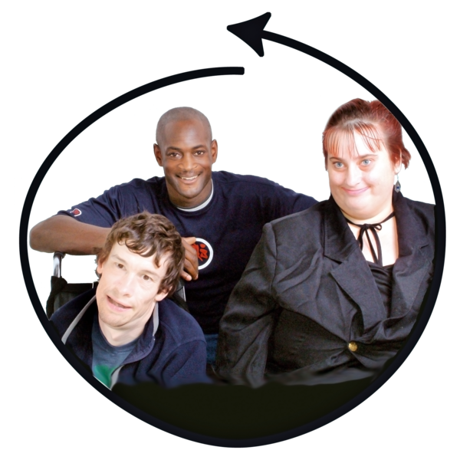
House keeping
Photo of co-facilitator
Please do not use jargon or acronyms
Speak slowly
Notes:
S6C Housekeeping - webinar
Suggested Time: 2 minutes
Notes:
Either co-facilitator can present this slide. Adapt as needed.
Refer to the Easy Read guide explanations of “jargon” and “acronyms”.
If you want, “jargon” can be swapped with “hard words”.
This slide is for a webinar.
Even though “Housekeeping” is usually one word, in Easy Read it works better as two.
Delete whichever “Optional script” part you are not using.
Key points:
Cameras on
Mute unless talking
How to raise your hand
Speak in an accessible way – explain the photo of the co-facilitator is a reminder
OK to use medical terms to discuss the case studies.
What you can say:
I will be running some of this training.
I have an intellectual disability.] Modify as needed if the other facilitator presents this slide.
So that we can all understand, please do not use jargon or acronyms.
And please speak slowly if you are sharing or asking a question.
Please do not be worried about making a mistake.
Sometimes we might not understand each other.
It is OK for us all to ask each other to explain something.
To help remind you, my photo is in the corner of all the slides where I am involved in running it.
There is one part of the training where it is OK to use words I might not understand.
That is when you talk about the case studies.
We want you to share your ideas with each other then.
That is why this is a workshop.
For those parts it is OK to share your ideas in the way you would normally speak to your co-workers.
But it is also OK if you want to ask someone to explain what they mean.

Slide 7
House keeping
Photo of co-facilitator
Please do not use jargon or acronyms
Speak slowly
Notes:
S7C Housekeeping – Face to Face
Suggested Time: 2 minutes
Notes:
Either co-facilitator can present this slide. Adapt as needed.
Refer to the Easy Read guide explanations of “jargon” and “acronyms”.
If you want, “jargon” can be swapped with “hard words”.
This slide is for a face to face session.
Even though “Housekeeping” is usually one word, in Easy Read it works better as two.
Delete whichever “Optional script” part you are not using.
Key points:
Bathrooms
Car park
Fire escapes
Speak in an accessible way – explain the photo of the co-facilitator is a reminder
OK to use medical terms to discuss the case studies.
What you can say:
There are some things you need to know about the building we are in.
The bathrooms are [describe location]
If the fire alarm goes off you have to leave through [point to exit]
[Insert any other information about the venue such as the carpark or refreshments here].
I will be running some of this training.
I have an intellectual disability.] Modify as needed if the other facilitator presents this slide.
So that we can all understand, please do not use jargon or acronyms.
And please speak slowly if you are sharing or asking a question.
Please do not be worried about making a mistake.
Sometimes we might not understand each other.
It is OK for us all to ask each other to explain something.
To help remind you, my photo is in the corner of all the slides where I am involved in running it.
There is one part of the training where it is OK to use words I might not understand.
That is when you talk about the case studies.
We want you to share your ideas with each other then.
That is why this is a workshop.
For those parts it is OK to share your ideas in the way you would normally speak to your co-workers.
But it is also OK if you want to ask someone to explain what they mean.

Slide 8
What do you hope to learn?
Photo of co-facilitator
Notes:
S8C What do you hope to learn?
Suggested time: 2 minutes
Notes:
This is a hidden slide. Whether it is helpful to use it depends on the number of people in the workshop / webinar, and whether you have time and capacity to modify what you deliver based on the input you receive from people.
If using it, it’s suggested that you tie the responses received to the outline in the next slide where possible, and again when reaching specific content that relates to what people have said here.
Although the picture of the co-facilitator with intellectual disability is in the corner, this is just to remind participants to consider their language. We suggest the PHN co-facilitator present this slide, if using,
Key points:
As this is early in the workshop, let people discuss with someone next to them first as an ice breaker.
Then ask them to share amongst the broader group.
You could also suggest people consider what they wrote in their pre-workshop reflection and activity and whether that gives clues as to what they hope to learn.

Slide 9
Workshop outline
Photo of co-facilitator
Photo of co-facilitator
Health care for people with intellectual disability
Case examples
What we can learn
Photo of physician or facilitator
Photo of co-facilitator
Notes:
S9C Workshop outline
Suggested time: 1 minute
Notes:
See the words list for an easy read explanation of “case examples”.
This can be presented by either co-facilitator.
Key points:
Health care for people with intellectual disability
Case examples (say how many)
What we can learn from those case studies
What you can say:
I am going to tell you what we will cover today.
We will talk about health in people with intellectual disability
We will talk about some things that make it harder for people to get good health care.
Then you all will get a chance to talk about some case examples.
And then I am going to talk about what you can learn from those case examples.
I will talk about the things you can do with anyone you see.
Things that will make their health care better.

Slide 10
Health care for people with intellectual disability
Photo of co-facilitator
Complex
Harder to get good health care
Health professionals are not confident
Notes:
S10C Health care for people with intellectual disability: Introductory information
Suggested time: 1-2 minutes
Notes:
Key points:
1 – 2 % of people have intellectual disability.
Health outcomes are not equal
Barriers in health care access
What you can say:
Australia’s health system is one of the best in the world.
Most Australians feel they have good health,
But health outcomes are much worse for people like me, living with intellectual disability.
1 to 2 percent of people have intellectual disability.
We have worse physical and mental health.
Many of us use lots of medications.
We have double the number of deaths that could be avoided.
An Australian study found that on average we die 27 years younger.
We can have trouble getting good health care.
We have lower rates of thing like vaccines.
Many of us have complex health conditions that are difficult to diagnose.
And sometimes the signs of illness are not so clear.
Communication can be harder in both directions.
But we want to be healthy.
We have right to good healthcare.

Slide 11
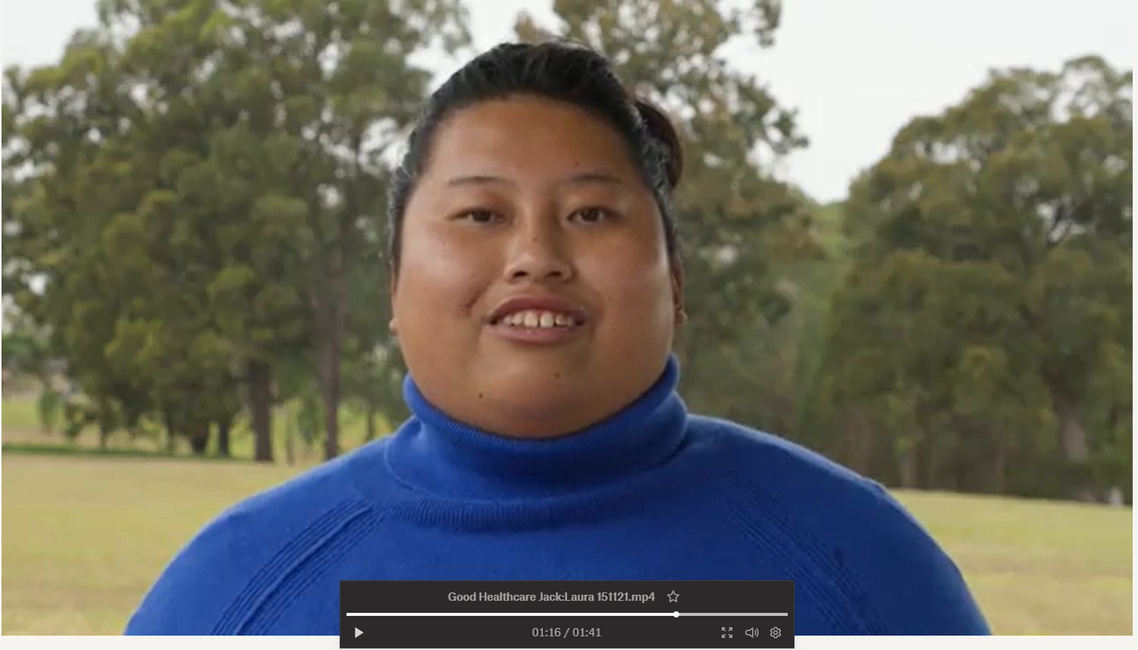
Health care for people with intellectual disability
Photo of co-facilitator
Notes:
S11V Health care for people with intellectual disability - Video placeholder
Suggested time: 1-2 minutes
Notes:
This is a video placeholder. If your co-facilitator with intellectual disability does not want to deliver this content, you may use a video instead.
Links to suitable videos made by CID are in the Training Guide.
Alternately, you can deliver this content yourself and use a video for the next part (a personal health care story).
Key points:
1 – 2 % of people have intellectual disability.
Health outcomes are not equal
Barriers in health care access exist

Slide 12
Good health care
Photo of co-facilitator
Insert an image or video here
Notes:
S12C Good health care
Suggested time: 1-2 minutes
Notes:
This can be a personal story from the co-presenter with intellectual disability, or a video.
Links to suitable videos made by CID are in the Training Guide.
If using a personal story, you can put in a picture or some key words
The PHN co-facilitator should work with the co-facilitator with intellectual disability to create a suitable script. The Easy Read co-facilitator guide includes information about choosing to tell your story and what makes a good story.
The point is to:
Give a person-centred account of a health journey
Showcase that good health care is possible to achieve for people with intellectual disability
Key point:
Even though there are the barriers to health care, good health care is still possible.
What you can say:
But it is possible to get good health care.
Here is my story of getting good health care.
Then tell the story.
Put your own notes here.
Or you can say:
But it is possible to get good health care.
Here is [person in video’s name] talking about their experience of good health care.

Slide 13
Case Studies
Notes:
S13C Intro to case examples
Suggested Time: 1 minute
Notes:
This divider slide is useful for orienting participants to the change from co-facilitator-led slides to case based learning.
The co-facilitator with intellectual disability is not involved in presenting the case studies. The Trainer’s guide and Easy Read co-facilitator guide gives details to understand this. The co-facilitator with intellectual disability can take a break during this time.
In the Trainer’s guide appendices are notes for each case study. Within the slides, we have suggested suitable audiences for that case study. Where the same case example is used for multiple audiences, the specific information given has been tailored to that audience.
You may wish to send the case descriptions to your participants ahead of the workshop. See the appendix to the Trainers guide, which includes this as a handout.
Breaking people into small groups (2 or 3) for the first case is likely to result in greater sharing than keeping them in larger groups. Break out rooms can be used if in a Webinar.
Key points:
If the co-facilitator with intellectual disability prefers to take a break during the case examples, thank them for their introduction to the topic and tell people that they will be back later, before they leave the room.
Encourage participants to contribute to the discussion, emphasise there is no one correct answer in most instances.
The point is to discuss the types of issues that can arise and what we can learn through reflecting on both positive aspects of the care provided and the challenges.
Many of the examples are conglomerates across several similar, real-life cases. In all cases, identifying information has been changed. The photos are not of these specific people.

Slide 14
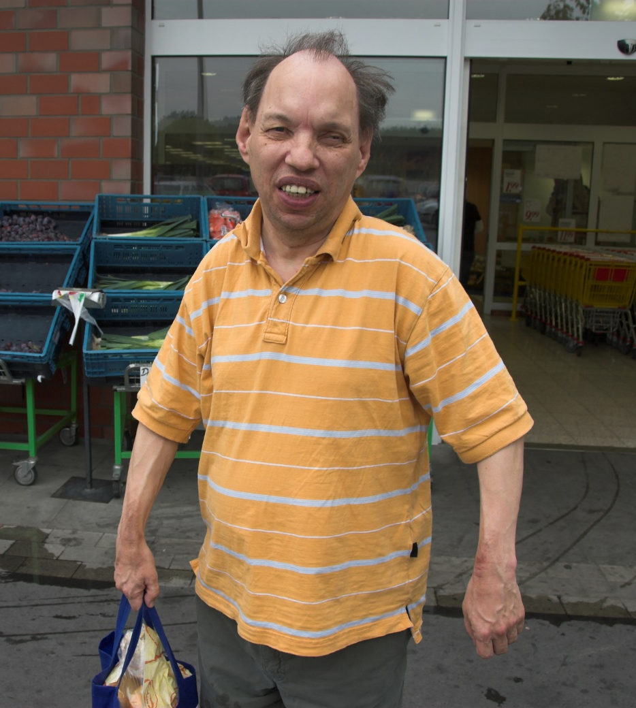
Joe
Late 50’s
Lives alone; ? family ?
Mild intellectual disability.
Speaks. Can read some short words.
Epilepsy – 900 mg sodium valproate daily, 10+ years.
Recent injury - ? topical treatment ?
2 mg Diazepam 21 days.
Constipation - ? time frame.
Change to balance/slower.
Notes:
S110P Joe - Pharmacists
Suggested time: 1.5 minutes:
Notes:
Read the case study as it is written.
See the appendix to the Training guide for detailed information about this case and the clinical and practical points it highlights, including appropriate reasonable adjustments.
Sodium valproate is commonly used to treat epilepsy and also bipolar disorder. It can disrupt metabolism.
Benzodiazepines commonly cause constipation but also can cause vagueness and balance issues.
People with intellectual disability being unsure of time frames is a common practical challenge that health professionals may face.
Suggested script:
Joe is man in his late 50’s who lives alone in a public housing unit. He has a mild intellectual disability. He communicates through speech and can read some simple text. Joe has never mentioned having a family or supports. He has always attended the local pharmacy alone.
Joe has epilepsy for which he takes 900 mg sodium valproate daily in 2 doses. The dose has remained the same for at least the past 10 years.
3 weeks ago, his GP prescribed 2 mg diazepam at night. Joe says this was for an injury. There are 3 repeats on this script.
When questioned, Joe reports that the diazepam helps him sleep. His sleep was compromised recently due to shoulder pain which remained after a fall. It’s unclear from his report whether he fell or slipped. He can’t recall when the injury occurred. He does know that he tried a cream first but it did not help. He does not know what the cream was called. He already owned it before the injury, having used it for an injury some years ago. He reports the tube has now run out.
Today Joe is at the local pharmacy, asking for a repeat of the sodium valproate. The script is on file. He also asks if he can get another box of diazepam while he’s here, he is not sure how many pills are left. It’s not due to be refilled for another week.
Joe also asks if you can recommend a product to help with constipation. When asked, he says he has been feeling blocked up for a while but he is not sure how long.
You note that Joe is holding on to the counter and appears generally slower than typical for him.
When asked, Joe can’t remember the last time he went to the doctor. He thinks he has not been since the script for diazepam was issued (4 weeks ago).

Slide 15
Joe – your turn
What are your initial thoughts?
Risks?
What other information do you need at this stage?
What should you communicate with Joe? How?
Notes:
S111P Joe – Pharmacists – Your turn
Suggested time: 10-12 minutes:
Notes:
Give people around 6-8 minutes to discuss in small groups (2 – 4 people) with a 1 minute warning of when you will end the groups.
Then ask the groups to share some of the insights they shared. (4 minutes).
The next slide is about communication and reasonable adjustments. If groups raise these topics in response here, encourage it and simply summarise additional points in the next slide.
Key points:
Need to send Joe back to his doctor and also communicate your concerns with the doctor
Adjustments to communication are important
Optional script: (what to say when depends on what answers arise, but potential answers to emphasise are below)
Ask people to get into small groups (2 – 4 people) to discuss their initial thoughts – by this we mean clinical impressions. What are some of the things that might be going on for Joe? Are there any risks from his medications?
What other information do you need at this stage? How are you going to get it? What would you communicate with Joe? How would you do that?
Answers to emphasise include the following:
Clinical impressions and risks:
Why do you think he is constipated?
Injury = reduced exercise. You could ask him what part of his body he injured. Has it affected his walking? Activity levels?
Could be a side-effect of medications:
Benzodiazepines = increase risk of constipation.
Could also reflect metabolism changes, which could be due to sodium valproate. They could also reflect age-related changes in pharmacokinetics. Even in their late 50’s, a person with intellectual disability may experience frailty.
The fall itself could also be a sign of medication problems.
Seizure is possible.
There is some data on an increased falls risk from sodium valproate - though it’s not as high as for other anti-epileptics
The addition of diazepam is a further risk for falls AND his slowness and holding the counter gives a strong indication that this needs review.
It’s also possible he just plain slipped.
Other information to gather:
You might want to check his blood pressure.
Can you be confident that Joe is reliable in taking his meds on time?
A benzodiazepine could change this considerably
Ask Joe if his Epilim pills have ran out yet (and when)? Check the date of the last time he filled the script and the number dispensed.
What would you do if the dates on the script suggest Joe has not been reliable in taking the Epilim? (Discuss it with him, give him a Webster pack & reminder app, ensure the GP knows if pills seem to be skipped).
Ask Joe if he knows when or how he is to stop the diazepam? Does he plan to see his doctor for a review?
Ask him how he has been feeling lately? Has he noted any changes? Dizziness? Tiredness?
What to tell Joe:
It might be that his constipation is due to his medicine.
He needs to see his doctor to review the need for diazepam and to talk about how and when to stop.
He can bring old medications and creams in to check with you if they are still OK to use for a problem he is having. He can also take them to his doctor.
Topical treatments are still drugs.
How to communicate:
Suggest Joe sits down - this is not needed for every person with intellectual disability but it makes sense when someone is gripping the counter.
Speak slowly using plain language.
Tell him why you want more information from him – to work out how to help him. This includes asking personal questions, e.g. about his poo.
Reassure him that it is OK if he does not know the answers to your questions.
Ask only one question at a time and wait for an answer – give Joe thinking time.
Give Joe time to think about whether he has questions for you.
Write down things for him in steps, e.g. seeing his doctor.
It may not be practical to communicate ALL the information in the time Joe is in your pharmacy. He also appears to be vague and slow so he may not retain the information. Encourage participants to think about alternatives. Examples are home based meds review; communicating the same info to the doctor.
Would you communicate with the doctor, too? It is a good idea because:
He may be experiencing a side effect of the diazepam which would leave him at an increased risk of falls.
The constipation could also be a side effect of his medications and may need investigation.
There are several indicators that Joe may not remember to see his doctor despite your conversation.
Joe could benefit from a home-based medication review to check what is still in his cupboard and identify unused or expired pills. This would also be a chance to ask the doctor for recent blood results to check metabolism and side effects.
Before doing this, tell Joe that you are going to call his doctor to get more information and to talk to the doctor about the plan for his pills.

Slide 16
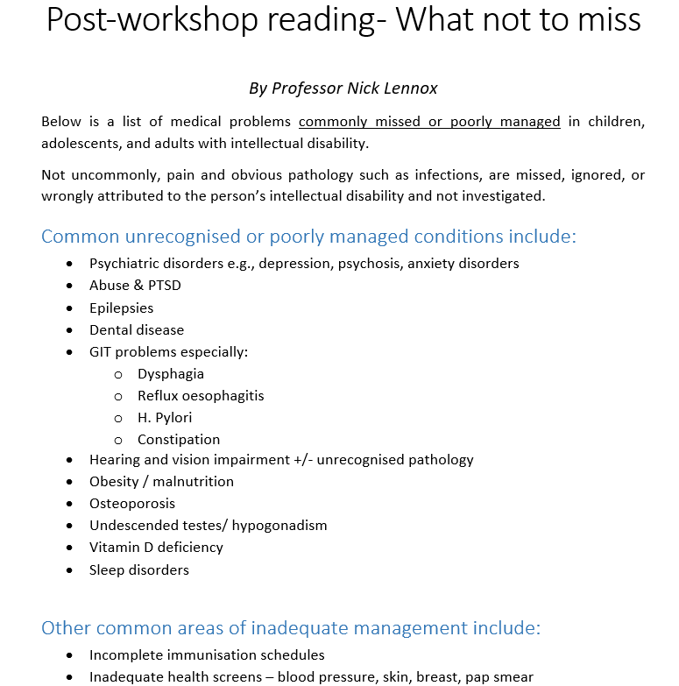
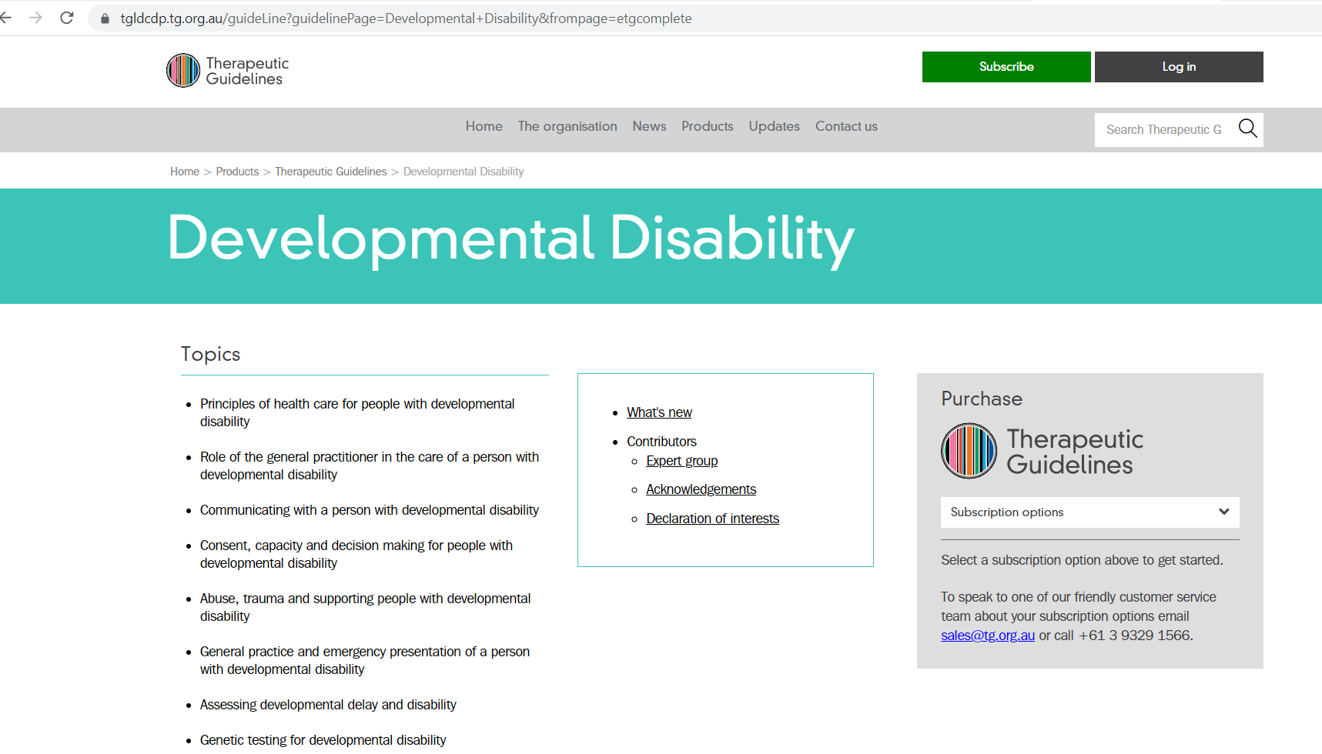
Joe – further considerations
Clinical complexity:
Frailty risk
Missed conditions
Incomplete reports
Scripts on file; check dates
Touch base with the doctor
Home-based medication reviews
tg.org.au
Notes:
S112P Joe – Pharmacists – Further considerations
Suggested time: 6 minutes:
Notes:
Many of these suggestions may have already emerged from the previous discussion and group feedback. If so, acknowledge this and just summarise.
If you are turning off animations, use the next slide instead as this one will appear odd.
Key points:
People with intellectual disability can present with much complexity due to:
Increased frailty risk
Missed conditions
Incomplete reports are common. To help:
Keep scripts on file; check dates
Touch base with the doctor
Home-based medication reviews are possible for people with intellectual disability. GP referral is needed.
The Therapeutic Guidelines are an excellent resource - chapter on Developmental Disability and chapter on psychotropic prescribing (not specific to people with intellectual disability). They have recently been updated and are available online as a subscription service.
Optional script: (what to say when depends on what answers arise, but potential answers to emphasise are below)
- Summarise from the slides
Joe’s case highlights some common clinical and practical concerns that can apply to anyone but are much more common in people with intellectual disability.
Constipation is a really common side effect of many medications but it’s also already extremely common and commonly missed in people with intellectual disability.
Pharmacists can assist by communicating with their patients to look out for changes in their poo if a medicine is known to have that side effect.
The good old Bristol stool chart can be a great visual to aid a conversation.
There are a bunch of other conditions which also tend to be missed or under-managed in people with intellectual disability and these are summarised within the handouts.
The Therapeutic Guidelines are an excellent resource. There is a chapter on Developmental Disability which includes tips for communicating with people with intellectual disability, as well as covering common health problems including epilepsy and its management. There is also a chapter on psychotropic prescribing which is not specific to people with intellectual disability but it is a great resource nonetheless and applicable to this group because so many people with intellectual disability are prescribed psychotropics. They have recently been updated and are available online as a subscription service.
Early frailty is also much more common in people with intellectual disability. So for middle aged or older adults, always open to the possibility of new side effects, even if they’ve been on a medication for some time.
Incomplete reports and not being clear of time frames is also a common scenario.
Touch base with the doctor if you have concerns. For someone like Joe, who essentially has no supports, adopt a low threshold for doing this. The side effects of his benzodiazepine may have a large impact on his function and capacity to be independent – yet he has no supports. He is extremely vulnerable. It’s easy to see how the side effects of the benzodiazepines could mean he ceases regular contact with his doctor but is still in contact with the pharmacy. So your contact with the doctor could trigger a falls risk assessment for Joe and prevent him having further injury.
Offering to keep scripts on file is sensible.
Checking dates. If the person is able to, ask them photograph the remaining medication before coming in to see you for the repeat.
Home-based medication reviews are a great way to gauge how reliable someone is in taking their medication. It also gives you an opportunity to see what over-the-counter products they have. It gives you time in a comfortable environment for them to communicate more fully. And, because they require a GP referral, it is a chance to ask the doctor what the intended use of each medication is.

Slide 17
Joe – further considerations
Clinical complexity:
Frailty risk
Missed conditions
Incomplete reports
Scripts on file; check dates
Touch base with the doctor
Home-based medication reviews
See POMPIDA
tg.org.au
Notes:
S113P Joe – Pharmacists – Further considerations – No animations
Suggested time: 6 minutes:
Notes:
Only use this slide if you are turning off animations. To unhide it, right click on the slide in the left hand menu and select unhide.
Many of these suggestions may have already emerged from the previous discussion and group feedback. If so, acknowledge this and just summarise.
Key points:
People with intellectual disability can present with much complexity due to:
Increased frailty risk
Missed conditions
Incomplete reports are common. To help:
Keep scripts on file; check dates
Touch base with the doctor
Home-based medication reviews are possible for people with intellectual disability. GP referral is needed.
The Therapeutic Guidelines are an excellent resource - chapter on Developmental Disability and chapter on psychotropic prescribing (not specific to people with intellectual disability). They have recently been updated and are available online as a subscription service.
Optional script: (what to say when depends on what answers arise, but potential answers to emphasise are below)
- Summarise from the slides
Joe’s case highlights some common clinical and practical concerns that can apply to anyone but are much more common in people with intellectual disability.
Constipation is a really common side effect of many medications but it’s also already extremely common and commonly missed in people with intellectual disability.
Pharmacists can assist by communicating with their patients to look out for changes in their poo if a medicine is known to have that side effect.
The good old Bristol stool chart can be a great visual to aid a conversation.
There are a bunch of other conditions which also tend to be missed or under-managed in people with intellectual disability and these are summarised within the handouts.
The Therapeutic Guidelines are an excellent resource. There is a chapter on Developmental Disability which includes tips for communicating with people with intellectual disability, as well as covering common health problems including epilepsy and its management. There is also a chapter on psychotropic prescribing which is not specific to people with intellectual disability but it is a great resource nonetheless and applicable to this group because so many people with intellectual disability are prescribed psychotropics. They have recently been updated and are available online as a subscription service.
Early frailty is also much more common in people with intellectual disability. So for middle aged or older adults, always open to the possibility of new side effects, even if they’ve been on a medication for some time.
Incomplete reports and not being clear of time frames is also a common scenario.
Touch base with the doctor if you have concerns. For someone like Joe, who essentially has no supports, adopt a low threshold for doing this. The side effects of his benzodiazepine may have a large impact on his function and capacity to be independent – yet he has no supports. He is extremely vulnerable. It’s easy to see how the side effects of the benzodiazepines could mean he ceases regular contact with his doctor but is still in contact with the pharmacy. So your contact with the doctor could trigger a falls risk assessment for Joe and prevent him having further injury.
Offering to keep scripts on file is sensible.
Checking dates. If the person is able to, ask them photograph the remaining medication before coming in to see you for the repeat.
Home-based medication reviews are a great way to gauge how reliable someone is in taking their medication. It also gives you an opportunity to see what over-the-counter products they have. It gives you time in a comfortable environment for them to communicate more fully. And, because they require a GP referral, it is a chance to ask the doctor what the intended use of each medication is.

Slide 18
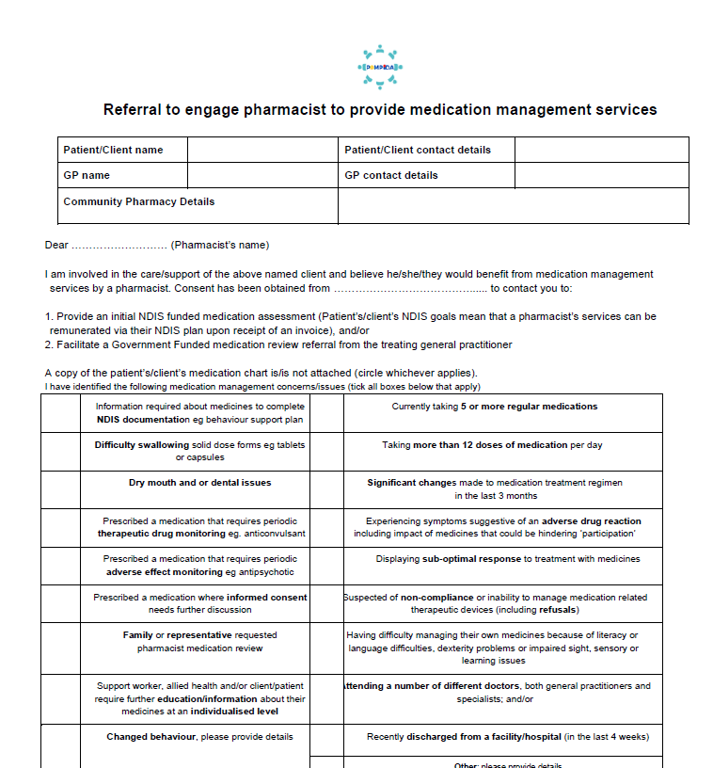
Resources - POMPIDA
Notes:
S114P Pharmacists – POMPIDA resources
Suggested time: 1 minutes
Notes:
Check if the POMPIDA website is active before running the training. If so, you need only include a link to it.
Key point:
The POMPIDA (Pharmacists Optimising Medication for People with Intellectual Disability and Autism) is a source of information, including forms for Home medication review and information about how to charge for it.
A GP can provide a referral under Medicare and pharmacists can charge through Medicare.
Another option is to provide 1 hour of clinical supervision to a Positive Behaviour Support practitioner, at the person’s home, and have this include a medication review. This is billed to their NDIS plan. You can treat this like an initial review and then ask the GP for a referral for a fuller review. The POMPIDA alliance has compiled resources on this, including referral forms. We will send you those after the training.
Optional script:
One of the handouts we have sent to you is a resource developed POMPIDA (Pharmacists Optimising Medication for People with Intellectual Disability and Autism which includes a template for a home-based medication review for someone with intellectual disability, as well as information on how to bill for it, and a referral form.
A GP can provide a referral under Medicare and pharmacists can charge through Medicare.
Another option is to provide 1 hour of clinical supervision to a Positive Behaviour Support practitioner, at the person’s home, and have this include a medication review. This is billed to their NDIS plan. You can treat this like an initial review and then ask the GP for a referral for a fuller review. The POMPIDA alliance has compiled resources on this, including referral forms. We will send you those after the training.

Slide 19
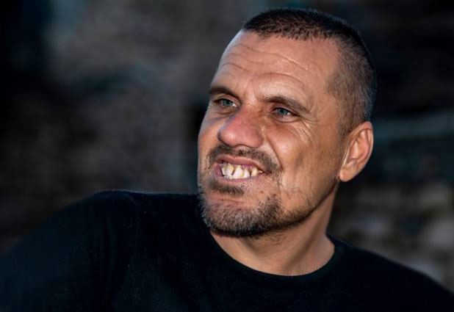
Daryan
- 25 years old
- Loves being outdoors, music
- Enjoys sensory stimulation
- Lives alone with 2:1 support in a regional town
- intellectual disability, autism, bipolar disorder, challenging behaviours
- 11 medications including 2 antipsychotics daily and 1 PRN
Notes:
S116P Daryan - Pharmacists
Suggested time: 1.5 minutes:
Notes:
Read the case study as it is written.
See the appendix to the Training guide for detailed information about this case and the clinical and practical points it highlights, including appropriate reasonable adjustments.
A slightly different approach is used for this case study. Not all medications are listed below – there are too many. Give participants time to read through this at the start of group discussion (get them to read it simultaneously and allow them to react and discuss in their small groups as they do).
The handout has space for notes.
Direct participants to find the chart of Daryan’s medications in their handouts
The case study is based on a real case. However, it is an extreme example of polypharmacy and includes elements of chemical restraint. Participants may express surprise. Pause to allow for reactions.
Suggested script:
Daryan is a man in his mid-20’s who enjoys nature shares a close bond with his mum. He has lived in supported accommodation since the age of 16, and currently receives 2:1 care in a unit on his own.
He is obese and has a family history of cardiovascular disease
Daryan has intellectual disability, autism, bipolar disorder, and “challenging behaviours”. These include noise and property destruction, inappropriate urination and smearing faeces, and spitting. He paces often and has a poor attention span.
However, he loves nature – his support workers report that Daryan is always calmer when they take him to a bushwalk or the beach – both of which are a 15 minute drive from his home.
Daryan sees a psychiatrist and also engages a psychologist and OT via the NDIS. He consulted a senior psychologist as part of a review of his Positive Behaviour Support plan. The psychologist requested the GP make a referral for a Home Medications Review.
Daryan is currently prescribed 11 medications; this includes 2 daily antipsychotics and a third on a PRN basis.

Slide 20
Daryan – your turn
What are the major risks for Daryan?
What recommendations would you make?
- to whom?
What else could you recommend?
- Non-pharmacological
Notes:
S117P Daryan – Pharmacists – Your turn
Suggested time: 10 - 12 minutes:
Notes:
Give groups time to digest the case study and the degree of polypharmacy in Daryan’s case
Their post-workshop activity is a chance to take more detailed notes and do necessary research to complete the medication review for Daryan.
For full clinical answers refer to the chart provided in the Training guide appendix.
Key points:
Emphasise the point is not to discuss the detail of every medication (it would take too long) but to discuss the major alarm bells
Key things to emphasise:
Huge dose of antipsychotics
Restrictive practice
Imposes cardiovascular risk
Metabolic side effects are already present – obesity for example
Increases likelihood of constipation which worsens behaviour
Benztropine can mask tardive dyskinesia
Stopping both antipsychotics and benztropine together can induce irreversible tardive dyskinesia
Non-pharmacological:
Move closer to nature
Address sensory needs, especially as he has autism.

Slide 21
Polypharmacy and restrictive practices
Common in people with intellectual disability
Consider anti-cholinergic burden:
Especially people with Down syndrome
What do you do?
NHS England » Stopping over medication of people with a learning disability, autism or both (STOMP)
Notes:
S118P Daryan – Pharmacists – Polypharmacy
Suggested time: 2 minutes
Notes:
Click the mouse again to reveal the text “What do you do?” and then give people a chance to answer
This slide has animations.
Please check if the POMPIDA website is live before running the workshop. It was planned at the time of writing. If possible, insert the link and their logo into the slide.
Key points:
Polypharmacy is common in people with intellectual disability and is of major concern due to:
Cumulative and compounding side effects and long term health risks
Anticholinergics are of particular concern
Polypharmacy can be a restrictive practice
STOMP protocol is a resource from UK about de-prescribing.
For complex cases, seek a senior pharmacist’s advice
Optional script:
Daryan’s case highlights the risks associated with polypharmacy:
Drugs with anticholinergic effects can severely impact the health outcomes of people with intellectual disability:
Cardiovascular effects compound lifestyle factors, and diet and exercise in people with intellectual disability is often really poor
There is also an increased dementia risk arising from overuse of these drugs. Which is why we have a note here about the importance of considering anticholinergic burden for people with Down syndrome because they are at really high risk of early onset Alzheimer’s disease
Use of an antipsychotic drug to address challenging behaviour in the absence of a mental health diagnosis is a restrictive practice. It is only appropriate in the case of behaviours of concern which are so severe they pose a risk to the safety of the person or those around them, and where non-pharmacological treatments have failed.
Using drugs for challenging behaviours requires a person to have in place a Positive Behaviour Support plan, which is regularly reviewed. But the dose should also be regularly reviewed.
However, in some states (e.g. NSW), if a person’s treatment for a diagnosed mental health disorder involves the administration of 1 or more psychotropics and the dosage levels, combinations or numbers of restricted substances used, or the duration of the treatment, are outside the accepted mode of treatment for such a patient, this requires consent from a tribunal rather than a person responsible. Depending on the specific drugs used and their reason, polypharmacy may fall into this category of treatment.
So, if your patient is currently on a less-than-ideal drug or a mix of drugs, what do you do?
Answers to encourage:
Home based medicines review
Advise the best order in which to de-prescribe
Check out the POMPIDA resources on how a Positive Behaviour Support specialist can request a mini review, through supervision of themselves, from a pharmacist. A GP may then be asked for a referral to do the full, Medicare-funded review.
Same principles as for safe prescribing apply:
Review reasons for prescribing
Ensure close supervision throughout
Ensure the person and their supporters knows what to do, and what side effects to watch for
Go slow
Check out the STOMP website which we have shared in your handouts, focused on de-prescribing.

Slide 22
Reasonable adjustments
Photo of co-facilitator
Your ideas?
Notes:
S14C Reasonable adjustments definition – share
Suggested time – 1 – 2 minutes.
Notes:
This slide can be co-led with a co-facilitator with intellectual disability. The lead in should come from the PHN co-facilitator who has covered case studies.
Below is an example of the sort of way this topic could be introduced. However, it is important to support a co-facilitator to use their own words if they prefer. If using the “What you can say” script, ensure the co-facilitator with intellectual disability has a copy of that script without the other notes on it.
See the Easy Read co-facilitator guide for information about reasonable adjustments.
Key points:
Welcome back co-facilitator
This is an opportunity for the group to share their thoughts.
Brief speaker notes:
Welcome back co-facilitator
Ask for ideas of what Reasonable adjustments means
Small adaptations to practice = reasonable adjustments
Optional script for PHN co-facilitator:
Welcome back to [co-facilitator’s name].
Throughout the case examples, we have identified ways that clinicians can make really small adaptations in order to health care better for people with intellectual disability. Many of these things fall under the umbrella of “reasonable adjustments”. To explain what reasonable adjustments are and talk about their impact, I am going to ask [co-facilitator’s name] to come back and lead us again.
For co-facilitator with intellectual disability:
What you can say:
So, what is a reasonable adjustment?
Firstly can I hear from you guys.
What do you think a reasonable adjustment is?
Listen to ideas.

Slide 23
Reasonable adjustments
Photo of co-facilitator
Takes away barriers that would stop someone getting good health care
Notes:
S15C Reasonable adjustments definition
Suggested time – 1 - 2 minutes.
Notes:
This slide can be presented by a co-facilitator with intellectual disability.
See the Easy Read co-facilitator guide for information about reasonable adjustments.
Key points:
Reasonable adjustments are small adaptations to practice
They can have a big impact on a person’s health care.
Give an example.
What you can say:
I think reasonable adjustments are things you do which takes away barriers that would stop someone getting good health care
The easiest way to tell you what a reasonable adjustment is with an example.
One of the pre-workshop activities was to gather the forms you ask people to do when they come to see them.
Put your hand up if you did that.
If you did not do it, then think about the forms new people do when they see you.
Put your hand up if you can think of your forms.
Now, keep your hand up if you are able to think of one thing that your practice does to help someone who needs help doing that form.
It does not have to be you that does it.
It might be some one who works with you.
Congratulations to people with their hands still up.
What you are doing to support someone with your forms - that’s a reasonable adjustment.
That is the sort of thing that makes it easier for someone like me to get health care when I need it.
And it means when I see you, I can give you the same info as other people.

Slide 24
Before I see you
Photo of co-facilitator
Forms
Booking times - reminders
Ask me what I need
Notes:
S16C Before I see you:
Suggested time: 1 - 2 minutes
Notes:
This slide can be led by a co-facilitator with intellectual disability.
On this slide or one that follows, if the person co-facilitating wants to share a personal experience, the text and flow can be modified to suit.
Brief notes:
Reasonable adjustments can happen before you see someone.
They might be done by the health worker or other people working there.
Things like
Booking visits at good times
Asking what you need
Help with forms
What you can say:
Some adjustments can be made before I see you
Like if your receptionist helps me with a form over the phone
Or sending a form out really early so I have enough time to do with my support worker, who only visits once a week
Or letting someone book a time slot that is going to work for them/
Or Booking a long appointment, or even coming to my house
Or knowing that it might take 5 appointments before we can do an assessment, before I can feel OK with that.
Or checking who should be at the appointment
Ask me what I need – like, who should be at the appointment with me?
I don’t have a computer, don’t send me forms through email.
And if I can’t read very well, don’t send me some 5 page letter. Phone me about it.

Slide 25
After I see you
Photo of co-facilitator
What I need to do
Send Referrals
Notes:
S17C After I see you:
Suggested time: 1 minute
Notes:
This slide can be led by a co-facilitator with intellectual disability.
Key points:
Adjustments can happen after you see someone.
Write things down
Make referrals easy for me.
What you can say:
At the end of my visit, write down for me what I need to do.
Try to make it neat!
If you send me to another doctor, can you please tell them about my disability?
Tell them what they can do to help me.
And send the referral straight to them.
Don’t hand it to me because I might not have a computer
So I can not email it to them.
Ask your staff to make my appointment with the other doctor while I am there.

Slide 26
When I see you
Photo of co-facilitator
Quiet waiting space
Health record
Notes:
S18C When I see you
Suggested time: 1 minute
Notes:
This slide can be led by a co-facilitator with intellectual disability.
The speaker notes can be adjusted as desired. See the manual for this information in Easy Read so as to support the co-facilitator to use their own words.
Key points
Wait where it is quiet
Use health records.
What you can say:
When someone comes to see you, you can let them wait outside.
Or wait in another room.
Where it is quiet.
You can help me to use a personal health record.
A lot of people with intellectual disability see a lot of different doctors
A record can help us communicate with all of them.
The my health record is one type.
But not every one uses it.
There are also other ones made for people with intellectual disability.
Like this one, the My Health Matters folder.
After the workshop we are going to email you a link to it.

Slide 27
Talk to me
Photo of co-facilitator
Break down info
Use easy words
Listen carefully
Check we understand each other
Notes:
S19C Talk to ME
Suggested time: 1 - 2 minutes
Notes:
This slide can be led by a co-facilitator with intellectual disability.
Key points:
Talk to ME
Ask before you touch me
Use easy words
Check we understand
What you can say:
The most important thing you can do when I see you is to talk to me.
Not just my support person.
It does not matter whether someone can speak, you still say Hi to them.
This is not a reasonable adjustment – it is what you would do for everyone else.
So please do it for me, too.
And then ask me if you can talk to my support person.
Tell me what you want to do before you touch me.
Ask me if it is OK.
When you talk to me:
Break it down into smaller bits
Use easy words
Talk about 1 point at a time
Check we understand each other
Another thing:
Explain why you need to ask something if it is personal.

Slide 28
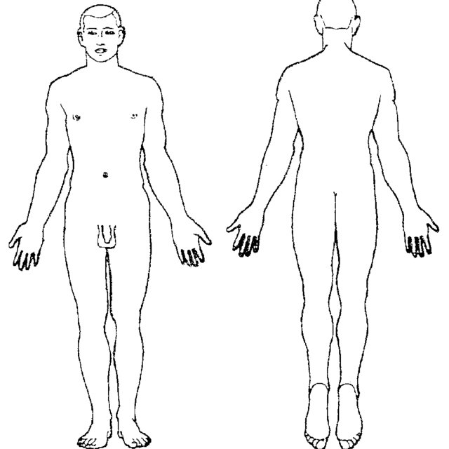
Photo of co-facilitator
Visual aids
Body charts
Show on your own body
Notes:
S20C Visual aids
Suggested time: 1 minute
Notes:
This slide can be led by a co-facilitator with intellectual disability.
Key points:
Use visual aids like body maps
Have them handy
What you can say:
You can also use visual aids
They can help people communicate.
Here is an example.
We can use this to show where things are happening in my body
We can use it to show what part of my body you are asking to touch.
You can also point on your own body, too.
We will send you links to resources like these.
Having visual aids handy helps us talk better.
It means I can understand you better.

Slide 29
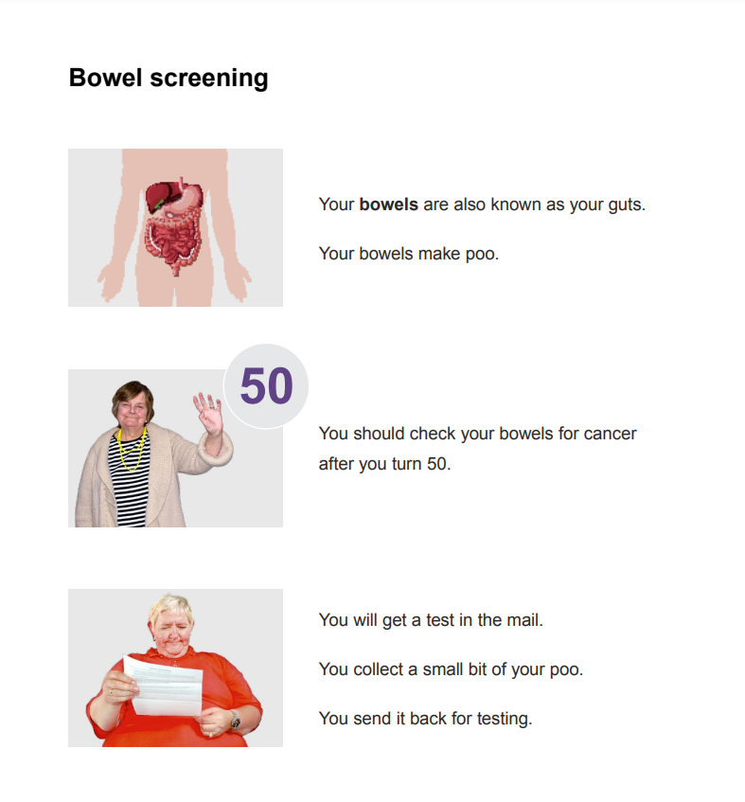
Photo of co-facilitator
Communication aids
Easy read
Social stories
Notes:
S21C Communication aids
Suggested time: 1 minute
Notes:
This slide can be led by a co-facilitator with intellectual disability.
Key points:
Easy Read is great
We will send a link to resources.
What you can say:
Easy Read sheets are terrific.
They use easy-to-understand language.
They have pictures to explain information.
They are a great conversation tool.
This is a picture of a page of easy read.
It is about bowel screening.
Some people also use social stories which are short stories explain a social situation
They can be individualised to a person.

Slide 30
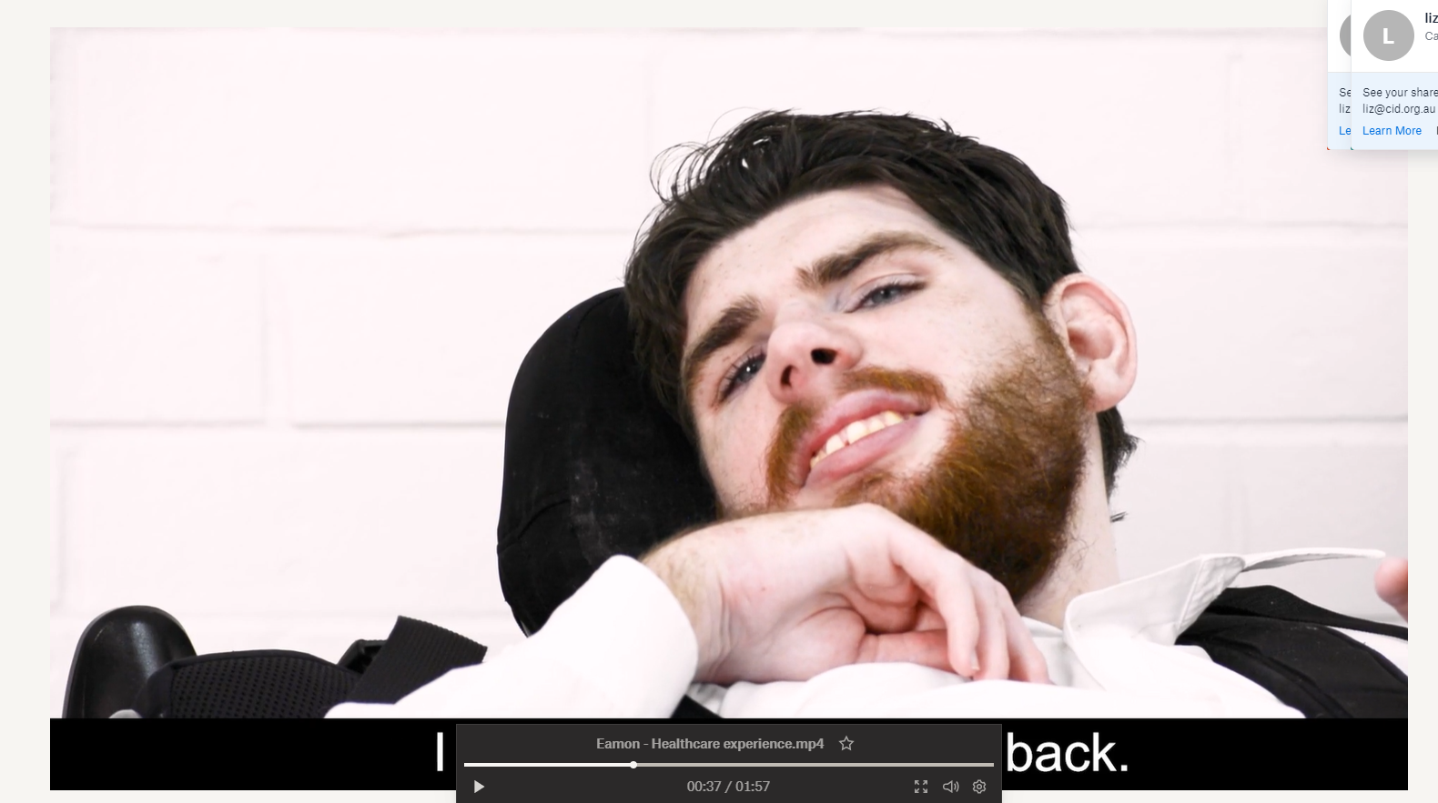
Eamon’s story
Notes:
S22V Video – Communication - longer
Suggested time: 3 minutes
Key points:
People may communicate in different ways.
Challenge assumptions about what someone can understand.
Notes:
This is a video placeholder. A link to a suitable videos is in the Training Guide.
Use this slide & video when presenting a longer workshop for GPs, nurses, or allied health staff.
If running a 1.5 or 2 hour workshop – include the video for GPs too. For a 1 hour workshop this video can only be included if other content is trimmed.
Key point: different ways people may communicate. Challenging assumptions about how much someone can understand.

Slide 31
Panel discussion
Photo of co-facilitator
Raise your hand
Say your name
Say who your question is for
Speak clearly and slowly
Notes:
S25C Panel discussion
Suggested time: 15 minutes, or longer with a longer workshop and longer break time.
Notes:
If having an expert panel, it should include a person with lived experience of intellectual disability, an experienced health professional from each of the professions the workshop is targeting (e.g. GPs, practice nurses, allied health professionals etc.), and a person from the Primary Health Network.
The Easy Read co-facilitator guide has information to help someone prepare to answer questions and be on a panel.
The PHN co-facilitator should run this part of the session.
However, we suggest you keep the photo up to remind participants to speak in an accessible way.
Speaker notes – key points:
Introduce panel and say why they are there.
Remind people of how to ask a question
Optional script
I’d like to welcome our panel members.
We have … [insert name and details of panellists here].
You can ask any of our panel members a question.
When you do, please remember to raise your hand [and someone will come to you with the microphone]
Say your name
Say who your question is for
Please speak clearly and slowly.

Slide 32
Questions?
Photo of co-facilitator
Say your name
Say who your question is for
Speak clearly and slowly
Notes:
S26C Question time
Suggested time: 5 - 10 minutes – depending on the workshop length.
Notes:
In a 1 hour workshop there may only be a few minutes for questions, depending on how long other parts ran for.
Do not include this slide if you are having a panel discussion.
See the section in the manual about supporting a co-facilitator to be involved in question time.
The PHN co-facilitator should moderate the questions.
Keep the photo of the co-facilitator as a reminder to use accessible language, even if they are not presenting this slide. However, it is a good idea to repeat all questions into the microphone, even in a small workshop. This allows you to naturally rephrase any questions to use accessible and person-centred language.
Optional script
Are there any questions?
If you have a question please raise your hand [and someone will come to you with the microphone]
Say your name
Say who your question is for
Please speak clearly and slowly.

Slide 33
6 Key points
Photo of co-facilitator
Talk to me
Ask me what I need
Look at my personal health record
Check dates, offer Webster pack
Suggest home-based medicine reviews
Talk to my doctor
Notes:
S120P Pharmacists - 6 key points:
Suggested time: 1 minute
Notes:
We suggest this is presented by the co-facilitator with intellectual disability
What you can say:
These are the 6 key points from this training.
Talk to me
Ask me what I need
Look at my personal health record
Don’t assume something is because of my disability
Help me stay healthy by suggesting yearly assessments & preventative health checks
Keep in mind that ANY time there is a change in how I act or what I can do you should check things in this order.
physical health
Then mental health
Then what else has been happening lately
Only after all that is done, consider if it is a behaviour.

Slide 34
Thank you
Photo of co-facilitator
Evaluation survey
Links coming via email:
POMPIDA links
Post-workshop reading – What not to miss
Links to Easy Read health fact sheets and other resources.
Notes:
S121P Pharmacists - Thank you and wrap-up
Suggested time: 1 – 2 minutes
Notes:
Either or both co-facilitators can present this slide. During preparation be sure to explain to the co-facilitator with intellectual disability what POMPIDA stands for and that it is mentioned in the case study section.
Key point:
Remind participants that links to the evaluation survey and helpful resources will be sent via email following the workshop.
What you can say:
Thank you for being part of this workshop.
Thank you for sharing your ideas.
We are trying to make these workshops as good as they can be.
So we will be emailing you a link to a survey.
Please do the survey.
We will also email you a post-workshop pack.
It has helpful information for you.
It also has links to accessible resources that you can share with people with intellectual disability.

