Slide 1

Primary Care Enhancement Program
How to use these slides
Notes:
S1C Explanatory slide – How to use these slides and the speaker notes
Do not include this slide in your presentation.
Ensure you have read the training manual which accompanies these slides. It gives valuable information to assist you in preparing to facilitate the workshop, including tips on how to support a person with intellectual disability to co-facilitate the workshop.
There is also an Easy Read co-facilitator guide for the co-facilitator with intellectual disability and a supporter to work through to understand the material.
This file is password protected. You must save a new copy before you make any changes to it.
This PowerPoint file contains slides for multiple audiences in the one master file. Separate files for different workshops are also available.
All materials can be used flexibly.
Some slides have animations. If a slide has animations, there is a little star next to it in the left hand slides menu.
If you prefer to present without animations, follow these instructions to turn them off:
Go to Slide show menu at the top of the screen
Select the Set up Slide Show button
Check the box that says “Show without animation”.
To turn animation back on just uncheck the box.
To turn off animation on a single slide, select everything on the slide, then go to Animations menu and select “None”.
Videos of how to do this are here: https://www.howtogeek.com/407396/how-to-disable-or-delete-powerpoint-animations/
Some slides are “hidden”. This means they will not show on a presentation. To unhide a slide, right click on it and select “Unhide”. To hide a different slide, right click and select “hide”.
You must tailor some slides with images of the workshop facilitators. If you have a co-facilitator who has intellectual disability, there is a space to include their photo in the corner of most slides. This serves as a reminder to participants to speak in an accessible manner for these sections of the training.
The suggested time for each slide is on the slide. If aiming for a 1 hour workshop, keep to the shorter the amount of time participants can share in small groups on each case study, remove the small group discussions for at least one case study (i.e. go straight to larger group sharing) and choose shorter options for any videos used.
Another approach to allow more time for all 3 case studies is a 1.5 hour workshop which includes a 10 - 15 minute panel discussion and a 10 minute break.
Format of the speaker notes:
For most slides, the notes page includes both brief speaker notes and an optional suggested script.
It is suggested that you read through the script in full when preparing to run the session, to ensure you understand the slide content. When presenting, you may edit the script as you please. One approach to ensure a natural style for facilitation is to use the full script to understand the content but then work from the key points, using your own words.
Case examples should be read as it is written (in full) to ensure all the clinical information is conveyed. These parts are written in italics.

Slide 2
Primary Care Enhancement Program
PHN Logo
Welcome
Notes:
S2C Welcome to workshop
Suggested time: 1 min.
Notes:
The co-facilitator with intellectual disability can do the welcome.
But only if they want to.
Key points:
Tell people you are starting the session.
Thank them for coming.
Tell them your name.
Tell the other co-facilitators’ names.
What you could say:
Hello. Welcome to the workshop. Thank you for coming along today.
My name is [insert speaker’s name].
This is [other facilitator’s name].
We will be running this workshop together today.

Slide 3

Photo of co-facilitator
Acknowledgement of Country
Notes:
S3C Acknowledgement of Country
Suggested time: 1 minute.
Notes:
The co-facilitator with intellectual disability can do the Acknowledgement of Country.
But only if they want to.
Key points:
Acknowledge the first owners of the Country you are on.
What you could say:
I would like to acknowledge the Aboriginal lands which we are all on.
I are meeting on the land of [insert name of land you are on].
I want to pay our respects to Elders past, present and emerging.
Let us remember that Aboriginal people have been living on this land for a very long time.

Slide 4
Who we are
This is [person’s name]
This is [person’s name]
Insert picture here
Insert picture here
Notes:
S4C Co-facilitators introduce themselves (with 2)
Suggested time: 3-5 minutes (if aiming for a 1 hour workshop with 3 case studies, keep this to 3 minutes or less)
Notes:
Tailor the slide with your pictures and names.
It is best if a co-facilitator with intellectual disability introduces themselves first.
Key points:
Tell people why you are involved in this training.
Tell them you have lived experience of intellectual disability
Tell them you have experience using health care.
The other co-facilitator should introduce themselves too.
What you could say:
We have not provided a script for this slide.

Slide 5
Who we are
This is [person’s name]
This is [person’s name]
This is [person’s name]
Insert picture here
Insert picture here
Insert picture here
Notes:
S5C Co-facilitators introduce themselves (with 3)
Suggested time: 3 -6 minutes (if aiming for a 1 hour workshop with 3 case studies, keep this to 3 minutes or less)
Notes:
Tailor the slide with your pictures and names.
It is best if a co-facilitator with intellectual disability introduces themselves first.
Key points:
Tell people why you are involved in this training.
Tell them you have lived experience of intellectual disability
Tell them you have experience using health care.
Other facilitators should introduce themselves too.
What you could say:
We have not provided a script for this slide.

Slide 6
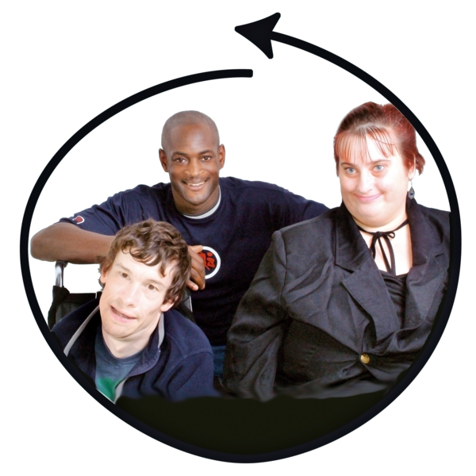
House keeping
Photo of co-facilitator
Please do not use jargon or acronyms
Speak slowly
Notes:
S6C Housekeeping - webinar
Suggested Time: 2 minutes
Notes:
Either co-facilitator can present this slide. Adapt as needed.
Refer to the Easy Read guide explanations of “jargon” and “acronyms”.
If you want, “jargon” can be swapped with “hard words”.
This slide is for a webinar.
Even though “Housekeeping” is usually one word, in Easy Read it works better as two.
Delete whichever “Optional script” part you are not using.
Key points:
Cameras on
Mute unless talking
How to raise your hand
Speak in an accessible way – explain the photo of the co-facilitator is a reminder
OK to use medical terms to discuss the case studies.
What you can say:
I will be running some of this training.
I have an intellectual disability.] Modify as needed if the other facilitator presents this slide.
So that we can all understand, please do not use jargon or acronyms.
And please speak slowly if you are sharing or asking a question.
Please do not be worried about making a mistake.
Sometimes we might not understand each other.
It is OK for us all to ask each other to explain something.
To help remind you, my photo is in the corner of all the slides where I am involved in running it.
There is one part of the training where it is OK to use words I might not understand.
That is when you talk about the case studies.
We want you to share your ideas with each other then.
That is why this is a workshop.
For those parts it is OK to share your ideas in the way you would normally speak to your co-workers.
But it is also OK if you want to ask someone to explain what they mean.

Slide 7
House keeping
Photo of co-facilitator
Please do not use jargon or acronyms
Speak slowly
Notes:
S7C Housekeeping – Face to Face
Suggested Time: 2 minutes
Notes:
Either co-facilitator can present this slide. Adapt as needed.
Refer to the Easy Read guide explanations of “jargon” and “acronyms”.
If you want, “jargon” can be swapped with “hard words”.
This slide is for a face to face session.
Even though “Housekeeping” is usually one word, in Easy Read it works better as two.
Delete whichever “Optional script” part you are not using.
Key points:
Bathrooms
Car park
Fire escapes
Speak in an accessible way – explain the photo of the co-facilitator is a reminder
OK to use medical terms to discuss the case studies.
What you can say:
There are some things you need to know about the building we are in.
The bathrooms are [describe location]
If the fire alarm goes off you have to leave through [point to exit]
[Insert any other information about the venue such as the carpark or refreshments here].
I will be running some of this training.
I have an intellectual disability.] Modify as needed if the other facilitator presents this slide.
So that we can all understand, please do not use jargon or acronyms.
And please speak slowly if you are sharing or asking a question.
Please do not be worried about making a mistake.
Sometimes we might not understand each other.
It is OK for us all to ask each other to explain something.
To help remind you, my photo is in the corner of all the slides where I am involved in running it.
There is one part of the training where it is OK to use words I might not understand.
That is when you talk about the case studies.
We want you to share your ideas with each other then.
That is why this is a workshop.
For those parts it is OK to share your ideas in the way you would normally speak to your co-workers.
But it is also OK if you want to ask someone to explain what they mean.

Slide 8
What do you hope to learn?
Photo of co-facilitator
Notes:
S8C What do you hope to learn?
Suggested time: 2 minutes
Notes:
This is a hidden slide. Whether it is helpful to use it depends on the number of people in the workshop / webinar, and whether you have time and capacity to modify what you deliver based on the input you receive from people.
If using it, it’s suggested that you tie the responses received to the outline in the next slide where possible, and again when reaching specific content that relates to what people have said here.
Although the picture of the co-facilitator with intellectual disability is in the corner, this is just to remind participants to consider their language. We suggest the PHN co-facilitator present this slide, if using,
Key points:
As this is early in the workshop, let people discuss with someone next to them first as an ice breaker.
Then ask them to share amongst the broader group.
You could also suggest people consider what they wrote in their pre-workshop reflection and activity and whether that gives clues as to what they hope to learn.

Slide 9
Workshop outline
Photo of co-facilitator
Photo of co-facilitator
Health care for people with intellectual disability
Case examples
What we can learn
Photo of physician or facilitator
Photo of co-facilitator
Notes:
S9C Workshop outline
Suggested time: 1 minute
Notes:
See the words list for an easy read explanation of “case examples”.
This can be presented by either co-facilitator.
Key points:
Health care for people with intellectual disability
Case examples (say how many)
What we can learn from those case studies
What you can say:
I am going to tell you what we will cover today.
We will talk about health in people with intellectual disability
We will talk about some things that make it harder for people to get good health care.
Then you all will get a chance to talk about some case examples.
And then I am going to talk about what you can learn from those case examples.
I will talk about the things you can do with anyone you see.
Things that will make their health care better.

Slide 10
Health care for people with intellectual disability
Photo of co-facilitator
Complex
Harder to get good health care
Health professionals are not confident
Notes:
S10C Health care for people with intellectual disability: Introductory information
Suggested time: 1-2 minutes
Notes:
Key points:
1 – 2 % of people have intellectual disability.
Health outcomes are not equal
Barriers in health care access
What you can say:
Australia’s health system is one of the best in the world.
Most Australians feel they have good health,
But health outcomes are much worse for people like me, living with intellectual disability.
1 to 2 percent of people have intellectual disability.
We have worse physical and mental health.
Many of us use lots of medications.
We have double the number of deaths that could be avoided.
An Australian study found that on average we die 27 years younger.
We can have trouble getting good health care.
We have lower rates of thing like vaccines.
Many of us have complex health conditions that are difficult to diagnose.
And sometimes the signs of illness are not so clear.
Communication can be harder in both directions.
But we want to be healthy.
We have right to good healthcare.

Slide 11
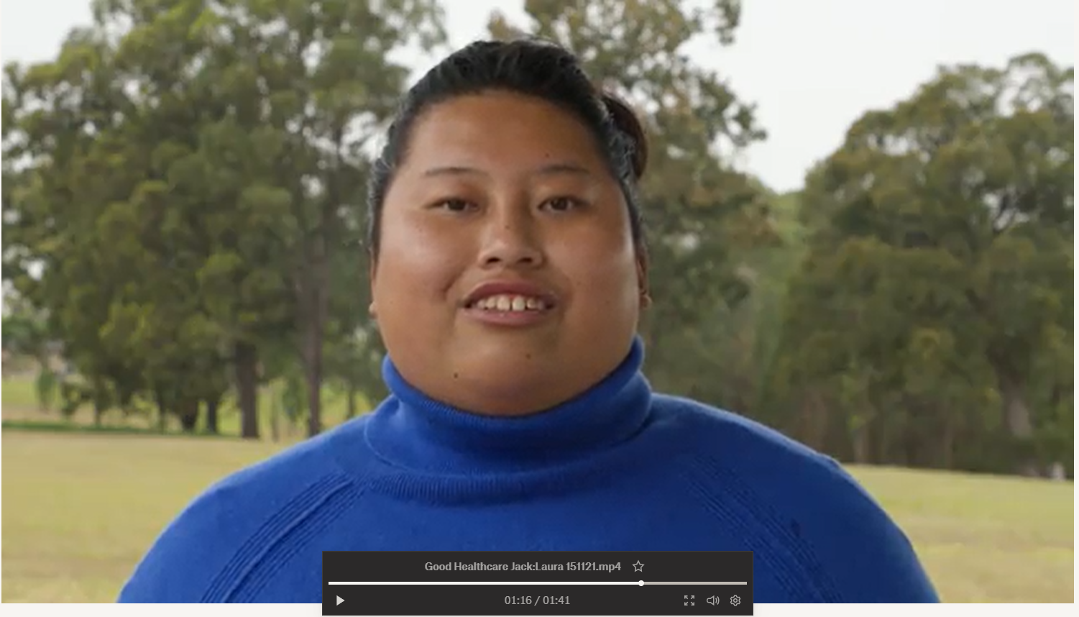
Health care for people with intellectual disability
Photo of co-facilitator
Notes:
S11V Health care for people with intellectual disability - Video placeholder
Suggested time: 1-2 minutes
Notes:
This is a video placeholder. If your co-facilitator with intellectual disability does not want to deliver this content, you may use a video instead.
Links to suitable videos made by CID are in the Training Guide.
Alternately, you can deliver this content yourself and use a video for the next part (a personal health care story).
Key points:
1 – 2 % of people have intellectual disability.
Health outcomes are not equal
Barriers in health care access exist

Slide 12
Good health care
Photo of co-facilitator
Insert an image or video here
Notes:
S12C Good health care
Suggested time: 1-2 minutes
Notes:
This can be a personal story from the co-presenter with intellectual disability, or a video.
Links to suitable videos made by CID are in the Training Guide.
If using a personal story, you can put in a picture or some key words
The PHN co-facilitator should work with the co-facilitator with intellectual disability to create a suitable script. The Easy Read co-facilitator guide includes information about choosing to tell your story and what makes a good story.
The point is to:
Give a person-centred account of a health journey
Showcase that good health care is possible to achieve for people with intellectual disability
Key point:
Even though there are the barriers to health care, good health care is still possible.
What you can say:
But it is possible to get good health care.
Here is my story of getting good health care.
Then tell the story.
Put your own notes here.
Or you can say:
But it is possible to get good health care.
Here is [person in video’s name] talking about their experience of good health care.

Slide 13
Case Studies
Notes:
S13C Intro to case examples
Suggested Time: 1 minute
Notes:
This divider slide is useful for orienting participants to the change from co-facilitator-led slides to case based learning.
The co-facilitator with intellectual disability is not involved in presenting the case studies. The Trainer’s guide and Easy Read co-facilitator guide gives details to understand this. The co-facilitator with intellectual disability can take a break during this time.
The specific case examples used should be tailored according to the audience. Case studies begin at slide 40. Remember, this is the master slide set. There are “Recommended slide sets” already prepared for different audiences, which can be used as is or tailored as needed. See the Training guide for more details.
In the Trainer’s guide appendices are notes for each case study. Within the slides, we have suggested suitable audiences for that case study. Where the same case example is used for multiple audiences, the specific information given has been tailored to that audience.
You may wish to send the case descriptions to your participants ahead of the workshop. See the appendix to the Trainers guide, which includes this as a handout.
Breaking people into small groups (2 or 3) for the first case is likely to result in greater sharing than keeping them in larger groups. Break out rooms can be used if in a Webinar.
Key points:
If the co-facilitator with intellectual disability prefers to take a break during the case examples, thank them for their introduction to the topic and tell people that they will be back later, before they leave the room.
Encourage participants to contribute to the discussion, emphasise there is no one correct answer in most instances.
The point is to discuss the types of issues that can arise and what we can learn through reflecting on both positive aspects of the care provided and the challenges.
Many of the examples are conglomerates across several similar, real-life cases. In all cases, identifying information has been changed. The photos are not of these specific people.

Slide 14
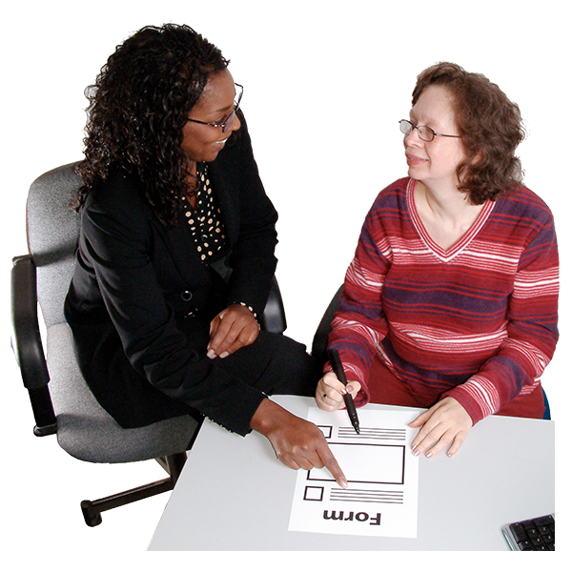
Reasonable adjustments
Photo of co-facilitator
Your ideas?
Notes:
S14C Reasonable adjustments definition – share
Suggested time – 1 – 2 minutes.
Notes:
This slide can be co-led with a co-facilitator with intellectual disability. The lead in should come from the PHN co-facilitator who has covered case studies.
Below is an example of the sort of way this topic could be introduced. However, it is important to support a co-facilitator to use their own words if they prefer. If using the “What you can say” script, ensure the co-facilitator with intellectual disability has a copy of that script without the other notes on it.
See the Easy Read co-facilitator guide for information about reasonable adjustments.
Key points:
Welcome back co-facilitator
This is an opportunity for the group to share their thoughts.
Brief speaker notes:
Welcome back co-facilitator
Ask for ideas of what Reasonable adjustments means
Small adaptations to practice = reasonable adjustments
Optional script for PHN co-facilitator:
Welcome back to [co-facilitator’s name].
Throughout the case examples, we have identified ways that clinicians can make really small adaptations in order to health care better for people with intellectual disability. Many of these things fall under the umbrella of “reasonable adjustments”. To explain what reasonable adjustments are and talk about their impact, I am going to ask [co-facilitator’s name] to come back and lead us again.
For co-facilitator with intellectual disability:
What you can say:
So, what is a reasonable adjustment?
Firstly can I hear from you guys.
What do you think a reasonable adjustment is?
Listen to ideas.

Slide 15
Reasonable adjustments
Photo of co-facilitator
  Takes away barriers that would stop someone getting good health care
Notes:
S15C Reasonable adjustments definition
Suggested time – 1 - 2 minutes.
Notes:
This slide can be presented by a co-facilitator with intellectual disability.
See the Easy Read co-facilitator guide for information about reasonable adjustments.
Key points:
Reasonable adjustments are small adaptations to practice
They can have a big impact on a person’s health care.
Give an example.
What you can say:
I think reasonable adjustments are things you do which takes away barriers that would stop someone getting good health care
The easiest way to tell you what a reasonable adjustment is with an example.
One of the pre-workshop activities was to gather the forms you ask people to do when they come to see them.
Put your hand up if you did that.
If you did not do it, then think about the forms new people do when they see you.
Put your hand up if you can think of your forms.
Now, keep your hand up if you are able to think of one thing that your practice does to help someone who needs help doing that form.
It does not have to be you that does it.
It might be some one who works with you.
Congratulations to people with their hands still up.
What you are doing to support someone with your forms - that’s a reasonable adjustment.
That is the sort of thing that makes it easier for someone like me to get health care when I need it.
And it means when I see you, I can give you the same info as other people.

Slide 16

Before I see you
Photo of co-facilitator
Forms
Booking times - reminders
Ask me what I need
Notes:
S16C Before I see you:
Suggested time: 1 - 2 minutes
Notes:
This slide can be led by a co-facilitator with intellectual disability.
On this slide or one that follows, if the person co-facilitating wants to share a personal experience, the text and flow can be modified to suit.
Brief notes:
Reasonable adjustments can happen before you see someone.
They might be done by the health worker or other people working there.
Things like
Booking visits at good times
Asking what you need
Help with forms
What you can say:
Some adjustments can be made before I see you
Like if your receptionist helps me with a form over the phone
Or sending a form out really early so I have enough time to do with my support worker, who only visits once a week
Or letting someone book a time slot that is going to work for them/
Or Booking a long appointment, or even coming to my house
Or knowing that it might take 5 appointments before we can do an assessment, before I can feel OK with that.
Or checking who should be at the appointment
Ask me what I need – like, who should be at the appointment with me?
I don’t have a computer, don’t send me forms through email.
And if I can’t read very well, don’t send me some 5 page letter. Phone me about it.

Slide 17
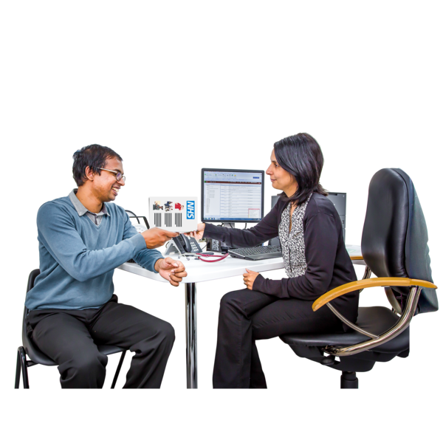

After I see you
Photo of co-facilitator
What I need to do
Send Referrals
Notes:
S17C After I see you:
Suggested time: 1 minute
Notes:
This slide can be led by a co-facilitator with intellectual disability.
Key points:
Adjustments can happen after you see someone.
Write things down
Make referrals easy for me.
What you can say:
At the end of my visit, write down for me what I need to do.
Try to make it neat!
If you send me to another doctor, can you please tell them about my disability?
Tell them what they can do to help me.
And send the referral straight to them.
Don’t hand it to me because I might not have a computer
So I can not email it to them.
Ask your staff to make my appointment with the other doctor while I am there.

Slide 18

When I see you
Photo of co-facilitator
Quiet waiting space
Health record
Notes:
S18C When I see you
Suggested time: 1 minute
Notes:
This slide can be led by a co-facilitator with intellectual disability.
The speaker notes can be adjusted as desired. See the manual for this information in Easy Read so as to support the co-facilitator to use their own words.
Key points
Wait where it is quiet
Use health records.
What you can say:
When someone comes to see you, you can let them wait outside.
Or wait in another room.
Where it is quiet.
You can help me to use a personal health record.
A lot of people with intellectual disability see a lot of different doctors
A record can help us communicate with all of them.
The my health record is one type.
But not every one uses it.
There are also other ones made for people with intellectual disability.
Like this one, the My Health Matters folder.
After the workshop we are going to email you a link to it.

Slide 19

Talk to me
Photo of co-facilitator
Break down info
Use easy words
Listen carefully
Check we understand each other
Notes:
S19C Talk to ME
Suggested time: 1 - 2 minutes
Notes:
This slide can be led by a co-facilitator with intellectual disability.
Key points:
Talk to ME
Ask before you touch me
Use easy words
Check we understand
What you can say:
The most important thing you can do when I see you is to talk to me.
Not just my support person.
It does not matter whether someone can speak, you still say Hi to them.
This is not a reasonable adjustment – it is what you would do for everyone else.
So please do it for me, too.
And then ask me if you can talk to my support person.
Tell me what you want to do before you touch me.
Ask me if it is OK.
When you talk to me:
Break it down into smaller bits
Use easy words
Talk about 1 point at a time
Check we understand each other
Another thing:
Explain why you need to ask something if it is personal.

Slide 20
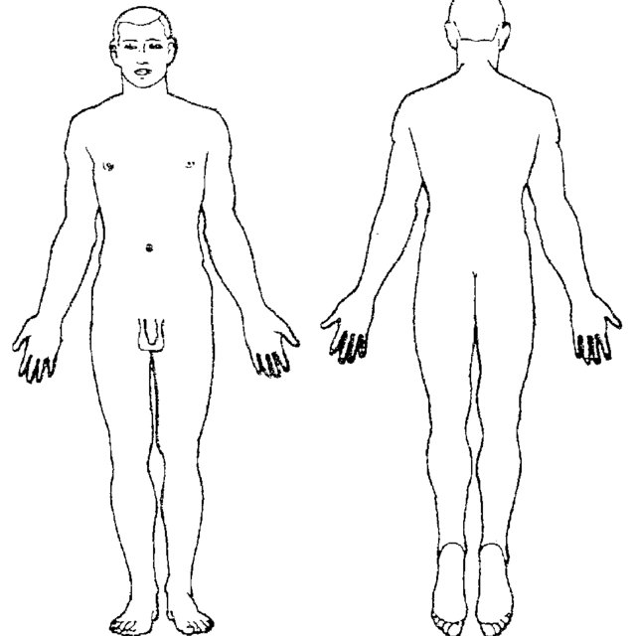
Photo of co-facilitator
Visual aids
Body charts
Show on your own body
Notes:
S20C Visual aids
Suggested time: 1 minute
Notes:
This slide can be led by a co-facilitator with intellectual disability.
Key points:
Use visual aids like body maps
Have them handy
What you can say:
You can also use visual aids
They can help people communicate.
Here is an example.
We can use this to show where things are happening in my body
We can use it to show what part of my body you are asking to touch.
You can also point on your own body, too.
We will send you links to resources like these.
Having visual aids handy helps us talk better.
It means I can understand you better.

Slide 21
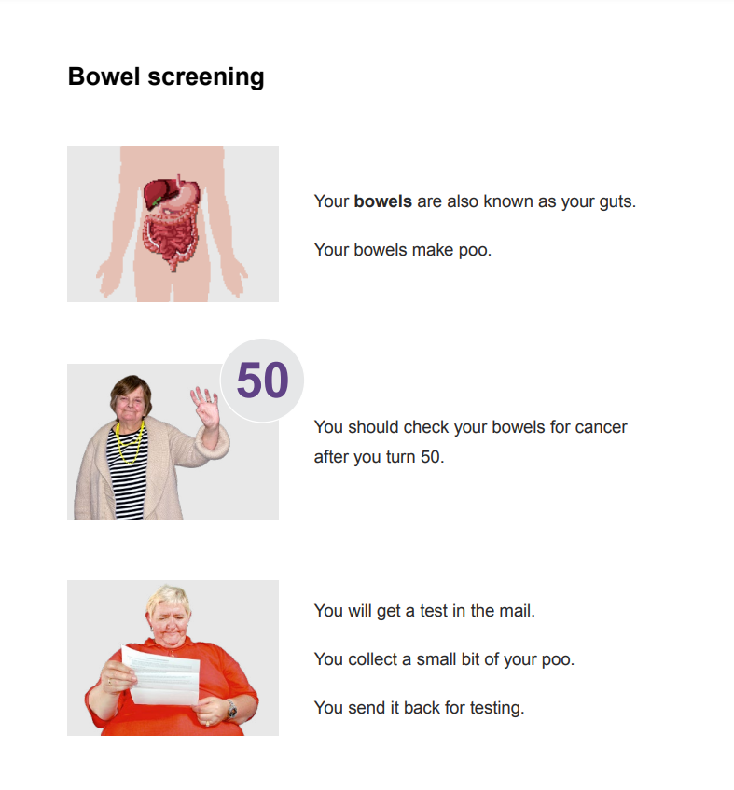
Photo of co-facilitator
Communication aids
Easy read
Social stories
Notes:
S21C Communication aids
Suggested time: 1 minute
Notes:
This slide can be led by a co-facilitator with intellectual disability.
Key points:
Easy Read is great
We will send a link to resources.
What you can say:
Easy Read sheets are terrific.
They use easy-to-understand language.
They have pictures to explain information.
They are a great conversation tool.
This is a picture of a page of easy read.
It is about bowel screening.
Some people also use social stories which are short stories explain a social situation
They can be individualised to a person.

Slide 22
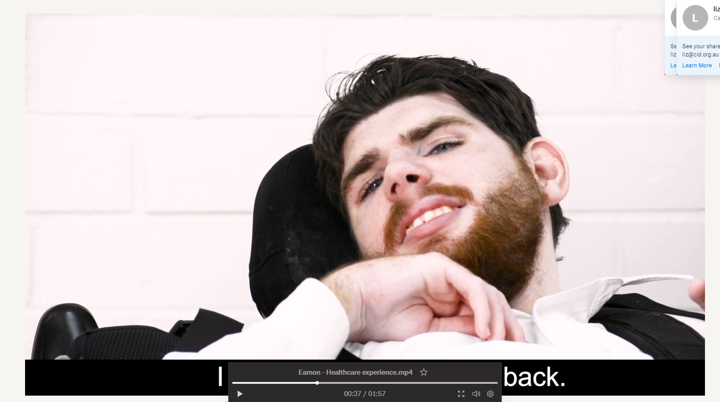
Eamon’s story
Notes:
S22V Video – Communication - longer
Suggested time: 3 minutes
Key points:
People may communicate in different ways.
Challenge assumptions about what someone can understand.
Notes:
This is a video placeholder. A link to a suitable videos is in the Training Guide.
Use this slide & video when presenting a longer workshop for GPs, nurses, or allied health staff.
If running a 1.5 or 2 hour workshop – include the video for GPs too. For a 1 hour workshop this video can only be included if other content is trimmed.
Key point: different ways people may communicate. Challenging assumptions about how much someone can understand.

Slide 23
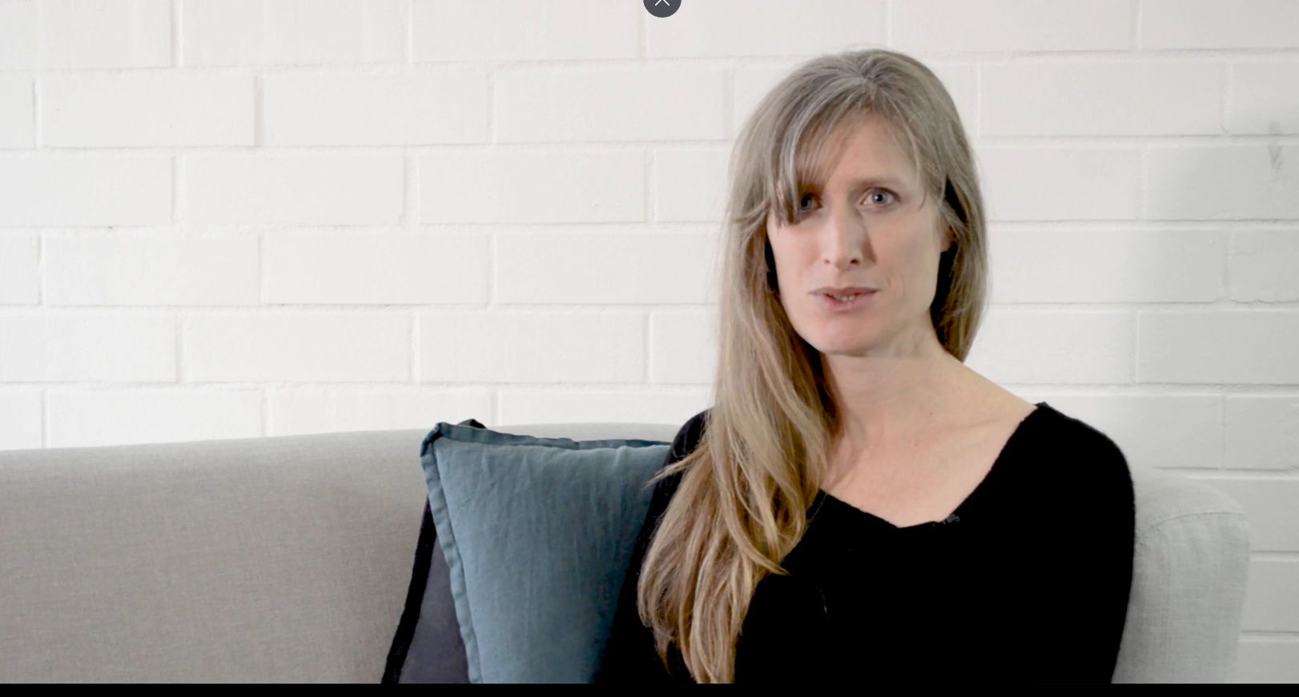
Interacting with people who use non-verbal communication
Notes:
S23V Video – Non-verbal and augmentative communication
Suggested time: 3 minutes
Key point:
The importance of promoting communication for all
Notes:
The link to a suitable video is in the Training guide.
Use this slide & video when presenting a longer workshop.
For a 1 hour workshop this video can only be included if other content is trimmed. However, a link to the video can also be sent as a post-workshop activity.

Slide 24
Video
Video of personal health story involving an annual health assessment goes here
Notes:
S24V Video – Annual health assessment
Suggested time: 1 - 3 minutes
Key point:
A health story of a good health outcome following use of the Comprehensive Health Assessment Program.
Notes:
Use this slide & video when presenting a longer workshop for GPs, or if adding to the end of other training
Links to suitable videos made by CID are in the Training Guide.
Alternately, a co-facilitator with intellectual disability can share their own story if they wish to.
For a 1 hour workshop this video can only be included if other content is trimmed.
Key point: Annual health assessments yield benefits.

Slide 25
Panel discussion
Photo of co-facilitator
Raise your hand
Say your name
Say who your question is for
Speak clearly and slowly
Notes:
S25C Panel discussion
Suggested time: 15 minutes, or longer with a longer workshop and longer break time.
Notes:
If having an expert panel, it should include a person with lived experience of intellectual disability, an experienced health professional from each of the professions the workshop is targeting (e.g. GPs, practice nurses, allied health professionals etc.), and a person from the Primary Health Network.
The Easy Read co-facilitator guide has information to help someone prepare to answer questions and be on a panel.
The PHN co-facilitator should run this part of the session.
However, we suggest you keep the photo up to remind participants to speak in an accessible way.
Speaker notes – key points:
Introduce panel and say why they are there.
Remind people of how to ask a question
Optional script
I’d like to welcome our panel members.
We have … [insert name and details of panellists here].
You can ask any of our panel members a question.
When you do, please remember to raise your hand [and someone will come to you with the microphone]
Say your name
Say who your question is for
Please speak clearly and slowly.

Slide 26
Questions?
Photo of co-facilitator
Say your name
Say who your question is for
Speak clearly and slowly
Notes:
S26C Question time
Suggested time: 5 - 10 minutes – depending on the workshop length.
Notes:
In a 1 hour workshop there may only be a few minutes for questions, depending on how long other parts ran for.
Do not include this slide if you are having a panel discussion.
See the section in the manual about supporting a co-facilitator to be involved in question time.
The PHN co-facilitator should moderate the questions.
Keep the photo of the co-facilitator as a reminder to use accessible language, even if they are not presenting this slide. However, it is a good idea to repeat all questions into the microphone, even in a small workshop. This allows you to naturally rephrase any questions to use accessible and person-centred language.
Optional script
Are there any questions?
If you have a question please raise your hand [and someone will come to you with the microphone]
Say your name
Say who your question is for
Please speak clearly and slowly.

Slide 27
6 Key points
Photo of co-facilitator
Talk to me
Ask me what I need
Look at my personal health record
Don’t assume something is because of my disability
Help me stay healthy - yearly assessments & preventative health
ANY change in how I act or what I can do:
Physical health
Mental health
Social / trauma / environment
Behaviour
Notes:
S27C 6 key points:
Suggested time: 1 minute
Notes:
We suggest this is presented by the co-facilitator with intellectual disability. However, if they have difficulty with any of the points (or the layout of point 6) then it can also be done together. Another option is for the PHN co-facilitator to present this slide, and the co-facilitator with intellectual disability to present the next.
Alternate endings are available for dentists and pharmacists. This slide is suitable for GPs and other allied health workers.
Key points:
Talk to me
Ask me what I need
Look at my personal health record
Don’t assume something is because of my disability
Help me stay healthy by suggesting yearly assessments & preventative health checks
ANY time there is a change in how I act or what I can do you should check physical health first.
What you can say:
These are the 6 key points from this training.
Talk to me
Ask me what I need
Look at my personal health record
Don’t assume something is because of my disability
Help me stay healthy by suggesting yearly assessments & preventative health checks
Keep in mind that ANY time there is a change in how I act or what I can do you should check things in this order.
physical health
Then mental health
Then what else has been happening lately
Only after all that is done, consider if it is a behaviour.

Slide 28
2 Key messages
Photo of co-facilitator
Talk to me
Give me a proper health check once a year
Notes:
S28C 2 key messages
Time: 1 minute
Notes:
We suggest this is presented by the co-facilitator with intellectual disability.
This slide is optional.
If not including it, include the personal statement from the co-facilitator with the previous slide.
Alternate endings are available for dentists and pharmacists. This slide is suitable for GPs and other allied health workers.
Key points:
Talk to me
Give me a proper yearly assessment.
Tell people what this will mean for you.
What you can say:
Just in case you can only remember 2 things from this training:
1. Talk to me
2. Give me a proper yearly assessment.
[If you have a co-facilitator who is happy to share their views, conclude with the co-facilitator’s own statement on what this will mean for their health care and hence their life].

Slide 29
Thank you
Photo of co-facilitator
Evaluation survey
We have sent you information in an email.
Notes:
S29C Thank you and wrap-up
Suggested time: 1 – 2 minutes
Notes:
The PHN co-facilitator is best placed to describe any emails being sent out. However, the co-facilitator with intellectual disability should be involved in thanking people for coming and saying goodbye.
Key point:
Remind people that links to will be sent via email.
Say thanks.
What you can say:
Thank you for being part of this workshop.
Thank you for sharing your ideas.
We are trying to make these workshops as good as they can be.
So we will be emailing you a link to a survey.
Please do the survey.
We will send other information too.
Like links to resources that you can share with people with intellectual disability.
Thanks everyone.

Slide 30
Slides to use within other training
PHN Logo
Notes:
S30O Divider slide – Slides to use in other training
The following slides can be used as a part of other training, that is, where the focus is not specific to intellectual disability.
They can be added to the end of any case study. Rather than describe a new case, you can save time by using one that is already within your training course.
The role of the facilitator is to encourage workshop participants to reflect on, and share, how intellectual disability could impact a scenario and how adjustments can overcome barriers.

Slide 31
What if …
[Your patient/client/Person’s name] has an intellectual disability?
    What changes?
    What stays the same?
Notes:
S31O Slides to use in other training – “What if…”
Suggested time: Around 4 minutes, but this really depends on the complexity of your case study
Notes:
Ask participants reflect for a minute, and then discuss how the presence of intellectual disability impacts the presentation, and/or how they would proceed.
If time permits, allow people to discuss firstly with the person next to them (or assign them to small break out rooms in a webinar) and then ask people to share insights with the entire group.
Answers to encourage are summarised in the notes for the next slide.
Tailor the slide to have the case study name in it.
Key point:
Generate group discussion. Health professionals consider what would change or stay the same if a person has an intellectual disability.

Slide 32
Changed? The same?
↑ complexity?
Comorbidity
Polypharmacy
Presentation
Trauma
Communication style
Time frame
Need for:
  Assessment
  Treatment
Communicating, rapport and respect
Notes:
S32O Slides to use in other training – “What has changed? What is the same?”
Suggested time: 2 – 5 minutes
Notes:
You may wish to modify this slide if there is anything that has specific relevance to the topic you’re presenting on, or the case presented.
Workshop participants who are not expecting this question may recognise that they don’t feel confident to provide health care for people with intellectual disability. If they share this, thank them for their honesty and reassure them they aren’t alone, and that your PHN is providing both training and resources to improve confidence.
If using the optional script, tailor it with the case study name and according to the professions involved.
Key points:
What stays the same is providing person-centred, proactive health care
What is different is the need for reasonable adjustments.
Optional script:
There is the potential for increased complexity due to higher rates of:
Existing conditions – diagnosed and missed
Polypharmacy
Idiosyncratic presentation
Other factors that can complicate assessment and management such as trauma.
There is a much higher rate of abuse amongst people with intellectual disability, and on top of that, medical assessments and procedures that have not been done sensitively in the past can mean there is a real possibility for someone who has limited communication to be re-traumatised.
This all means there is a greater need for vigilance and thorough investigation.
Which taps into the first major thing that remains the same: [person’s name] needs to be assessed and treated.
It may sound absurd to point that out, but all too often, people with intellectual disability do not get an appropriate assessment because a health professional thinks it is too hard. The same goes for preventative health checks that can be invasive in nature. But people with limited verbal communication actually have a greater need for such measures because they do not have the same capacity to recognise and report any symptoms when they do occur.
[Tailor this next point to your audience:
Physicians
- Ensure you undertake medical checks in a systematic manner.
- The likely time frame to assess and treat [NAME] may also change, if they are someone you don’t regularly see, and especially if they have a history of trauma.
You may need a few visits before you can attempt an assessment. This is reasonable.
If the person cannot tolerate tests which are reasonably indicated from the presentation, then arranging for them to be assessed under sedation or GA may be needed. Liaise with the hospital rehab medicine unit to ensure dental, bloods, other checks they need can be done at the same time.
Allied
Double check appropriate checks have been done or that the doctor has a plan to do them soon.
The likely time frame to assess and treat [NAME] may also change. ]
Communication will require some changes:
Use visual cues where possible
Use slower speech, focus on smaller chunks of information
Check your own communication
Check your understanding of what they are saying
Break it down – you might need to schedule some extra visits to have enough time.
And use visuals - have them on hand.
After this workshop, we will share some resources with you that can assist with these things.
Another thing that may change is who you’re communicating with, as you may need to involve support people to gather enough information.
But what stays the same is the need to talk to the patient themselves, even if a supporter is present, and even if they don’t communicate verbally. To direct respect and rapport towards them. To acknowledge them and ask for permission, or at least tell them that you are going to talk with their support person.

Slide 33

Further reflections
Missed health conditions are common
Value of annual health checks
https://eshop.uniquest.com.au/chap/
Notes:
S33O Use as extra to other training - Further reflections
Suggested time: 3 minutes
Notes:
When showcasing the Comprehensive Health Assessment Program, give up to date information about the cost and availability as a hard-copy or electronic form. This is changing at the time of writing so please double-check as you prepare to run the training.
Key points:
Missed health conditions are common
Showcase the Comprehensive Health Assessment Program as a tool to ensure a methodical way approach to annual health checks:
The only evidence-based tool in Australia
Identifies unmet health needs and promotes education for all involved
Includes gathering of important health history information before the health check
Optional script:
Missed health conditions are very common in people with intellectual disability
This means:
For allied health professionals - it is important to be aware of the potential for missed health conditions and to be assertive in asking the GP if they’ve been assessed.
For GPs, there is real value in ensuring a person with intellectual disability has a Comprehensive Health check annually.
A great way to do this to use a tool. Can I see a show of hands of who has heard of the Comprehensive Annual health Program, also known as the CHAP? And keep your hand up if you’ve ever used it? [Great so some of you are already using it.] For those who don’t know it, this is what it looks like (click mouse). And that is the link to it.
It has two parts. The first is a survey completed by the person with support as needed. The second part guides a GP through the steps to ensure a comprehensive assessment.
It’s been specifically designed for use with people with intellectual disability and it prompts you to do necessary preventative health checks at particular ages.
The CHAP is the only evidence-based tool that has been proven in Australia to identify unmet health needs in people with intellectual disability. The evidence for its effectiveness comes from 3 randomised controlled trials.
It encourages gathering of a comprehensive health history and prompts access to healthcare. It also educates all those involved in the process, to maximise the healthcare delivered to the person. The CHAP encourages follow up when problems are found.
The CHAP includes some features that don’t appear in other pro-formas, such as the history gathering prior to the consultation, and specific tips for the clinician regarding things to look out for. These elements of the CHAP educate and train people with disability, their family or support workers, and encourage them to advocate if they think problems are missed or poorly managed.

Slide 34
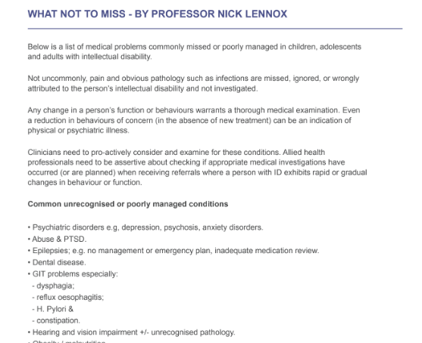
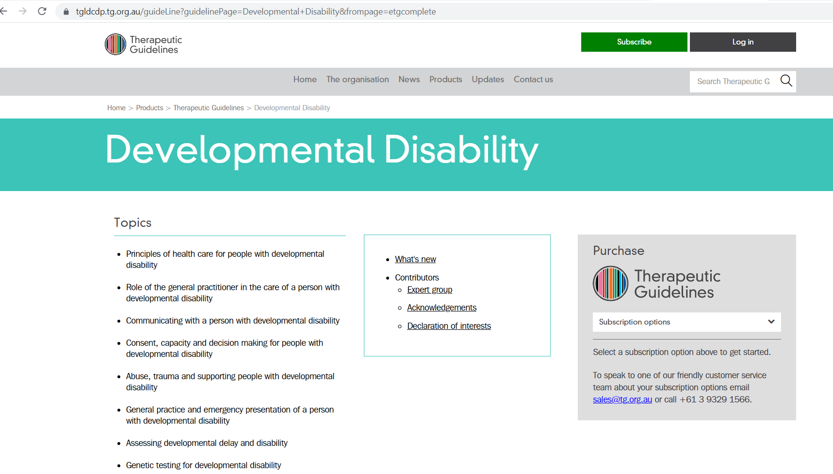
Resources
tg.org.au
Notes:
S34O Use as extra to other training – Clinical resources
Timing: 1 – 2 minutes
Key notes:
Excellent clinical resources are available
Showcase:
What not to miss – included in the links to resources for health professionals
The Therapeutic Guidelines (subscription service) – link is provided and is in the links to resources for health professionals
Optional script:
There are a couple of other resources worth highlighting.
We have distributed a resource pack which includes links to various resources. It also includes a 1-pager on conditions which are often missed or mismanaged for people with intellectual disability. Being aware of these conditions and the potential for them to be missed can help clinicians to be on the lookout for them.
A second resource to highlight is the Therapeutic Guidelines.
These are an excellent resource. There is a chapter on Developmental Disability, which includes tips for communicating with people with intellectual disability as well as covering common health problems. There is also a chapter on psychotropic prescribing which is not specific to people with intellectual disability but it is a great resource nonetheless and applicable to this group because many people with intellectual disability are prescribed psychotropics. The guidelines have recently been updated and are available online as a subscription service.

Slide 35
Easy read
Notes:
S35O Use as extra to other training – Easy Read resources
Timing: Less than 1 minute.
Key point:
Briefly showcase the availability of Easy Read resources
Optional script:
Also in your handouts pack is a page of links to resources you can share with people with intellectual disability, including easy read materials such as those from the Council for Intellectual Disability website.
Easy Read involves a mix of short text and images. It can handed to the person or their supporters, particularly if they have someone who can go through the information with them.
But it’s also a great communication tool for health professionals to use with someone.

Slide 36
Resources – Medicare item numbers
Notes:
S36O - Use within other training - Resources – Medicare Item numbers
Time: Less than 1 minute
Notes:
Only use this slide if you are conducting a workshop for GPs. It is not pertinent to allied health workers.
Tailor according to the case study’s name and presenting issues.
If time is an issue, rather than using this slide, simply state that the resources you send will also include a list of relevant Medicare item numbers, or highlight it in the follow up email.
Key point:
Highlight the resource - list of relevant Medicare item numbers.
Suggested script:
People with intellectual disability qualify for annual health assessment using item 703, 705 or 707. After the health assessment, it’s a matter of using things like team care arrangements with regular review, along with Home medication review.
[Your case name] would be a really good candidate for these services because [give the reason e.g. they have a chronic condition and are seeing 2 specialists, in need of at least 2 allied health services].
The other thing is to always book a long or prolonged appointment for someone.
This is a reasonable adjustment if they have a communication disability and you know it will take longer. If it turns out they don’t need the whole time you can use that time on other parts of their health care such as to complete paperwork such as liaising with their other health professionals in that time.
Home visits can include long or prolonged appointments. This becomes more financially viable if someone is living in a group home, and you can see several residents at once.

Slide 37
Polypharmacy and restrictive practices
Common in people with intellectual disability
Consider anti-cholinergic burden:
  Especially people with Down syndrome
What do you do?
NHS England » Stopping over medication of people with a learning disability, autism or both (STOMP)
Notes:
S37O - Use with other training – Polypharmacy
Suggested time: 2 minutes
Notes:
This slide will only be relevant to your training if the case study you have featured in your workshop involves polypharmacy. Otherwise, if you choose to use it, you will need to include some introduction to give context as to why it is included.
The slide is most relevant to GPs and practice nurses, mental health clinicians, Positive Behaviour Support practitioners, and pharmacists.
Please check if the POMPIDA website is live before running the workshop. It was planned at the time of writing. If possible, insert the link and their logo into the slide.
This slide has animations.
Key points:
Polypharmacy is common in people with intellectual disability and is of major concern due to:
Cumulative and compounding side effects and long term health risks
Many drugs have anticholinergic effects – they may be of particular concern
Polypharmacy may require special approval if it involves multiple psychotropics with cumulative doses outside the accepted mode of treatment for such a person.
STOMP protocol is a resource from UK about de-prescribing.
For complex cases, seek a pharmacist’s advice first
GPs can refer for home medicine review through Medicare,
Check POMPIDA resources – Pharmacists Optimising Medication in People with Intellectual Disability and Austim. Positive Behaviour Support specialists can request a review from a pharmacist.
Optional script:
Use of an antipsychotic drug to address challenging behaviour in the absence of a mental health diagnosis is a restrictive practice. It is only appropriate in the case of behaviours of concern which are so severe they pose a risk to the safety of the person or those around them, and where non-pharmacological treatments have failed.
Using drugs for challenging behaviours requires a person to have in place a Positive Behaviour Support plan, which is regularly reviewed. But the dose should also be regularly reviewed.
However, in some states (e.g. NSW), if a person’s treatment for a diagnosed mental health disorder involves the administration of 1 or more psychotropics and the dosage levels, combinations or numbers of restricted substances used, or the duration of the treatment, are outside the accepted mode of treatment for such a patient, this requires consent from a tribunal rather than a person responsible. Depending on the specific drugs used and their reason, polypharmacy may fall into this category of treatment.
So, if your patient is currently on a less-than-ideal drug or a mix of drugs, what do you do?
Answers to encourage:
Home based medicines review
Not only can the pharmacist highlight concerns, they can also advise the best order in which to de-prescribe
Check out the POMPIDA resources on how a Positive Behaviour Support specialist can request a mini review, through supervision of themselves, from a pharmacist. A GP may then be asked for a referral to do the full, Medicare-funded review.
Same principles as for safe prescribing apply:
Review reasons for prescribing
Ensure close supervision throughout
Ensure the person and their supporters knows what to do, and what side effects to watch for
Go slow
Check out the STOMP website which we have shared in your handouts, focused on de-prescribing.

Slide 38
[Name of person on video]’s story
This slide is a placeholder for video showing a person’s story with a focus on health and health care.
It could also be a video covering key points on reasonable adjustments and communication:
  Speaking with the person first (not just support people)
  Using aids, and avoiding difficult words
  Giving them enough time to process and respond
  Encouraging use of a personal health record – and reading the information in it.
Video of person’s health story goes here
Notes:
S38V Slides to use in other training – Video Placeholder
Suggested time: 3 minutes.
Notes:
Links to suitable videos made by CID are in the Training Guide.
Key point:
Include the story of someone with intellectual disability.
It may include tips like:
Speaking with the person first (not just support people)
Using aids, and avoiding difficult words
Giving them enough time to process and respond
Encouraging use of a personal health record – and reading the information in it.

Slide 39
Video (placeholder)
Video of person’s health story following an annual health assessment goes here
Notes:
S39V Video – Annual health assessment - to use in other training
Suggested time: 1 - 3 minutes
Notes:
Links to suitable videos made by CID are in the Training Guide.
This is a repeat of slide S24V.
Use this slide & video when presenting a longer workshop for GPs, or if adding to the end of other training for GPs and practice nurses.
For a 1 hour workshop this video can only be included if other content is trimmed.
Key point:
Annual health assessments yield benefits.

Slide 40
Case study slides
Notes:
S40O Divider slide – Case study slides
The following slides are for case based learning.
Each case study lists the suggested professional audience.
Following each case study are slides showcasing relevant resources.
Remember, this is the master slide set. There are “Recommended slide sets” already prepared for different audiences, which can be used as is or tailored as needed. See the Training guide for more details.

Slide 41
Case examples
For GPs and Practice Nurses – 1.5 or 2 hour Workshop
Notes:
S41P Divider slide – Case examples – GPs longer
Suggested Time: 1 minute
Notes:
Notes for introducing and describing the case examples are given in full for these slides. It is best to read them as they are written.

Slide 42
Kit
For GPs and Practice Nurses in a longer workshop
Notes:
S42P Kit divider slide
You can remove this slide

Slide 43
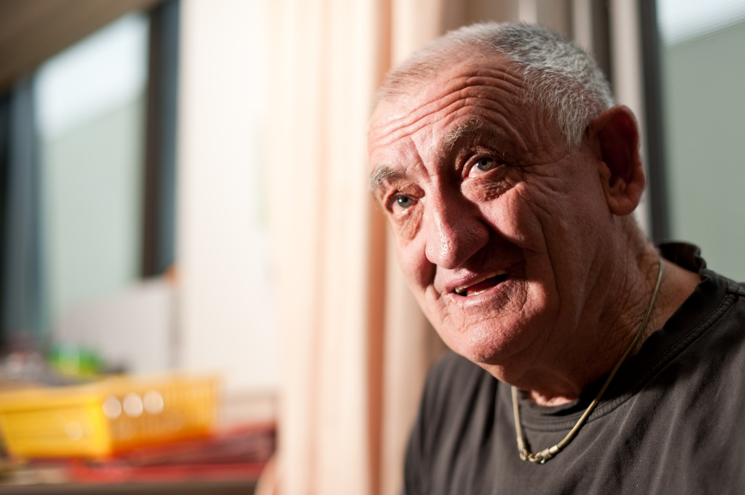
Kit
51 year old man
Enjoys gardening and Star Wars
Mild intellectual disability; speaks
Lives with mother, Sherrie
Recently lost father; lost job
Mental health history – SSRI anti-depressant
↑ irritable – aggression to Mum
Notes:
S43P Case example 1: Kit Longer GP workshop
Suggested Time: 1.5 minutes
Notes:
Read the case study text in italics as it is written.
SSRI stands for Selective Serotonin Reuptake Inhibitor, a commonly prescribed type of antidepressant.
See the appendix to the Training guide for detailed information about this case and the clinical and practical points it highlights, including appropriate reasonable adjustments.
The next slide contains further details about Kit’s case.
Suggested script (read as it is written):
Kit is a 51 year old man who enjoys gardening and Star Wars.
He lives with his mother Sherrie. His father David passed away last year. Kit also has a sister who lives interstate.
Kit’s father used to drive him to work where he restocked shelves at a small grocery store. Since his father’s passing, Kit left his job as it was too difficult to get there. His only NDIS supports cover his psychology services.
Kit has a history of anxiety, for which he takes an antidepressant (an SSRI). This was first prescribed by a psychiatrist over 10 years ago and the dose has remained stable for the past 8 years.
In the past year, Kit has become increasingly irritable, and on two occasions he has become aggressive towards Sherrie. Sherrie, who is 76 and has a history of osteoporosis, is concerned for her own safety, and for Kit’s wellbeing.
Kit has seen his psychologist 6 times so far this year to try to reduce his levels of agitation to discuss behaviour management. However, it is not working.
They have come to you for further assistance.

Slide 44
Kit – your turn
What could be going on for Kit?
- Differentials?
What is the first thing to do?
What should you do for Kit going forth?
Notes:
S44P Kit – Longer GP workshop – Small group discussion
Suggested time: 10 - 12 minutes
Notes:
This slide has animations to make the final text (what should you do for Kit going forth) appear after an additional mouse-click. They will only work if presented as a slide show.
See the appendix to the Training guide for detailed information about this case and the clinical and practical points it highlights, including appropriate reasonable adjustments.
Read the further details part as it is written.
Optional script:
With the person or people closest to you, answer about the following questions:
What could be going on for Kit? i.e. what do you think is likely and what are the differentials?
What is the first thing to do? And what should you do next?
Give people 3 minutes to discuss in small groups with a 30 second warning of when you will end the groups.
Then ask the groups to share some of the insights they shared. (2 minutes)
The answers to emphasise in your feedback and prompting are:
What could be going on?
Depression
Thyroid disorder
Constipation (especially as he is less active now than before, given he no longer works in a physical job)
Grief response
Medication reaction – even at 51 it is possible that Kit is experiencing early frailty. People with intellectual disability are at increased risk of early frailty. So this could impact his metabolism of medication
Other unrecognised physical or mental health problem.
What to do first?
Talk to Kit.
Ask him if he wants Sherrie to stay or leave the room while you talk.
With his consent, talk to Sherrie too.
Gather more information about any recent symptoms.
[If no one has discussed this yet]:
You need to do a physical examination – should this be done today? What do people think?
He needs a long appointment and it’s unlikely there will be sufficient time for this today
Explain this to Kit and Sherrie. Ask them to book a long appointment.
Suggested script (read as it is written): 1 min to read + 3 minute discussion
There is more information on Kit’s case.
When prompted with a visual aid of a body map, Kit indicates he has been experiencing pain in his upper and middle abdomen, and his head. You are not able to get a reliable answer on the time frame though.
A week later they return for a comprehensive assessment. Your examination reveals a distended sigmoid colon. You ask Kit to have a plain X-ray which confirms constipation. You prescribe laxatives and exercise.
Kit and Sherrie together complete a survey as part of the comprehensive assessment. This reveals Kit has not seen a dentist in 18 months. Sherrie reports this is due to Kit’s anxiety over the dentist.
Optional script continued:
So back in the same groups, discuss the question –
What do you need to for Kit going forth? What else needs to happen in the short and the long term?
Bring the groups together to share with the broader group. (2 minutes).
Answers to emphasise include:
Suggest an easy read or video resource about dental care
Liaise with his psychologist to see if they can address the dental anxiety
Explain that if needed, dental care can be done under anaesthetic – however, he has tolerated dentistry before so we want to try other methods to calm Kit first. A special care dentist could help. Check health pathways for options.
Review the SSRI dosage following blood test results.
Follow up to ensure constipation resolves (you can prompt: how would you do this? - Use the same visuals to assess his pain, repeat the physical assessment.
Suggest allied health services that could be useful, e.g. dietitian for nutrition, exercise physiologist. Suggest an NDIS plan review ask to include these services, as well as supports to enhance his participation in work and the community.
Going forth, discuss preventative health care checks
Talking with Sherrie about her own wellbeing and safety. Ensure this conversation occurs without Kit being present. If not already done, raise the topic of:
Respite care
Future care planning.
Again, an NDIS review is warranted to assess Kit’s eligibility for such services.

Slide 45
Further reflections?
Notes:
S45P Kit – Longer GP workshop – Further reflections? Blank
Suggested time: 4 minutes
Notes:
To keep momentum going in the room, keep this part short and punchy.
If people have already mentioned some of these points when sharing their insights, then acknowledge the insights already shared and summarise them before asking what else stood out.
The notes for this slide are all repeated on the next slide. This is so that you can use the blank slide to canvas any further ideas from people, and then use the next slide to summarise content.
Key points:
Validate participants’ insights
Constipation is very common in people with intellectual disability and commonly missed.
Resources document includes What not to miss.
Optional script:
Kit’s case highlights one of the most commonly missed health problems in people with intellectual disability – constipation.
Did anything else stand out to you? Can I start with the people [here - point to a section of the room that has been relatively engaged so far, then move on to another section of the room].
Listen to input. Prompt for any of the points on the slide not yet covered (for example Does anyone remember how the GP in this case study assessed Kit’s pain? Or There is no mention of whether Kit and Sherrie have discussed Kit’s longer term care needs. What do people think about this?
Possible answers worth emphasizing:
The helpfulness of a visual aid to assess pain
The potential for frailty (AND the potential for new medication side effects) at an earlier age
The vulnerability of someone who relies on another person to proactively maintain their health
The role of the GP in encouraging families to engage in meaningful conversations with a person with intellectual disability about their own choices for their future care. Kit is very capable of understanding care options and with support he could choose between them. Planning could avoid him needing to move in a crisis (his own or his mum’s).
The value in a reminder regarding annual health checks. There are Medicare billing items which can make this financially viable for you to do.
Listen to participants’ input and feedback and then move on to the next slide.

Slide 46
Further reflections?
Missed health conditions are common
Reliance on supporters for health care
Role of GP to encourage families to plan future care needs
Role of being prepared for communication
Value of annual health checks
https://eshop.uniquest.com.au/chap/
Notes:
S46P Kit – Longer GP workshop – Further reflections? Animated
Suggested time: 4 minutes
Notes:
The notes from the last slide are repeated here. Then the notes go on to talk about the CHAP.
When showcasing the CHAP, give up to date information about the cost and availability as a hard-copy or electronic form. At the time of writing, this was changing. Please check for up-to-date information before you run a session.
This slide has animations.
Key points:
Validate participants’ insights
Constipation is very common in people with intellectual disability and commonly missed.
Resources document includes What not to miss.
Optional script:
Kit’s case highlights one of the most commonly missed health problems in people with intellectual disability – constipation.
Did anything else stand out to you? Can I start with the people [here - point to a section of the room that has been relatively engaged so far, then move on to another section of the room].
Listen to input. Prompt for any of the points on the slide not yet covered (for example Does anyone remember how the GP in this case study assessed Kit’s pain? Or There is no mention of whether Kit and Sherrie have discussed Kit’s longer term care needs. What do people think about this?
Possible answers worth emphasizing:
The helpfulness of a visual aid to assess pain
The potential for frailty (AND the potential for new medication side effects) at an earlier age
The vulnerability of someone who relies on another person to proactively maintain their health
The role of the GP in encouraging families to engage in meaningful conversations with a person with intellectual disability about their own choices for their future care. Kit is very capable of understanding care options and with support he could choose between them. Planning could avoid him needing to move in a crisis (his own or his mum’s).
The value in a reminder regarding annual health checks. There are Medicare billing items which can make this financially viable for you to do.
Listen to participants’ input and feedback and then say:
Here is a short summary of some of those points” and click through them, reading each of the bullet points.
Then showcase the CHAP tool – this can be brief if it has already been mentioned.
A great way to do this to use a tool. Can I see a show of hands of who has heard of the Comprehensive Annual health Program, also known as the CHAP? And keep your hand up if you’ve ever used it? [Great so some of you are already using it.] For those who don’t know it, this is what it looks like (click mouse). And that is the link to it.
It has two parts. The first is a survey completed by the person with support as needed. The second part guides a GP through the steps to ensure a comprehensive assessment.
It’s been specifically designed for use with people with intellectual disability and it prompts you to do necessary preventative health checks at particular ages.
The CHAP is the only evidence-based tool that has been proven in Australia to identify unmet health needs in people with intellectual disability. The evidence for its effectiveness comes from 3 randomised controlled trials.
It encourages gathering of a comprehensive health history and prompts access to healthcare. It also educates all those involved in the process, to maximise the healthcare delivered to the person. The CHAP encourages follow up when problems are found.
The CHAP includes some features that don’t appear in other pro-formas, such as the history gathering prior to the consultation, and specific tips for the clinician regarding things to look out for. These elements of the CHAP educate and train people with disability, their family or support workers, and encourage them to advocate if they think problems are missed or poorly managed.

Slide 47
Diagnostic overshadowing
Mistakenly attributing a person’s symptoms to their disability
- or to a mental health or behavioural problem.
Notes:
S47P Diagnostic overshadowing
Suggested time: 1-2 minutes
Notes:
This concept may have already come up in discussion. If so, highlight that participants also made this point and it a very important one so here is the official definition.
Key point:
Define diagnostic overshadowing per the slide
For people with intellectual disability there is high potential for something physical like constipation to be overlooked as a cause of symptoms
Emphasise how to avoid it – methodical health checks, proactively and responsively.
Optional script:
It is unfortunately common for the potential for something physical like constipation to be overlooked as a cause of symptoms.
Diagnostic overshadowing is where someone mistakenly attributes a person’s symptoms to their disability or to a mental health or behavioural problem.
As you can imagine, this results in
delays to care
unnecessary comorbidity
And it can be dangerous or even fatal.
So how can a clinician avoid this? It involves applying the clinical skills you already have, in a thorough fashion. This includes:
- Ensuring people with intellectual disability have regular and thorough health assessments is key. You can involve your reception staff in diarizing a reminder to contact them next year to book their annual health assessment.
Taking a methodical approach to assessing cause of symptoms, and realizing this might require additional consultations, and that is OK.
Reflecting on your own assumptions is also helpful
And if treatment does not work – review the diagnosis.
[If discussion has been adequate so far] - And we have seen from the discussion that came up in Kit’s case that you all are able to take that approach and apply those skills.

Slide 48
Resources
tg.org.au
Notes:
S48P Kit – Longer GP workshop - Highlight resources
Suggested time: 1 – 2 minutes
Key point:
Showcase:
Therapeutic Guidelines – requires subscription but excellent, Australian, comprehensive, and recently updated
Resources document includes What not to miss – a list of commonly missed or mismanaged health issues in people with intellectual disability.
Optional script:
There are a couple of other resources worth highlighting.
One of the resources that accompanies this training is a 1-pager on conditions which are often missed or mismanaged for people with intellectual disability. Being aware of these conditions and the potential for them to be missed can help clinicians to be on the lookout for them.
A second resource to highlight is the Therapeutic Guidelines.
These are an excellent resource. There is a chapter on Developmental Disability, which includes tips for communicating with people with intellectual disability as well as covering common health problems. There is also a chapter on psychotropic prescribing which is not specific to people with intellectual disability but it is a great resource nonetheless and applicable to this group because many people with intellectual disability are prescribed psychotropics. The guidelines have recently been updated and are available online as a subscription service.

Slide 49
Resources – HealthPathways
Insert an image of your local HealthPathways webpage here.
If the section on intellectual disability is suitable to show then use that.
URL for your healthpathways log in page goes here
Notes:
S49P Your HealthPathways
Suggested time: 1 minute
Notes:
You must tailor this slide for your PHN.
Key point:
Outline what your local HealthPathways can offer that is specific to intellectual disability health.

Slide 50
Amelia
For GPs and Practice Nurses in a longer workshop
Notes:
S50P Amelia divider slide
You can remove this slide.

Slide 51
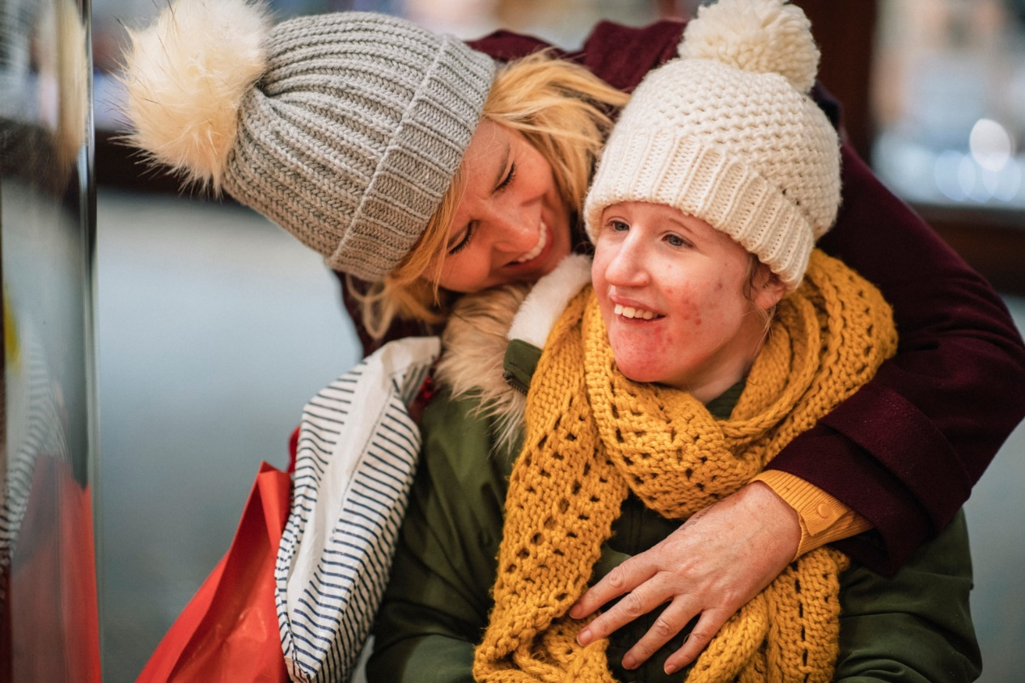
Amelia
Early 20’s
Loves cats, cooking shows
Intellectual disability & cerebral palsy
Group home
Social day program 5 days a week
History of abuse and mental health problems
Staff report recent history of ‘sexualised behaviours’
Notes:
S51P Amelia – Longer GP workshop
Suggested time: 1.5 minutes:
Notes:
Read the case example as it is written.
See the appendix to the Training guide for detailed information about this case and the clinical and practical points it highlights, including appropriate reasonable adjustments.
Suggested script
Amelia is a woman in her early 20’s who loves cats and enjoys watching cooking shows on TV.
She has an intellectual disability and cerebral palsy.
She is able to vocalise and use some sign language. However, it is very difficult for people to understand her communication.
This is Amelia’s first visit with you. Her previous GP - whom she saw since she was a child - recently retired. You see two other residents in Amelia’s group home.
Support staff inform you that Amelia has lived in their residential service for the past 3 years. She sees her Mum every weekend.
They tell you she has epilepsy for which she takes medication.
They also tell you that Amelia has a history of trauma – as a teenager she was sexually and physically abused by someone who was not a family member.
In recent years, she has had mental health problems, including a suspected suicide attempt. She has also exhibited behaviours of concern, including non-suicidal self-harm.
Support staff report that for the past month Amelia has exhibited 'sexualised' behaviours – this includes taking off her clothes, exposing her genitals to staff (male and female), and touching her genitals in public.
Staff report that these behaviours are becoming more frequent.
They report that there were no changes in Amelia’s group home or day program close to when these behaviours began, and also no other signs of any mental health crises emerged around then.

Slide 52
Amelia – Your turn
What could be contributing?
First steps?
Next steps?
Notes:
S52P Amelia – Longer GP - Group discussion
Suggested time: 6 - 8 minutes
Notes:
Depending on how dynamic your group is, you may no longer need small group discussions – if sufficient participants are volunteering answers just go straight to the whole group discussion. This will save time. However, if your group is reticent have them share in small groups followed by your summary of the points - then ask if anyone had more to add.
Optional script: (what to say when depends on what answers arise, but potential answers to emphasise are below)
In small groups discuss these questions
What could be contributing to Amelia’s behaviour?
What are the first steps you would take in response?
What would you do next (i.e. next week or further)
After 3 – 4 minutes (earlier if the room appears to go quieter after some discussion), either share with the broader group; or you go through the answers and invite other input at each stage.
Potential answers to encourage or prompt on could be:
What could be contributing?
Further abuse – she is very vulnerable. People with intellectual disability experience higher rates of all forms of abuse.
Is she on a hormonal contraceptive? Has it changed somehow and could this be contributing to the behaviour?
Is there a communicative element to the behaviour?
Could it relate to seizure activity?
Is it behaviourally driven, or a trauma response from prior abuse?
Note - if mania is suggested, say while it is important to be open to the possibility, it seems there are no other clear symptoms of mania at this stage
First steps?
In this consultation - Speak to Amelia. Introduce yourself. Tell her you are a doctor.
Even if someone is not able to communicate verbally, always acknowledge their presence and show them the respect of saying hello.
Check if the support staff present knows her well and is able to interpret her communication.
Find out what consent arrangements are in place. Ask the Group home for the mother’s contact details and ensure she has been appraised of the situation.
Before the end of the day, ensure Amelia is safe:
Phone the group home manager to discuss staffing for Amelia’s personal care and supervision:
until the underlying cause is identified she needs 2 staff members with her for all personal care and she needs to never be alone.
Ensure adequate support is in place for any excursions
These steps are important not only if there is suspicion of abuse but also to protect her from abuse, as the behaviours make her more vulnerable to it. These steps also protect the staff and ensure that difficult situations can be managed through the least restrictive option.
However it comes at a cost. It’s not guaranteed that increased supports will be covered by NDIS and they certainly can’t increase them without approval of NDIA.
The group home manager could ask her planner to request an urgent change of circumstances review
They may ask the GP for a letter of support – if so, be aware that NDIS will only fund needs that pertain to her disability not medical problems. It can, however, mention her increased risk arising from the behavioural changes
Once a cause is identified, if that cause relates to Amelia’s disability then evidence of increased support needs is needed to fund them under the NDIS. This may require a Positive Behaviour support plan.
See the links in the handouts regarding supporting NDIS eligibility and plan reviews.
Next steps?
Gather more information. Questions to ask could include:
- has this ever happened before?
- Were there any other changes around that time? Changes could be in Amelia’s:
health
medications
lifestyle and surroundings.
Does she appear withdrawn? Irritable?
In fact these questions were asked and the answer to all was no.

Slide 53
Amelia – your turn
Comprehensive assessment?
  How?
  When?
Notes:
S53P Amelia – Longer GP - Comprehensive assessment?
Suggested time: 2 minutes
Notes:
If you are running a longer workshop (2 hours), you could ask participants to discuss what they would do for Amelia in the longer term and what allied health services she may benefit from.
If the case of Kit has not been used in your workshop, you could introduce the use of the Comprehensive Health Assessment Program at the end of this slide, using slide S46P.
Key points:
Be mindful of the impact of trauma and the potential for medical trauma.
It is reasonable to plan additional visits to allow the person to get to know you and vice versa.
Outcome: In truth, Amelia had actually consulted numerous allied health professionals before she was brought to see a doctor. The eventual diagnosis was thrush. It was treated and all her behaviours resolved.
Optional script:
Can I see a show of hands:
- Who thinks a comprehensive assessment is indicated at this stage?
- Who thinks it is feasible or wise at this stage?
I see some of you hesitating. Given her prior trauma and the possibility of recent trauma a physical assessment would be very challenging and it may induce further trauma for Amelia if it were done before she felt comfortable.
Remember, this is her first visit. So, you don’t know each other yet.
Instead, ask her mum and the group home staff to arrange repeat visits with Amelia to build rapport and trust. It is reasonable to do this. It also gives you a chance to learn about how Amelia communicates. And ask how she went with physical health checks with her last GP.
What else can you do?
You can ask staff to track her diet, menstrual cycles and discharge, mood, any other behaviours
Conduct a full file review. Why?
She is a new patient,
It allows you to track her history of recent assessments, dental care etc.
Liaise with her neurologist and find out how long since her last review there.
If indicated, ask a local pharmacist to visit her Group home to conduct a medication review - there is a Medicare item for this.
In the longer term, it would be useful to discuss:
Allied health services that may benefit Amelia. For example, a speech therapist may work with her to enhance her communication systems and/or train her support workers to understand her communication better; physiotherapy and OT as she has cerebral palsy, exercise physiologist, too. Some of these services could be added to her NDIS plan at the next review.
Preventative health including cancer screening checks.
The Comprehensive Health Assessment Program prompts all the preventative health care checks for a person’s age.
In truth, Amelia had actually consulted numerous allied health professionals before she was brought to see a doctor. The eventual diagnosis was thrush. It was treated and all her behaviours resolved.

Slide 54
Amelia – further reflections
Recognising:
  Complexity
  Trauma
Adjustment to standard practice
  Opportunistic investigations
Any change in behaviour:
Physical health
Mental health
Social / trauma / environment
Behaviour
Notes:
S54P Amelia – Longer GP workshop – Further reflections
Suggested time: 2 minutes
Notes:
Even though Amelia’s case turned out to have a physical cause, be sure to validate of all the suggestions made by participants. There were many possibilities which could have been the eventual diagnosis. The point is to investigate, thoroughly and cautiously.
Include the text in italics to give the outcome of the case.
This slide contains animations.
Key points:
Amelia’s case is very complex.
Appropriate to take a while to work through what to do.
Any change in behaviour should be assessed in order of: physical, mental health, social/environment and behaviour
Importance of being trauma-aware before doing invasive tests
Sometimes sedation is needed to assess – if so arrange other needed tests.
Optional script:
Amelia’s case is very complex.
It is appropriate that it takes a while to work through what to do. It is NOT straightforward. Recognising that complexity and the impact of trauma on a medical assessment is exactly the sort of skill that is needed.
[if the group made suggestions] Lots of great suggestions have come up about adjustments to standard practice, such as booking multiple visits, liaising with the Group home manager and with Amelia’s mother for information, and doing a file review.
Another potential adjustment is looking for opportunities in the event the general anaesthetic is required to investigate, because if that’s to happen, you want to take advantage of it to get as many checks done as possible. The file review we talked about will identify other things to assess or manage at the same time, such as preventative cancer screening checks; dental checks and cleaning; vaccinations; blood tests.
We have included in the handouts information about such opportunistic investigations. It involves liaising with clinicians at the hospital but often a physician from an adult rehab unit will be able to direct this. The other thing that a GP can do is provide the person, or their supporters, with a general bloods form that has the standard full blood count and full metabolic panel on it, as well as anything else you’d like to check based on their risk factors. You can also simply do this in a letter. And they can just keep that on file and if the person needs a blood test for any reason, like they have an accident and go to hospital, or if a specialist wants something, then it can all be done in one blood draw.
Even though Amelia had thrush, any number of the suggested diagnoses could have been the answer. The key point here is to follow a thorough strategy so as not to miss things. Always look at physical then mental health and then environmental explanations for a change in behaviour. No matter the history - always look for evidence of medical issues first.

Slide 55
Amir
For GPs and Practice Nurses in a longer workshop
Notes:
S55P Amir divider slide
You can remove this slide

Slide 56
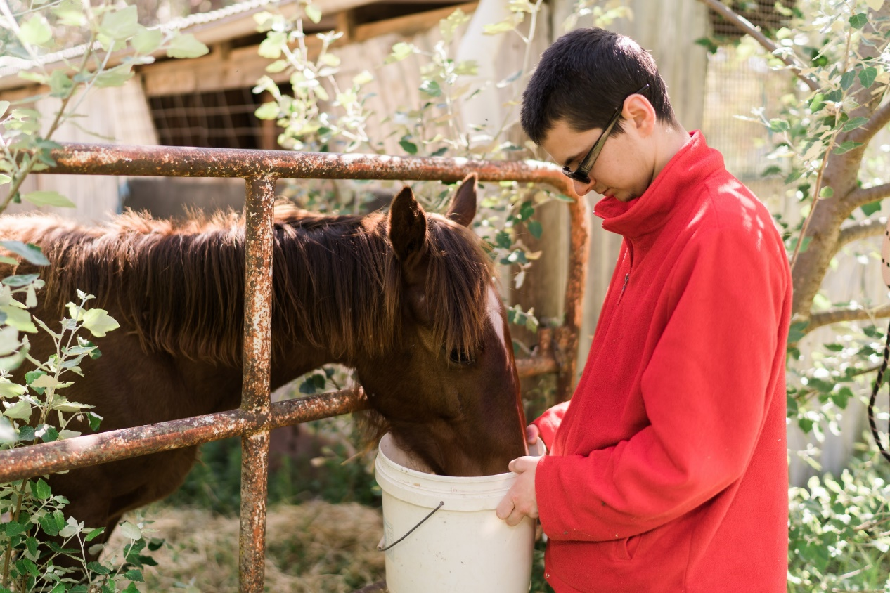
Amir
19 years old
  Enjoys bush walking, time with family, visiting family farm
  Moderate intellectual disability; some sign language
  Epilepsy – Tegretol 8+ years
Stopped eating past 3 weeks
  5 – 6 months increasingly ‘picky’ eater
  Food avoidance
  Medication – worse
  1 - 2 banana smoothies a day
Notes:
S56P Amir - Longer GP or GP Express workshop
Suggested time: 2 minutes.
Notes:
Read the case study as it is written.
See the appendix to the Training guide for detailed information about this case and the clinical and practical points it highlights, including appropriate reasonable adjustments.
Risperidone is an anti-psychotic and when prescribed for behaviours of concern it is considered a restrictive practice. Appetite stimulation and weight gain is a major side effect. 3 mg is quite a high dose for someone who is underweight.
Tegretol is an anti-epileptic drug that interacts with a number of other drugs.
Suggested script:
Amir is a 19 year old man who enjoys walks and spending time with his family. He moved to a group home 8 months ago. He visits his family’s farm one weekend a month.
He has an intellectual disability in the moderate range. He needs support in many areas, including for planning his activities, as well as some more complex self-care activities such as shaving. Amir has no speech - he communicates through basic sign language.
Amir attended a special education school where his parents report he received excellent support. The transition to post-school options was difficult and he often refused to go. This was a reason for his move into residential care. He still frequently refuses to attend the program and on these days he spends most of the day on his bed watching TV.
Most of Amir’s health care to date has been provided by a developmental paediatrician, who has liaised with a paediatric neurologist and more recently a child and adolescent psychiatrist. As a result, Amir has only seen you sporadically. He previously accessed some allied health services through the children’s hospital but now he has transitioned out of the children’s services. He still sees his psychiatrist 3 times a year and neurologist biannually.
Amir’s medical history includes Epilepsy, which appears to be well controlled using Tegretol. His parents made the appointment and asked group home staff to bring him to see you because he has been refusing to eat for 3 weeks.
Staff report Amir has always been a picky eater while in their care but this has gradually become worse. A few months back, Amir’s psychiatrist prescribed 3mg risperidone for behaviours of concern – it was hoped this would help his eating but it seems to be even worse since then. Amir stopped eating following a choking episode exactly 3 weeks ago – he appears ‘scared’ of food since this time. He refuses to go to the table for meals. He will eat small amounts of banana smoothie, only.
Amir appears very thin and underweight. By the time you see him, he has been in the waiting room for 40 minutes and he is agitated, though no one knows exactly why. He appears to be trying to communicate but the staff member who has come with Amir is not his key worker and does not know all of his signs.

Slide 57
Amir – first steps, and beyond
What are some possible contributors to Amir’s food refusal?
is the first thing you would do?
What can be done longer term?
Annual health assessment
Care co-ordination: Transitions, allied health
Notes:
S73P Amir – Longer GP or GP Express workshop - First steps
Suggested time: 10 minutes
Notes:
At the end, you can share the outcome. It is written in italics.
Provided the group is volunteering answers, you can skip small group discussions and ask the whole group for answers if using this as your second or third case. Use the extra prompt questions to keep the discussion quick and dynamic.
Optional script: (what to say when depends on what answers arise, but potential answers to emphasise are below)
Ask the group to suggest answers for any of the following questions.
1. What is the first thing you would do?
Follow-up prompts if needed:
What is the most important thing to do right now?
Would you try to weigh him?
Would you take a history? If so, what would you ask about?
Could Amir be experiencing pain? How would you assess it?
Answers to emphasise or prompt:
1st thing to do: engage with Amir. Say hello.
Getting a history:
Weight
Past swallowing problems
Other possible causes – constipation, reflux, dental problems, ear infections, any history of abuse, signs of mental health problems including depression or PTSD.
Recent changes in behaviour – did the group home staff document them?
Some of these answers could be in his file notes.
Assessing pain:
you could try using visuals (validate the suggestion), but this is unlikely to be successful when he is distressed. A sensible approach is to ask them to make another appointment.
You could also ask those who know him well about any other recent changes in his behaviour
Would you try to weigh Amir?
- Only if he calmed down and appeared to asset to it. It would be helpful to establish if the person who has brought him knows his yes/no signs.
What is the most important thing to do right now?
No assessment is possible in this appointment – he is distressed
Must convey to staff the importance of hydration. Call a chemist – ask about a high-quality over the counter nutritional supplement. If he does not like that, then if possible, staff can get Amir’s assent and/or his parents’ consent as appropriate, to adding extra nutrients to the banana smoothies. If he does not assent, the group home may need to firstly seek approval as it could be deemed a restricted practice. A health professional can help by providing documentation of his medical condition.
Arrange swallowing assessment urgently by a specialist speech therapist.
Amir is at risk of choking, aspiration of food into his lungs, blocking his airways, and even dying from this.
Check health pathways for speech therapists to refer to, or
Ring the hospital speech pathology department.
Ask the family and group home manager to make another appointment ASAP when either the parents or Amir’s keyworker can come and can interpret Amir’s signs.
Could this be a medication reaction? Things got worse with risperidone.
Risperidone can – rarely - lead dysphagia, and so could explain the worsening of his symptoms
People with intellectual disability are more likely than others to experience adverse reactions to psychotropic medications.
How do you deal with this possibility?
Speak with the prescribing psychiatrist, review any information they have sent about the reasons for prescription.
Ask the psychiatrist to advise on significantly reducing, or ceasing the medication.
How would you ensure this is done safely?
It must be considered case by case, with regard for the reason for prescribing and any diagnosis.
- If it is primarily prescribed to address behaviours of concern then this is a restrictive practice.
What else would you do for Amir in the longer term?
Refer to a dietitian – to build weight and ensure adequate nutrition
Refer to any other allied health professionals he has lost when leaving child services but could still benefit from
Ensure review occurs to see if this issue is resolved
Ensure annual health assessments are done. An annual health assessment may have revealed these concerns sooner.
If no physical cause were determined, refer to a specialist psychologist or behaviour support practitioner for further assessment of the behaviour.
Share the outcome:
A swallowing assessment suggested oesophageal dysphagia. An urgent referral to a gastroenterologist was made for further assessment. The psychiatrist agreed to having Amir discontinue the risperidone under the GP’s supervision.
The speech therapist recommended a thickened liquid diet whilst awaiting gastroenterology assessment and thereafter pending gastroenterology results and advice.
The dietitian assisted with planning a very high nutrition liquid diet with review once Amir’s BMI reaches 18.5.
The group home agreed to weigh Amir every week and will report any weight loss immediately.

Slide 58
Polypharmacy and restrictive practices
Common in people with intellectual disability
Consider anti-cholinergic burden:
  Especially people with Down syndrome
What do you do?
NHS England » Stopping over medication of people with a learning disability, autism or both (STOMP)
Notes:
S58P Amir – Longer GP or GP Express workshop; also for pharmacists and mental health workers – Polypharmacy
Suggested time: 2 minutes
Notes:
Click the mouse again to reveal the text “What do you do?” and then give people a chance to answer
This slide has animations.
Please check if the POMPIDA website is live before running the workshop. It was planned at the time of writing. If possible, insert the link and their logo into the slide.
Key points:
Polypharmacy is common in people with intellectual disability and is of major concern due to:
Cumulative and compounding side effects and long term health risks
Many drugs have anticholinergic effects – they may be of particular concern
Polypharmacy may require special approval if it involves multiple psychotropics with cumulative doses outside the accepted mode of treatment for such a person.
STOMP protocol is a resource from UK about de-prescribing.
For complex cases, seek a pharmacist’s advice first
GPs can refer for home medicine review through Medicare,
Check POMPIDA resources – Pharmacists Optimising Medication in People with Intellectual Disability and Austim.
Positive Behaviour Support specialists can request a review from a pharmacist.
Optional script:
Amir’s case highlights the risks associated with polypharmacy:
Carbamazepine (Tegretol) has a high anticholinergic burden compared with other anti-epileptic drugs
Furthermore, Tegretol may be associated with behavior disturbance, which in Amir’s case is then being treated with risperidone. Tegretol also interacts with many drugs, including Risepridone – such that a higher dose is needed before effects of the Risperidone are seen.
Risperidone does not have a high anticholinergic burden, but both these meds can have nervous system side effects and both can cause gastrointestinal upsets.
Drugs with anticholinergic effects can severely impact the health outcomes of people with intellectual disability:
Cardiovascular effects compound lifestyle factors, and diet and exercise in people with intellectual disability is often really poor
There is also an increased dementia risk arising from overuse of these drugs. Which is why we have a note here about the importance of considering anticholinergic burden for people with Down syndrome because they are at really high risk of early onset Alzheimer’s disease
Use of an antipsychotic drug to address challenging behaviour in the absence of a mental health diagnosis is a restrictive practice. It is only appropriate in the case of behaviours of concern which are so severe they pose a risk to the safety of the person or those around them, and where non-pharmacological treatments have failed.
Using drugs for challenging behaviours requires a person to have in place a Positive Behaviour Support plan, which is regularly reviewed. But the dose should also be regularly reviewed.
However, in some states (e.g. NSW), if a person’s treatment for a diagnosed mental health disorder involves the administration of 1 or more psychotropics and the dosage levels, combinations or numbers of restricted substances used, or the duration of the treatment, are outside the accepted mode of treatment for such a patient, this requires consent from a tribunal rather than a person responsible. Depending on the specific drugs used and their reason, polypharmacy may fall into this category of treatment.
So, if your patient, like Amir, is currently on a less-than-ideal drug or a mix of drugs, what do you do?
Answers to encourage:
Home based medicines review
Not only can the pharmacist highlight concerns, they can also advise the best order in which to de-prescribe
Check out the POMPIDA resources on how a Positive Behaviour Support specialist can request a mini review, through supervision of themselves, from a pharmacist. A GP may then be asked for a referral to do the fuller, Medicare-based review.
Same principles as for safe prescribing apply:
Review reasons for prescribing
Ensure close supervision throughout
Ensure the person and their supporters knows what to do, and what side effects to watch for
Go slow
Check out the STOMP website which we have shared in your handouts, focused on de-prescribing.

Slide 59
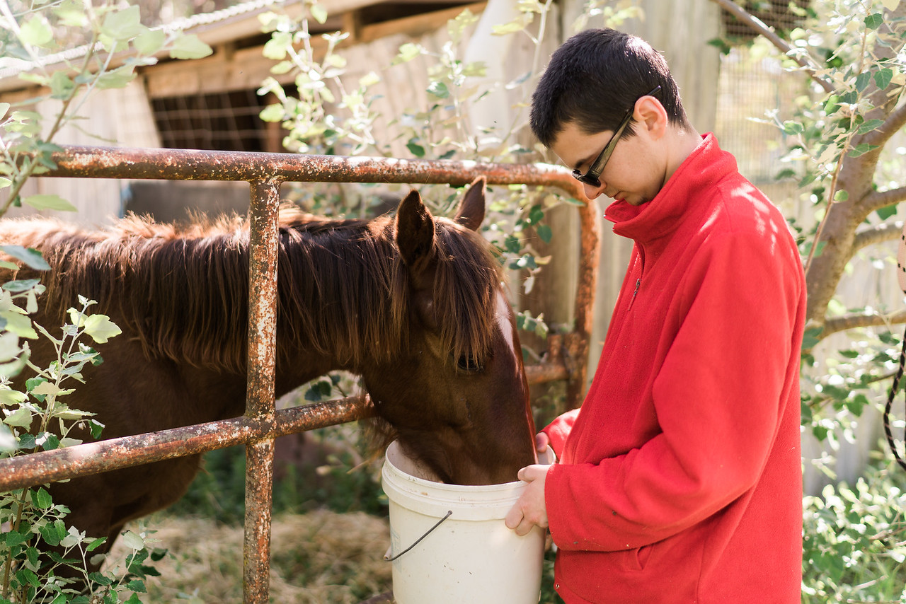
Amir – further reflections
Communication
What do you hope is different at Amir’s next visit?
Scheduling:
  Waiting?
  Liaising with the group home
Transition to adult services
Notes:
S59P Amir – Longer GP or GP Express workshop – Further reflections
Suggested time: 1- 2 minutes
Notes:
For a 1 hour workshop, keep this short - just summarise and move on.
For a longer workshop, you can lead the group in a discussion.
This slide has animations to make the bullet points appear in turn.
Some of these points may have already arisen during the group discussion – summarise briefly if so.
Key points:
Communication is key – need the worker who knows him best present
A GP should not be responsible for getting the group home to schedule supports better.
BUT a pragmatic approach will benefit Amir, make everyone’s day less stressful
Reception staff can speak to group home manager for future scheduling
Consider waiting:
Timing
Place
Distraction
Optional script:
Let’s step back and consider some of the practical challenges of Amir’s case a bit more.
Communication is key and takes time. You can’t know all communication systems. In this case, Amir’s support person also does not know all his signs.
Some things are beyond a GP or nurse’s control, however, you can try to influence them. It is reasonable to expect the group home should schedule the best staff member to accompany Amir. In cases of repeated failure to do this, you can complain to the CEO of the service provider. However, even though this is the group home’s responsibility, it is also pragmatic to ask your reception staff to phone the house manager and let them know if an appointment has been scheduled by someone other than the house manager, and to request that a person’s key worker be present.
Similarly, the fact that he waited 40 minutes may be beyond a GP’s control on the day – things happen. Other urgencies also arise.
However, if we stop and reflect, and think “What do I wish could have happened differently today?” we might find there are some things that might be influenced next time. Particularly by reception staff. For example, if Amir was offered an early morning appointment it is less likely he will have to wait so long.
Other ways to make an appointment more likely to be smooth are:
Allow him to wait outside and call them when it’s his turn; or have him wait in a separate room if available
Ask reception staff to always schedule a long appointment for Amir – given his communication needs this is reasonable
Amir could bring headphones and an iPad. You could suggest it.
Another thing we might try to influence is to know Amir better.
Has anyone had young patients with complex conditions or disability that see their paediatrician more than their GP?
It is common for kids with developmental disability be do so, but it can mean additional efforts are needed when changing to adult services
Multidisciplinary clinics in the children’s hospitals tend to be good at promoting transitions. But those who access private services may not be eligible for them.
For a smoother transition, from around the age of 11 onwards, make sure a paediatrician is copying the GP into every communication – and asking any others health to do so too. Ask everyone to also copy to the family and upload to My Health Record if the person has one.
At this point, we might encourage Amir’s supporters to bring him in more often for regular check ups.

Slide 60
Resources – Medicare item numbers
Notes:
S60P Resources – Medicare Item numbers
Time: Less than 1 minute
Notes:
Only use this slide in a 1.5 or 2 hour workshop for GPs. For a shorter workshop this can only fit if you cut out other information.
It is not pertinent to allied health workers.
Key point:
Refer GPs to the resource in the handouts
They can make this work financially viable
Optional script:
We have sent/will send a list of Medicare item numbers relevant to coordinating care for people with intellectual disability who have complex health needs. People with intellectual disability qualify for annual health assessment using item 703, 705 or 707.
After the health assessment, it’s a matter of using things like team care arrangements with regular review, along with Home medication review.
Amir would be a really good candidate for all of these services because he could benefit from accessing additional allied health services and he is already seeing 2 specialists.
The other thing is to always book a long or prolonged appointment for someone.
This is a reasonable adjustment if they have a communication disability and you know it will take longer. If it turns out they don’t need the whole time you can use that time on other parts of their health care such as to complete paperwork such as liaising with their other health professionals in that time.
Home visits can include long or prolonged appointments. So this becomes more financially viable if someone, like Amir, is living in a group home, and you can see several residents at once.

Slide 61
Case examples
For GPs and Practice Nurses – 1 hour Express workshop
Notes:
S61P Divider Slide - Case examples – GP Express
Suggested Time: 1 minute
Notes:
Notes for introducing and describing the case examples are given in full for these slides. It is best to read them as they are written.

Slide 62
Amelia
For GPs and Practice Nurses in a shorter workshop, or a longer workshop with a supplementary case added
Notes:
S62P Amelia divider slide
You can remove this slide.
The key difference between this version of Amelia’s case study and the one for the longer GP workshop is that additional resources are highlighted here, to allow Kit’s case to be left out of the shorter workshop.

Slide 63
Amelia
Early 20’s
Loves cats, cooking shows
Intellectual disability & cerebral palsy
Group home
Social day program 5 days a week
History of abuse and mental health problems
Staff report recent history of ‘sexualised behaviours’
Notes:
S63P Amelia – GP express workshop
Suggested time: 1.5 minutes:
Notes:
Read the case example as it is written and remind participants that it also appears at the end of their slides handout.
See the appendix to the Training guide for detailed information about this case and the clinical and practical points it highlights, including appropriate reasonable adjustments.
Suggested script
Let’s move on to our second case.
Amelia is a woman in her early 20’s who loves cats and enjoys watching cooking shows on TV.
She has an intellectual disability and cerebral palsy.
She is able to vocalise and use some sign language. However, it is very difficult for people to understand her communication.
This is Amelia’s first visit with you. Her previous GP - whom she saw since she was a child - recently retired. You see two other residents in Amelia’s group home.
Support staff inform you that Amelia has lived in their residential service for the past 3 years. She sees her Mum every weekend.
They tell you she has epilepsy for which she takes medication.
They also tell you that Amelia has a history of trauma – as a teenager she was sexually and physically abused by someone who was not a family member.
In recent years, she has had mental health problems, including a suspected suicide attempt. She has also exhibited behaviours of concern, including non-suicidal self-harm.
Support staff report that for the past month Amelia has exhibited 'sexualised' behaviours – this includes taking off her clothes, exposing her genitals to staff (male and female), and touching her genitals in public.
Staff report that these behaviours are becoming more frequent.
They report that there were no changes in Amelia’s group home or day program close to when these behaviours began, and also no other signs of any mental health crises emerged around then.

Slide 64
Amelia – Your turn
What could be contributing?
First steps?
Next steps?
Notes:
S64P Amelia – GP express workshop – group discussion
Suggested time: 6 - 8 minutes
Notes:
Depending on how dynamic and cooperative your group is, you may no longer need small group discussions – if sufficient participants are volunteering answers just go straight to the whole group discussion. This will save time. However, if your group is reticent, have them share in small groups followed by your summary of the points - then ask if anyone had more to add.
Optional script: (what to say when depends on what answers arise, but potential answers to emphasise are below)
Time now to discuss these questions:
What could be contributing to Amelia’s behaviour?
What are the first steps you would take in response?
What would you do next (i.e. next week or further)
After 3 – 4 minutes (earlier if the room appears to go quieter after some discussion), either share with the broader group; or you go through the answers and invite other input at each stage.
Potential answers to encourage or prompt on could be:
What could be contributing?
Further abuse – she is very vulnerable. People with intellectual disability experience higher rates of all forms of abuse.
Is she on a hormonal contraceptive? Has it changed somehow and could this be contributing to the behaviour?
Is there a communicative element to the behaviour?
Could it relate to seizure activity?
Is it behaviourally driven, or a trauma response from prior abuse?
Note - if mania is suggested, say while it is important to be open to the possibility, it seems there are no other clear symptoms of mania at this stage
First steps?
In this consultation - Speak to Amelia. Introduce yourself. Tell her you are a doctor.
Even if someone is not able to communicate verbally, always acknowledge their presence and show them the respect of saying hello.
Check if the support staff present knows her well and is able to interpret her communication.
Find out what consent arrangements are in place. Ask the Group home for the mother’s contact details and ensure she has been appraised of the situation.
Before the end of the day, ensure Amelia is safe:
Phone the group home manager to discuss staffing for Amelia’s personal care and supervision:
until the underlying cause is identified she needs 2 staff members with her for all personal care and she needs to never be alone.
Ensure adequate support is in place for any excursions
These steps are important not only if there is suspicion of abuse but also to protect her from abuse, as the behaviours make her more vulnerable to it. These steps also protect the staff and ensure that difficult situations can be managed through the least restrictive option.
However it comes at a cost. It’s not guaranteed that increased supports will be covered by NDIS and they certainly can’t increase them without approval of NDIA.
The group home manager could ask her planner to request an urgent change of circumstances review
They may ask the GP for a letter of support – if so, be aware that NDIS will only fund needs that pertain to her disability not medical problems. It can, however, mention her increased risk arising from the behavioural changes
Once a cause is identified, if that cause relates to Amelia’s disability then evidence of increased support needs is needed to fund them under the NDIS. This may require a Positive Behaviour support plan.
See the links in the handouts regarding supporting NDIS eligibility and plan reviews.
Next steps?
Gather more information. Questions to ask could include:
- has this ever happened before?
- Were there any other changes around that time? Changes could be in Amelia’s:
health
medications
lifestyle and surroundings.
Does she appear withdrawn? Irritable?
In fact these questions were asked and the answer to all was no.

Slide 65
Amelia – Your turn
Comprehensive assessment?
  How?
  When?
Notes:
S65P Amelia – GP express workshop – Comprehensive assessment?
Suggested time: 2 minutes
Notes:
If you are running a longer workshop (2 hours), you could ask participants to discuss what they would do for Amelia in the longer term and what allied health services she may benefit from
Key points:
Be mindful of the impact of trauma and the potential for medical trauma.
It is reasonable to plan additional visits to allow the person to get to know you and vice versa.
Outcome: In truth, Amelia had actually consulted numerous allied health professionals before she was brought to see a doctor. The eventual diagnosis was thrush. It was treated and all her behaviours resolved.
Optional script:
Can I see a show of hands:
- Who thinks a comprehensive assessment is indicated at this stage?
- Who thinks it is feasible or wise at this stage?
I see some of you hesitating. Given her prior trauma and the possibility of recent trauma a physical assessment would be very challenging and it may induce further trauma for Amelia if it were done before she felt comfortable.
Remember, this is her first visit. So, you don’t know each other yet.
Instead, ask her mum and the group home staff to arrange repeat visits with Amelia to build rapport and trust. It is reasonable to do this. It also gives you a chance to learn about how Amelia communicates. And ask how she went with physical health checks with her last GP.
What else can you do?
You can ask staff to track her diet, menstrual cycles and discharge, mood, any other behaviours
Conduct a full file review. Why?
She is a new patient,
It allows you to track her history of recent assessments, dental care etc.
Liaise with her neurologist and find out how long since her last review there.
If indicated, ask a local pharmacist to visit her Group home to conduct a medication review - there is a Medicare item for this.
In the longer term, it would be useful to discuss:
Allied health services that may benefit Amelia. For example, a speech therapist may work with her to enhance her communication systems and/or train her support workers to understand her communication better; physiotherapy and OT as she has cerebral palsy, exercise physiologist, too. Some of these services could be added to her NDIS plan at the next review.
Preventative health including cancer screening checks.
The Comprehensive Health Assessment Program prompts all the preventative health care checks for a person’s age.
In truth, Amelia had actually consulted numerous allied health professionals before she was brought to see a doctor. The eventual diagnosis was thrush. It was treated and all her behaviours resolved.

Slide 66
Further reflections?
Recognising:
  Complexity
  Trauma
Reliance on supporters for health care
Missed health conditions are common
Notes:
S66P Amelia – GP express workshop – Further reflections 1
Suggested time: 2 minutes
Notes:
Even though Amelia’s case turned out to have a physical cause, be sure to validate all of the suggestions made by participants. There were so many possibilities and any number of them could have been the eventual diagnosis, the point is to investigate, thoroughly and cautiously.
This slide contains animations to allow the text to appear point by point.
Key points:
Importance of being trauma-aware before doing invasive tests
Recognise complexity means methodical approach is needed – appropriate it takes a while to work through
Resources document includes What not to miss – a list of commonly missed or mismanaged health issues in people with intellectual disability.
Optional script:
Amelia’s case is very complex.
It is appropriate that it takes a while to work out what to do, it is NOT straightforward.
Recognising that complexity and the impact of trauma on a medical assessment is exactly the sort of skill that is needed.
[If the group made suggestions] Lots of great suggestions have come up about adjustments to standard practice, such as booking multiple visits, liaising with the Group home manager and with Amelia’s mother for information, and doing a file review.
Amelia‘s case also highlights how someone like Amelia is entirely reliant on others to help them seek health care.
And finally, it highlights how easily a health condition can be overlooked. There are many commonly missed health conditions in people with intellectual disability. We have already shared with you [or will share with you] a handout on commonly missed conditions. Thrush is actually not a common one, things like constipation and reflux are far more commonly missed.
Any number of the suggested diagnoses could have been the answer. So, it highlights the importance of adopting a thorough approach to assessing potential causes for behavioural change in a person with intellectual disability.

Slide 67
Diagnostic overshadowing
Mistakenly attributing a person’s symptoms to their disability
or to a mental health or behavioural problem.
For any change in behaviour:
Physical health
Mental health
Social / trauma / environment
Behaviour
Notes:
S67P Diagnostic overshadowing
Suggested time: 1-2 minutes
Notes:
This concept may have already come up in discussion. If so, highlight that participants also made this point and it is a very important one, so here is the official definition.
Key points:
Define diagnostic overshadowing – to emphasise the importance of proactive and methodical health checks
A methodical approach overcomes this.
Any change in behaviour should be assessed in order of: physical, mental health, social/environment and behaviour
Optional script:
Amelia’s case is a classic example of what we call diagnostic overshadowing.
This is where someone mistakenly attributes a person’s symptoms to their disability, or to a mental health or behavioural problem.
As you can imagine, this results in:
delays to care;
unnecessary comorbidity;
and it can be dangerous or even fatal.
So how can a clinician avoid this? It really boils down to applying the clinical skills you already have, in a systematic fashion:
- Always look at physical then mental health and then environmental explanations for a change in behaviour. No matter the social history - always look for evidence of medical issues first.

Slide 68
Further reflections?
Value of annual health checks
Adjustments to practice
Opportunistic investigations
https://eshop.uniquest.com.au/chap/
Notes:
S68P Amelia – GP express - Further reflections 2
Suggested time: 2 minutes
Notes:
To keep momentum going in the room, keep this part short and punchy.
If people have already mentioned some of these points when sharing their insights, then say something like “We’ve already had fantastic insights shared about…. “, and summarise those things verbally before asking if anything else stood out for them.
When showcasing the Comprehensive Health Assessment Program, give up to date information about the cost and availability as a hard-copy or electronic form. At the time of writing, this was changing. Please check for up-to-date information before you run a session.
Key points:
Showcase the Comprehensive Health Assessment Program as a tool to ensure a methodical way approach to annual health checks:
The only evidence-based tool in Australia
Identifies unmet health needs and promotes education for all involved
Includes gathering of important health history information before the health check
Adjustments at the whole of practice level can improve health care.
Sometimes sedation is needed to assess – if so arrange other needed tests.
Optional script:
The potential for diagnostic overshadowing and missed conditions case underscores the value in annual health checks.
One way to ensure a comprehensive annual health check is through use of a tool. Can I see a show of hands of who has heard of the Comprehensive Annual health Program, also known as the CHAP tool? And keep your hand up if you’ve ever used it? Great so some of you are already using it. For those who don’t know it, this is what it looks like (click mouse).
Essentially it is a form in two parts. The first is a survey completed by the person with support as needed. And the second part guides a GP through the steps to ensure a comprehensive assessment. It’s been specifically designed for use with people with intellectual disability and it prompts you to do necessary preventative health checks at particular ages. The link for the CHAP is there on the screen and is included in your workshop handouts.
The CHAP is the only evidence-based tool that has been proven in Australia to identify unmet health needs in people with intellectual disability. The evidence for its effectiveness comes from 3 randomised controlled trials.
It encourages the gathering of a comprehensive health history and provides access to healthcare. It also educates to all those involved in the process, prompts everyone in the process to maximise healthcare delivered to the person and encourages follow up when problems are found.
The Comprehensive Health Assessment Program includes some features that don’t appear in other pro-formas, such as the history gathering prior to the consultation, and specific tips for the clinician regarding things to look out for. These elements of the CHAP educate and train people with disability, their family or support workers, and encourage them to advocate if they think problems are missed or poorly managed.
The other thing this case highlights is the potential to need an anaesthetic in order to perform an adequate physical exam in someone who cannot tolerate any invasive tests. If Amelia were to need a GA, what would you want to do ahead of that? [Give time to answer].
Liaising with the hospital ahead of time is useful, because if that’s to happen you want to take advantage of it to get as many checks done as possible. This could include preventative cancer screening checks along with dental checks and cleaning, vaccinations and blood tests. We have included in the handouts a link to a document about such opportunistic investigations.
You will need to liaise with clinicians at the hospital but often a physician from an adult rehab unit will be able to direct this.
A GP can also provide the person or their supporters with a general bloods form that has the standard full blood count and full metabolic panel on it, as well as anything else you’d like to check, based on their risk factors. It can also just be a letter. They can keep that on file and if the person needs a blood test for any reason, like they have an accident and go to hospital, or if a specialist wants something, then it can all be done in one blood draw.

Slide 69
Resources
tg.org.au
Notes:
S69P Amelia – GP express – Highlight resources
Suggested time: 1 – 2 minutes
Key point:
Showcase the Therapeutic Guidelines – requires subscription but excellent, Australian, comprehensive, and recently updated
Optional script:
There are a couple of other resources that are worth highlighting here.
The Therapeutic Guidelines is an excellent resource. There is a chapter on Developmental Disability, which includes tips for communicating with people with intellectual disability as well as covering common health problems. There is also a chapter on psychotropic prescribing which is not specific to people with intellectual disability but it is a great resource nonetheless and applicable to this group because many people with intellectual disability are prescribed psychotropics. The guidelines have recently been updated and are available online as a subscription service.

Slide 70
Resources – HealthPathways
Insert an image of your local HealthPathways webpage here.
If the section on intellectual disability is suitable to show then use that.
URL for your healthpathways log in page goes here
Notes:
S70P GP express - Your HealthPathways
Suggested time: 1 minute
Notes:
You must tailor this slide for your PHN.
Key point:
Outline what your local HealthPathways can offer that is specific to intellectual disability health.

Slide 71
Amir
For GPs and Practice Nurses in a shorter workshop, or a longer workshop with a supplementary case added
Notes:
S71P Amir divider slide
You can remove this slide.
The key difference between this version of Amir’s case study and the one in longer workshops is that the Medicare item numbers are simply mentioned rather than showcased, to save time.

Slide 72
Amir
19 years old
  Enjoys bush walking, time with family, visiting family farm
  Moderate intellectual disability; some sign language
  Epilepsy – Tegretol 8+ years
Stopped eating past 3 weeks
  5 – 6 months increasingly ‘picky’ eater
  Food avoidance
  Medication – worse
  1 - 2 banana smoothies a day
Notes:
S72P Amir - Longer GP or GP Express workshop
Suggested time: 2 minutes.
Notes:
Read the case study as it is written.
See the appendix to the Training guide for detailed information about this case and the clinical and practical points it highlights, including appropriate reasonable adjustments.
Risperidone is an anti-psychotic and when prescribed for behaviours of concern it is considered a restrictive practice. Appetite stimulation and weight gain is a major side effect. 3 mg is quite a high dose for someone who is underweight.
Tegretol is an anti-epileptic drug that interacts with a number of other drugs.
Suggested script:
Amir is a 19 year old man who enjoys walks and spending time with his family. He moved to a group home 8 months ago. He visits his family’s farm one weekend a month.
He has an intellectual disability in the moderate range. He needs support in many areas, including for planning his activities, as well as some more complex self-care activities such as shaving. Amir has no speech - he communicates through basic sign language.
Amir attended a special education school where his parents report he received excellent support. The transition to post-school options was difficult and he often refused to go. This was a reason for his move into residential care. He still frequently refuses to attend the program and on these days he spends most of the day on his bed watching TV.
Most of Amir’s health care to date has been provided by a developmental paediatrician, who has liaised with a paediatric neurologist and more recently a child and adolescent psychiatrist. As a result, Amir has only seen you sporadically. He previously accessed some allied health services through the children’s hospital but now he has transitioned out of the children’s services. He still sees his psychiatrist 3 times a year and neurologist biannually.
Amir’s medical history includes Epilepsy, which appears to be well controlled using Tegretol. His parents made the appointment and asked group home staff to bring him to see you because he has been refusing to eat for 3 weeks.
Staff report Amir has always been a picky eater while in their care but this has gradually become worse. A few months back, Amir’s psychiatrist prescribed 3mg risperidone for behaviours of concern – it was hoped this would help his eating but it seems to be even worse since then. Amir stopped eating following a choking episode exactly 3 weeks ago – he appears ‘scared’ of food since this time. He refuses to go to the table for meals. He will eat small amounts of banana smoothie, only.
Amir appears very thin and underweight. By the time you see him, he has been in the waiting room for 40 minutes and he is agitated, though no one knows exactly why. He appears to be trying to communicate but the staff member who has come with Amir is not his key worker and does not know all of his signs.

Slide 73
Amir – first steps, and beyond
What are some possible contributors to Amir’s food refusal?
is the first thing you would do?
What can be done longer term?
Annual health assessment
Care co-ordination: Transitions, allied health
Notes:
S73P Amir – Longer GP or GP Express workshop - First steps
Suggested time: 10 minutes
Notes:
At the end, you can share the outcome. It is written in italics.
Provided the group is volunteering answers, you can skip small group discussions and ask the whole group for answers if using this as your second or third case. Use the extra prompt questions to keep the discussion quick and dynamic.
Optional script: (what to say when depends on what answers arise, but potential answers to emphasise are below)
Ask the group to suggest answers for any of the following questions.
1. What is the first thing you would do?
Follow-up prompts if needed:
What is the most important thing to do right now?
Would you try to weigh him?
Would you take a history? If so, what would you ask about?
Could Amir be experiencing pain? How would you assess it?
Answers to emphasise or prompt:
1st thing to do: engage with Amir. Say hello.
Getting a history:
Weight
Past swallowing problems
Other possible causes – constipation, reflux, dental problems, ear infections, any history of abuse, signs of mental health problems including depression or PTSD.
Recent changes in behaviour – did the group home staff document them?
Some of these answers could be in his file notes.
Assessing pain:
you could try using visuals (validate the suggestion), but this is unlikely to be successful when he is distressed. A sensible approach is to ask them to make another appointment.
You could also ask those who know him well about any other recent changes in his behaviour
Would you try to weigh Amir?
- Only if he calmed down and appeared to asset to it. It would be helpful to establish if the person who has brought him knows his yes/no signs.
What is the most important thing to do right now?
No assessment is possible in this appointment – he is distressed
Must convey to staff the importance of hydration. Call a chemist – ask about a high-quality over the counter nutritional supplement. If he does not like that, then if possible, staff can get Amir’s assent and/or his parents’ consent as appropriate, to adding extra nutrients to the banana smoothies. If he does not assent, the group home may need to firstly seek approval as it could be deemed a restricted practice. A health professional can help by providing documentation of his medical condition.
Arrange swallowing assessment urgently by a specialist speech therapist.
Amir is at risk of choking, aspiration of food into his lungs, blocking his airways, and even dying from this.
Check health pathways for speech therapists to refer to, or
Ring the hospital speech pathology department.
Ask the family and group home manager to make another appointment ASAP when either the parents or Amir’s keyworker can come and can interpret Amir’s signs.
Could this be a medication reaction? Things got worse with risperidone.
Risperidone can – rarely - lead dysphagia, and so could explain the worsening of his symptoms
People with intellectual disability are more likely than others to experience adverse reactions to psychotropic medications.
How do you deal with this possibility?
Speak with the prescribing psychiatrist, review any information they have sent about the reasons for prescription.
Ask the psychiatrist to advise on significantly reducing, or ceasing the medication.
How would you ensure this is done safely?
It must be considered case by case, with regard for the reason for prescribing and any diagnosis.
- If it is primarily prescribed to address behaviours of concern then this is a restrictive practice.
What else would you do for Amir in the longer term?
Refer to a dietitian – to build weight and ensure adequate nutrition
Refer to any other allied health professionals he has lost when leaving child services but could still benefit from
Ensure review occurs to see if this issue is resolved
Ensure annual health assessments are done. An annual health assessment may have revealed these concerns sooner.
If no physical cause were determined, refer to a specialist psychologist or behaviour support practitioner for further assessment of the behaviour.
Share the outcome:
A swallowing assessment suggested oesophageal dysphagia. An urgent referral to a gastroenterologist was made for further assessment. The psychiatrist agreed to having Amir discontinue the risperidone under the GP’s supervision.
The speech therapist recommended a thickened liquid diet whilst awaiting gastroenterology assessment and thereafter pending gastroenterology results and advice.
The dietitian assisted with planning a very high nutrition liquid diet with review once Amir’s BMI reaches 18.5.
The group home agreed to weigh Amir every week and will report any weight loss immediately.

Slide 74
Amir – further reflections
Communication
What do you hope is different at Amir’s next visit?
Scheduling:
  Waiting?
  Liaising with the group home
Transition to adult services
Notes:
S74P Amir – Longer GP or GP Express workshop – Further reflections
Suggested time: 1- 2 minutes
Notes:
For a 1 hour workshop, keep this short - just summarise and move on.
For a longer workshop, you can lead the group in a discussion.
This slide has animations to make the bullet points appear in turn.
Some of these points may have already arisen during the group discussion – summarise briefly if so.
Key points:
Communication is key – need the worker who knows him best present
A GP should not be responsible for getting the group home to schedule supports better.
BUT a pragmatic approach will benefit Amir, make everyone’s day less stressful
Reception staff can speak to group home manager for future scheduling
Consider waiting:
Timing
Place
Distraction
Optional script:
Let’s step back and consider some of the practical challenges of Amir’s case a bit more.
Communication is key and takes time. You can’t know all communication systems. In this case, Amir’s support person also does not know all his signs.
Some things are beyond a GP or nurse’s control, however, you can try to influence them. It is reasonable to expect the group home should schedule the best staff member to accompany Amir. In cases of repeated failure to do this, you can complain to the CEO of the service provider. However, even though this is the group home’s responsibility, it is also pragmatic to ask your reception staff to phone the house manager and let them know if an appointment has been scheduled by someone other than the house manager, and to request that a person’s key worker be present.
Similarly, the fact that he waited 40 minutes may be beyond a GP’s control on the day – things happen. Other urgencies also arise.
However, if we stop and reflect, and think “What do I wish could have happened differently today?” we might find there are some things that might be influenced next time. Particularly by reception staff. For example, if Amir was offered an early morning appointment it is less likely he will have to wait so long.
Other ways to make an appointment more likely to be smooth are:
Allow him to wait outside and call them when it’s his turn; or have him wait in a separate room if available
Ask reception staff to always schedule a long appointment for Amir – given his communication needs this is reasonable
Amir could bring headphones and an iPad. You could suggest it.
Another thing we might try to influence is to know Amir better.
Has anyone had young patients with complex conditions or disability that see their paediatrician more than their GP?
It is common for kids with developmental disability be do so, but it can mean additional efforts are needed when changing to adult services
Multidisciplinary clinics in the children’s hospitals tend to be good at promoting transitions. But those who access private services may not be eligible for them.
For a smoother transition, from around the age of 11 onwards, make sure a paediatrician is copying the GP into every communication – and asking any others health to do so too. Ask everyone to also copy to the family and upload to My Health Record if the person has one.
At this point, we might encourage Amir’s supporters to bring him in more often for regular check ups. Amir would be a really good candidate for a health assessment and following that, a Team Care arrangement with regular followup. We have sent/will send a list of Medicare item numbers relevant to coordinating care for people with intellectual disability who have complex health needs.

Slide 75
Polypharmacy and restrictive practices
Common in people with intellectual disability
Consider anti-cholinergic burden:
  Especially people with Down syndrome
What do you do?
NHS England » Stopping over medication of people with a learning disability, autism or both (STOMP)
Notes:
S75P Amir – Longer GP or GP Express workshop; also for pharmacists and mental health workers – Polypharmacy
Suggested time: 2 minutes
Notes:
Click the mouse again to reveal the text “What do you do?” and then give people a chance to answer
This slide has animations.
Please check if the POMPIDA website is live before running the workshop. It was planned at the time of writing. If possible, insert the link and their logo into the slide.
Key points:
Polypharmacy is common in people with intellectual disability and is of major concern due to:
Cumulative and compounding side effects and long term health risks
Many drugs have anticholinergic effects – they may be of particular concern
Polypharmacy may require special approval if it involves multiple psychotropics with cumulative doses outside the accepted mode of treatment for such a person.
STOMP protocol is a resource from UK about de-prescribing.
For complex cases, seek a pharmacist’s advice first
GPs can refer for home medicine review through Medicare,
Check POMPIDA resources – Pharmacists Optimising Medication in People with Intellectual Disability and Austim.
Positive Behaviour Support specialists can request a review from a pharmacist.
Optional script:
Amir’s case highlights the risks associated with polypharmacy:
Carbamazepine (Tegretol) has a high anticholinergic burden compared with other anti-epileptic drugs
Furthermore, Tegretol may be associated with behavior disturbance, which in Amir’s case is then being treated with risperidone. Tegretol also interacts with many drugs, including Risepridone – such that a higher dose is needed before effects of the Risperidone are seen.
Risperidone does not have a high anticholinergic burden, but both these meds can have nervous system side effects and both can cause gastrointestinal upsets.
Drugs with anticholinergic effects can severely impact the health outcomes of people with intellectual disability:
Cardiovascular effects compound lifestyle factors, and diet and exercise in people with intellectual disability is often really poor
There is also an increased dementia risk arising from overuse of these drugs. Which is why we have a note here about the importance of considering anticholinergic burden for people with Down syndrome because they are at really high risk of early onset Alzheimer’s disease
Use of an antipsychotic drug to address challenging behaviour in the absence of a mental health diagnosis is a restrictive practice. It is only appropriate in the case of behaviours of concern which are so severe they pose a risk to the safety of the person or those around them, and where non-pharmacological treatments have failed.
Using drugs for challenging behaviours requires a person to have in place a Positive Behaviour Support plan, which is regularly reviewed. But the dose should also be regularly reviewed.
However, in some states (e.g. NSW), if a person’s treatment for a diagnosed mental health disorder involves the administration of 1 or more psychotropics and the dosage levels, combinations or numbers of restricted substances used, or the duration of the treatment, are outside the accepted mode of treatment for such a patient, this requires consent from a tribunal rather than a person responsible. Depending on the specific drugs used and their reason, polypharmacy may fall into this category of treatment.
So, if your patient, like Amir, is currently on a less-than-ideal drug or a mix of drugs, what do you do?
Answers to encourage:
Home based medicines review
Not only can the pharmacist highlight concerns, they can also advise the best order in which to de-prescribe
Check out the POMPIDA resources on how a Positive Behaviour Support specialist can request a mini review, through supervision of themselves, from a pharmacist. A GP may then be asked for a referral to do the fuller, Medicare-based review.
Same principles as for safe prescribing apply:
Review reasons for prescribing
Ensure close supervision throughout
Ensure the person and their supporters knows what to do, and what side effects to watch for
Go slow
Check out the STOMP website which we have shared in your handouts, focused on de-prescribing.

Slide 76
Case examples
For Allied Health Workers
Notes:
S76P Divider Slide - Case examples – Allied health (MH)
Suggested Time: 1 minute
Notes:
Notes for introducing and describing the case examples are given in full for these slides. It is best to read them as they are written.

Slide 77
Kit
For Behaviour Support Specialists, Counsellors, and Psychologists
Notes:
S77P Kit cover slide (can be removed)
The following slides contain case studies more appropriate for allied health audiences.

Slide 78
Kit
51 year old man
Enjoys gardening and Star Wars
Mild intellectual disability; speaks
Lives with mother, Sherrie
Recently lost father; lost job
Mental health history – SSRI anti-depressant
↑ irritable – aggression to Mum
Notes:
S78P Kit - Allied health professionals
Suggested Time: 1.5 minutes
Notes:
Read the case study as it is written.
See the appendix to the Training guide for detailed information about this case and the clinical and practical points it highlights, including appropriate reasonable adjustments.
SSRI stands for Selective Serotonin Reuptake Inhibitor, a commonly prescribed type of antidepressant.
Kit is a 51 year old man who enjoys gardening and Star Wars.
He lives with his mother Sherrie. His father David passed away last year. Kit also has a sister who lives interstate.
Kit’s father used to drive him to work where he restocked shelves at a small grocery store. Since his father’s passing, Kit left his job as it was too difficult to get there. His only NDIS supports cover his psychology services.
Kit has a history of anxiety, for which he takes an antidepressant (an SSRI). This was first prescribed by a psychiatrist over 10 years ago and the dose has remained stable for the past 8 years.
In the past year, Kit has become increasingly irritable, and on two occasions he has become aggressive towards Sherrie. Sherrie, who is 76 and has a history of osteoporosis, is concerned for her own safety, and for Kit’s wellbeing.
Kit has seen his psychologist 6 times so far this year to try to reduce his levels of agitation to discuss behaviour management. However, it is not working.
They have come to you for further assistance.

Slide 79
Kit
What is going on?
First steps?
Ongoing?
Notes:
S79P Kit – Small group discussion – Allied health care
Time: 8 minutes
Notes:
Read the italicised “extra info” as it is written.
The prompt at the bottom can be used or not, depending on the experience of the participants and their profession.
Key points:
Huge number of potential contributors
Missed health conditions common
Ask permission to include a supporter – don’t assume
Consider family members’ needs and ask about these separately
Optional script: (what to say when depends on what answers arise, but potential answers to emphasise are below)
With the person or people closest to you, answer about the following questions:
What could be going on for Kit?
What is the first thing to do?
What should you do for Kit going forth?
Give people 3 -4 minutes to discuss in small groups then ask the groups to share their insights. The answers to emphasise are:
What could be going on?
Medical problem
Depression
Anxiety
Reaction to grief
Prodromal dementia
Behaviours
Medication reaction – even though he has been on the SSRI for some years, he could now experience new side effects with age
Other unrecognised physical or mental health problem.
First steps:
Talk to Kit. Ask him if he wants Sherrie to stay or leave the room while you talk.
Ask if they have seen Kit’s GP. If not, urge them to see the GP first.
Other short-term steps:
Find out what the psychologist has attempted so far.
Ensuring Sherrie's safety is important. Gather more detail about the aggression. Will she consider respite care until the behaviour is settled? A conversation about Sherrie's needs should to occur without Kit in the room. Phone Sherrie if needed.
What else needs to happen in the long term?
Talking with Sherrie about planning supports to ensure both Kit and her wellbeing
Do they have adequate supports?
Discussing an eventual planned transition of care arrangements is an important topic given Sherrie's age. Kit is capable of being involved in decisions about his future care. Getting his views now (rather than in a crisis or when his own health or capacity declines) would be better. The original psychologist could also help with this.
discuss whether he can access a day program or respite services; or whether he wants to find work again
At the end of the group discussion, add:
As it turns out – the GP did investigate and Kit was extremely constipated. Laxatives and exercise were prescribed.
How does this change your management plan?
Reasonable to still review – assess for any ongoing agitation, aggression, (or suggest they go back to original psychologist for this)
Reasonable to still undertake the other things discussed.
[Optional Prompt]: How would you ensure you got the best communication with Kit?
Potential Answers:
Have visuals ready.
Ask single questions at a time
If an open question gets no response, try a closed question
Check he has understood you and you are understanding him.

Slide 80
Further reflections?
Reliance on supporters for health care
Role of allied health workers to encourage families to plan future care needs
Value of annual health checks
Missed health conditions common
Notes:
S80P Kit – Further reflections? – Allied health workers
Time: 2 minutes
Notes:
If you are not also using the case study of Amelia, then use the next slide in place of this one for Kit.
Key points:
Reliance on supporters for health care
Role of allied health workers to encourage families to plan future care needs
Value of annual health checks
Missed health conditions common
Optional script:
Kit’s case highlights one of the most commonly missed health problems in people with intellectual disability – constipation.
One of the handouts we will send you after this training is a 1-pager on conditions which are often missed or mismanaged for people with intellectual disability.
It also highlights:
The vulnerability of someone who relies on another person to proactively maintain their health.
The role of an allied health professional in encouraging families to engage in meaningful conversations with a person with intellectual disability about their own choices for their future care. Kit is very capable of understanding care options and with support he could choose between them, but so far he has not been afforded that opportunity and without planning he may need to move in a crisis (his own or his mum’s).
The potential for side effects from medications someone has been on for some time - frailty (impacting meds) at an earlier age
The sequel of impacts that can occur following a change in someone’s circumstances: Kit’s father’s passing meant he no longer went to work, which may have contributed to his constipation through sedentary lifestyle. Work was likely a positive thing for Kit and it’s been replaced by nothing. There is a need here for identifying suitable supports to ensure he can either continue to work or be engaged in a suitable alternate activity.

Slide 81
Some key points
Missed health conditions common.
Any change in behaviour:
Reliance on supporters for health care
Role of allied health workers to encourage families to plan future care needs
Value of annual health checks
Physical health
Mental health
Social / trauma / environment
Behaviour
Notes:
S81P Kit – Some key points – Allied health workers
Time: 5 minutes
Notes:
Emphasise that a post-workshop handout will be a list of commonly missed and mismanaged conditions.
If you are also using the case study of Amelia, then use the previous slide in place of this one for Kit.
This slide has animations.
Key points:
Reliance on supporters for health care
Role of allied health workers to encourage families to plan future care needs
Value of annual health checks
Missed health conditions common.
Any change in behaviour should be assessed in order of: physical, mental health, social/environment and behaviour
Optional script:
Kit’s case highlights one of the most commonly missed health problems in people with intellectual disability – constipation.
One of the handouts we will send you after this training is a 1-pager on conditions which are often missed or mismanaged for people with intellectual disability.
Changed behaviour must ALWAYS be assessed firstly through physical health, THEN mental health, THEN social elements including trauma or environmental elements, and only once all of those things have been excluded is it appropriate to consider it may be behavioural in origin.
It is difficult because as allied health workers, it is not your role to do the earliest checks.
However, you have an important role to play in asking if it has been done – because it is so often missed, and because a lot of time and energy can be wasted on an inappropriate intervention – and in some cases that can lead to a worsening of a medical condition, which can even prove dangerous.
When someone has not yet seen their GP, it is easy to say “Go see your GP”. But what would you do if a client came to you with what seemed to be a behavioural/communication problem, which has emerged or changed recently, and they have seen their GP but the only thing the GP did was send them to you? What do you do? Has anyone had that happen?
Answers to emphasise – speak to the client and their supporters, gather relevant evidence and history in the initial consultation, but also write back to their GP to ask them to clarify if a thorough health check to investigate possible physical causes has been undertaken or is planned, and refer to the therapeutic guidelines about this. A link to these will be included in the post-workshop handouts - https://www.tg.org.au/ - it is a subscription service but many health professionals do already subscribe.
Kit’s case also highlights a number of other things which can commonly apply for people with intellectual disability:
The vulnerability of someone who relies on another person to proactively maintain their health.
The role of an allied health professional in encouraging families to engage in meaningful conversations with a person with intellectual disability about their own choices for their future care. Kit is very capable of understanding care options and with support he could choose between them, but so far he has not been afforded that opportunity and without planning he may need to move in a crisis (his own or his mum’s).
The potential for side effects from medications someone has been on for some time - frailty (impacting meds) at an earlier age
The sequel of impacts that can occur following a change in someone’s circumstances: Kit’s father’s passing meant he no longer went to work, which may have contributed to his constipation through sedentary lifestyle. Work was likely a positive thing for Kit and it’s been replaced by nothing. There is a need here for identifying suitable supports to ensure he can either continue to work or be engaged in a suitable alternate activity.

Slide 82
Amelia
For Behaviour Support Specialists, Counsellors, Psychologists, Speech Therapists
Notes:
S82P Amelia cover slide
The following slides contain case studies more appropriate for allied health audiences.

Slide 83
Amelia
Early 20’s
Loves cats, cooking shows
Intellectual disability & cerebral palsy
Group home
Social day program 5 days a week
History of abuse and mental health problems
Staff report recent history of ‘sexualised behaviours’
Notes:
S83P Amelia – Allied Health Professionals
Suggested time: 1.5 minutes:
Notes:
Read the case study as it is written.
See the appendix to the Training guide for detailed information about this case and the clinical and practical points it highlights, including appropriate reasonable adjustments.
Answers appropriate for allied health workers will vary based on their profession. Some general ideas are presented here. Work with the health professional involved in your training to understand what they think is important to highlight for their specific profession. They can make minor adjustments to the slide and notes.
Suggested script:
Amelia is a woman in her early 20’s who loves cats and enjoys watching cooking shows on TV.
She has an intellectual disability and cerebral palsy.
She is able to vocalise and use some sign language. However, it is very difficult for people to understand her communication.
This is Amelia’s first visit with you. Support staff inform you that Amelia has lived in their residential service for the past 3 years. She sees her Mum every weekend. They tell you she has epilepsy for which she takes medication.
They also tell you that Amelia has a history of trauma – as a teenager she was sexually and physically abused by someone who was not a family member.
In recent years, she has had mental health problems, including a suspected suicide attempt. She has also exhibited behaviours of concern, including non-suicidal self-harm.
Support staff report that for the past month Amelia has exhibited 'sexualised' behaviours – this includes taking off her clothes, exposing her genitals to staff (male and female), and touching her genitals in public.
Staff report that these behaviours are becoming more frequent.
They report that there were no changes in Amelia’s group home or day program close to that time also no other signs of any mental health crises around then.

Slide 84
Amelia – Your turn
What would you do?
Notes:
S84P Amelia – Allied Health Professionals – your turn
Suggested time: 8 minutes
Notes:
Depending on how dynamic and cooperative your group is, you may no longer need small group discussions – if sufficient participants are volunteering answers just go straight to the whole group discussion.
If your group is reticent, have them share in small groups and then you summarise the points and ask if anyone had more to add.
Optional script: (what to say when depends on what answers arise, but potential answers to emphasise are below)
In small groups / as a group, discuss: What would you do?
[If a further prompt is needed – what is the first thing you would do? Or - What is your main priority?]
[After 3-4 minutes (or when there is a general quietening in the room), bring them back to share in with the broader group; or alternately, you go through the options and invite input]
Answers to encourage include:
Engage with Amelia, introduce yourself if not already
Ask if Amelia typically consents for services or if someone support her for decision-making?
Check if the support staff present knows her well and is able to interpret her communication. If not (and someone else can) – explain the need to reschedule when someone is available to interpret
Ensure Amelia is safe:
Phone the group home manager to discuss staffing for Amelia’s personal care and supervision:
Until the underlying cause is identified she needs 2 staff members with her for all personal care and she needs to never be alone.
Ensure adequate support is in place for any excursions
These steps are important not only out of suspicion of abuse but also to protect her from abuse as the behaviours make her more vulnerable to it. These steps also protect the staff and ensure that difficult situations can be managed through the least restrictive option.
However they also come at a cost. It’s not guaranteed that increased supports will be covered by NDIS and they certainly can’t increase them without approval of NDIA.
The group home manager could ask her planner to request an urgent change of circumstances review
They may ask an allied health professional for a letter of support – if so, be aware that NDIS will only fund needs that pertain to her disability not medical problems. It can, however, mention her increased risk arising from the behavioural changes
Once a cause is identified, if that cause relates to Amelia’s disability then evidence of increased support needs is needed to fund them under the NDIS. This may require a Positive Behaviour support plan.
See the links in the handouts regarding supporting NDIS eligibility and plan reviews.
Gather further history:
Prior mental health episodes – what were they like? How long did they last? Did similar behaviour occur?

Slide 85
Amelia – Longer term
  Redirection
Functional assessment
Education
Notes:
S85P Amelia – Longer term
Suggested time: 4 minutes
Notes:
Be sure to read out the text in italics which gives the outcome of the case. Then pause to give people time to react, before continuing with the next steps.
Key points:
All other investigations yielded no answers.
The eventual diagnosis was thrush.
Optional script:
A psychological interview reveals no other current concerns about Amelia’s mental health:
During her prior mental health episodes, Amelia displayed signs of distress such as crying, withdrawing to her room, reduced signing or vocalisation, and refusing to cooperate with any self care. None of these things have occurred lately.
Instead, when asked how she is, Amelia signs ‘good’ and ‘happy’
Staff and her mother report that she continues to engage with her regular activities with her typical level of enthusiasm.
The group home manager investigates and confirms that no changes in staff or attendance occurred at either Amelia’s home or day program. Amelia’s mum confirms that during Amelia’s visits, no other visitors were present.
Would you do a functional assessment of Amelia’s behaviour at this point? (gauge reactions)
One was done – it revealed confusing results:
There were no specific antecedents,
No specific consequents.
It occurred when alone and around others.
For the real-life Amelia, here is what happened:
- A behaviour support plan was developed to redirect Amelia to an engaging activity whenever these behaviours occurred. This had success in the moment but the behaviour continued as frequently as before.
- Visual aids were used to communicate when to keep clothes on and when it was appropriate to remove them. Any time Amelia removed her clothes she was referred back to these visuals.
- Her key worker attempted to used easy read materials and other visual resources to educate Amelia about appropriate times and places to masturbate.
- A speech therapist was engaged to assist Amelia to communicate more clearly.
Finally after some time, someone thought to consult a medical practitioner who undertook a thorough medical investigation. This revealed that Amelia had a candida (thrush) infection. A single dose of oral medication was sufficient to treat it and after a short while all of Amelia’s behaviours of concern stopped.
So, once the thrush is identified and treated – what should happen now? Is there any more we could do for her?
Arrange a speech therapist - continue to work towards improving her expressive communication. Also work with supporters to hopefully identify some of Amelia’s communications.

Slide 86
Amelia – further reflections
  Any change in behaviour:
Physical health
Mental health
Social / trauma / environment
Behaviour
Notes:
S86P Amelia – Allied health - Further reflections
Suggested time: 1 minute
Notes:
There are many health conditions which are more commonly missed in people with intellectual disability. Candida is not amongst the “commonly missed conditions” list. However, Amelia’s case highlights how easy it is to overlook physical causes for what appears to be related to mental health or behaviour. The complexity of her history also makes such an oversight more likely.
Key points:
Any change in behaviour should be assessed in order of: physical, mental health, social/environment and behaviour
Allied health professionals should be vigilant in checking if a person has seen a medical professional about a change in behaviour, and assertive in suggesting that medical causes be ruled out first.
Optional script:
There are many health conditions which are more commonly missed in people with intellectual disability. Candida is not amongst the “commonly missed conditions” list.
However, Amelia’s case highlights how easy it is to overlook physical causes for what appears to be related to mental health or behaviour.
The complexity of her history also makes such an oversight more likely.
Changed behaviour must ALWAYS be assessed firstly through physical health, THEN mental health, THEN social elements including trauma or environmental elements, and only once all of those things have been excluded is it appropriate to consider it may be behavioural in origin.
It is difficult because as allied health workers, it is not your role to do the earliest checks.
However, you have an important role to play in asking if it has been done – because it is so often missed, and because a lot of time and energy can be wasted on an inappropriate intervention – and in some cases that can lead to a worsening of a medical condition, which can even prove dangerous.
When someone has not yet seen their GP, it is easy to say “Go see your GP”. But what would you do if a client came to you with what seemed to be a behavioural/communication problem, which has emerged or changed recently, and they have seen their GP but the only thing the GP did was send them to you? What do you do? Has anyone had that happen?
Answers to emphasise – speak to the client and their supporters, gather relevant evidence and history in the initial consultation, but also write back to their GP to ask them to clarify if a thorough health check to investigate possible physical causes has been undertaken or is planned, and refer to the therapeutic guidelines about this. A link to these will be included in the post-workshop handouts - https://www.tg.org.au/ - it is a subscription service but many health professionals do already subscribe.
.

Slide 87
Amir
For Behaviour Support Specialists, Counsellors, and Psychologists, Speech therapists
Notes:
S87P Amir divider slide
The following slides contain case studies more appropriate for allied health audiences.

Slide 88
Amir
19 years old
  Enjoys bush walking, time with family, visiting his family’s farm
  Moderate intellectual disability; some sign language
Epilepsy – medication 8+ years
Stopped eating past 3 weeks
  5 – 6 months increasingly ‘picky’ eater
  Food-related agitation
  Medication – worse
  1 - 2 banana smoothies a day
Notes:
S88P Amir – Allied health workers
Suggested time: 2 minutes.
Notes:
Read the case study as it is written.
See the appendix to the Training guide for detailed information about this case and the clinical and practical points it highlights, including appropriate reasonable adjustments.
Risperidone is an anti-psychotic and when prescribed for behaviours of concern it is considered a restrictive practice. Appetite stimulation and weight gain is a major side effect.
Suggested script:
Amir is a 19 year old man who enjoys walks and spending time with his family.
He has an intellectual disability in the moderate range. He needs support in many areas, including for planning his activities, as well as some more complex self-care activities such as shaving. Amir has no speech - he communicates through basic sign language.
He moved to a group home 8 months ago. He visits his family’s farm one weekend a month.
Amir attended a special education school where his parents report he received excellent support. The transition to post-school options was difficult and he often refused to go. This was a reason for him to move to into residential care. He still frequently refuses to attend the program, and on these days he spends most of the day on his bed watching TV.
Amir’s parents made the appointment and asked group home staff to bring him to see you, because he has been refusing to eat for 3 weeks. Staff report Amir has always been a picky eater while in their care, but this has gradually become worse. A few months back, Amir’s psychiatrist prescribed a medication for behaviours of concern (risperidone, usually prescribed for psychosis). It was hoped this would help his eating, but it seems to be even worse since then.
Amir stopped eating following a choking episode exactly 3 weeks ago – he appears ‘scared’ of food since this time. He refuses to go to the table for meals and can become agitated if staff try to cajole him. He will eat small amounts of banana smoothie, only.
Amir appears very thin and underweight. He appears to be trying to communicate, but the staff member who has come with Amir is not his key worker and does not know all of his signs.

Slide 89
Amir – your turn
What is the first thing you would do?
What else would you do – longer term?
Notes:
S89P Amir – Allied Health workers – Your turn:
Suggested time: 10 minutes
Notes:
Answers appropriate for allied health workers will vary based on their profession. Some general ideas are presented here. Work with the health professional involved in your training to understand what they think is important to highlight for their specific profession. They can make minor adjustments to the slide and notes.
If running with Behaviour support practitioners, please check if the POMPIDA website is active yet, and if so insert into this slide. If not then send out the POMPIDA resource as a post-workshop handout.
Key points:
Amir is at risk of choking, aspiration of food into his lungs, blocking his airways, and even dying. He needs a swallowing assessment by a specialist speech therapist.
Allied health workers need to send Amir back to his GP promptly. Beyond that, answers will vary based on their profession.
Speech therapists in particular should be able to identify the risk if Amir has dysphagia and the need to work longer term to improve his communication.
For positive behavior support (PBS) practitioners only – the POMPIDA referral pathway can allow for an NDIS-funded 1.5 hour consultation with a pharmacist, provided as supervision to the PBS practitioner, provided it is approved under a person’s plan.
Once appropriate medical investigations are completed or underway, start recording information to inform decisions.
Optional script: (what to say when depends on what answers arise, but potential answers to emphasise are below)
Ask the group to suggest answers for any of the following questions. Answers to encourage are listed below.
What is the first thing you would do?
Speak with Amir and introduce yourself. Ask if he has a way of saying yes or no – and ask if it’s OK to ask his supporter to help you understand.
If his support worker cannot understand his signs, then ask if it’s possible, for another interpreter such as a parent to assist
Find out if Amir has consulted his GP as yet – if not, send him immediately to see the GP.
Establish who is appropriate to give consent in this instance
Find out if appropriate medical investigations have been done. Also ask if seeing the dentist if due.
Write to GP and prescribing psychiatrist – repeat the staff’s report about eating becoming worse following the behaviour medication.
Ensuring appropriate physical health checks have been done (or ensuring they are done) is a high priority. Once they are done or at least under way, you can complete a more thorough file review and commence other sources of data-recording where needed. Look for information such as:
Any records of behaviour that preceded the medication change
Will Amir eat more when happy? What makes him happy? Suggest tracking behaviours daily in an objective manner – this will assist in measuring the impact of any medication change
Ask staff to record observations of the behaviour, antecedents, consequents to enable a functional assessment of it
For Speech therapists – conduct a swallowing assessment, report results to GP immediately. Amir is at risk of choking, aspiration of food into his lungs, blocking his airways, and even dying.
For other allied health practitioners – refer to a specialist speech therapist for investigation
A dietitian may be able to provide advice about meeting Amir’s nutritional needs.
If possible, get Amir’s assent and/or his parents’ consent as appropriate, to adding extra nutrients to the banana smoothies. If he does not assent – do people feel the duty of care outweighs his choice? The group home may seek approval to add to his smoothie – it could be deemed a restricted practice. A health professional can help by providing documentation of his medical condition.
What would you do in the longer term? (possible answers include)
Intervention (communication training) to be able to better express if he is in pain or dislikes something.
Liaise with the group home manager to ensure his key worker can be rostered on to bring him to any medical appointments
Ask what is being done about the day program. Speak to the day program staff – is it suitable for him? How does he do when there? Does he need more support to engage there? How do meal times go there?
For Positive Behaviour Support Practitioners – if you are concerned about a client’s medications, and they have a Positive Behaviour Support plan, then you can request a consultation with a pharmacist for the sake of providing you with clinical supervision. This can be funded by the person’s NDIS plan if it is approved. And this supervision can essentially involve an initial review of the person’s medications, and highlight if a full Home Medication Review is indicated. If it is then the GP can refer the person to the same pharmacist to complete the full review. A resource about the referral process will be emailed to you after the workshop.

Slide 90
Resources
tg.org.au
Notes:
S90P Amir – Allied health - Highlight resources
Time: 1 – 2 minutes
Notes:
Key points:
Showcase:
Therapeutic Guidelines – requires subscription but excellent, Australian, comprehensive, and recently updated
Resources document includes What not to miss – a list of commonly missed or mismanaged health issues in people with intellectual disability.
Optional script:
There are a couple of other resources worth highlighting.
One of the resources that accompanies this training is a 1-pager on conditions which are often missed or mismanaged for people with intellectual disability. Being aware of these conditions and the potential for them to be missed can help clinicians to be on the lookout for them.
A second resource to highlight is the Therapeutic Guidelines.
These are an excellent resource. There is a chapter on Developmental Disability, which includes tips for communicating with people with intellectual disability as well as covering common health problems. There is also a chapter on psychotropic prescribing which is not specific to people with intellectual disability but it is a great resource nonetheless and applicable to this group because many people with intellectual disability are prescribed psychotropics. The guidelines have recently been updated and are available online as a subscription service.

Slide 91
Case examples
Dentists
Notes:
S91P Divider Slide - Case examples – Dentists
Suggested Time: 1 minute
Notes:
Notes for introducing and describing the case examples are given in full for these slides. It is best to read them as they are written.

Slide 92
Stacey
For Dentists
Notes:
S92P Stacey divider slide
You can remove this slide.

Slide 93
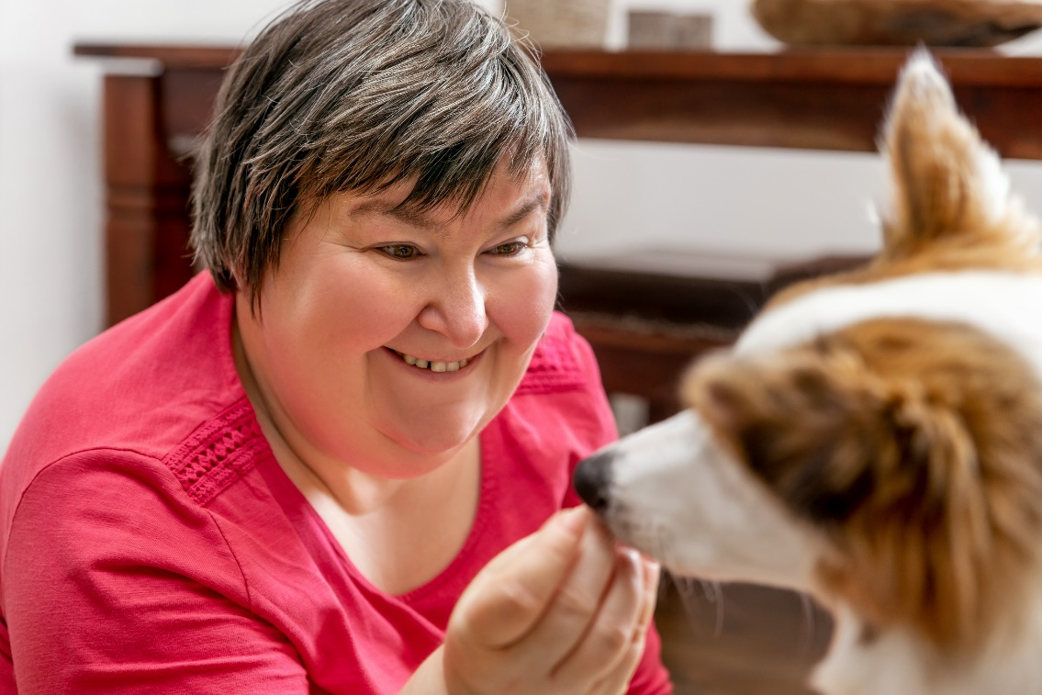
Stacey
Early 30’s, lives with family and dog
Works as a mail clerk and actor
Intellectual disability, speaks
Mouth breathing
Gagging
Bruxes teeth
Recent vertical root fracture of an unresolved premolar tooth
Fears needles
Notes:
S93P Stacey - Dentists
Suggested time: 1.5 minutes:
Notes:
Read the case study as it is written.
See the appendix to the Training guide for detailed information about this case and the clinical and practical points it highlights, including appropriate reasonable adjustments.
Remind participants that the case is also available in their notes pack.
Suggested script:
Stacey is a young woman who lives with her family and has a companion dog. She works as a mail clerk and occasionally as an actor. She has an intellectual disability and needs support across several areas of life.
Stacey communicates using simple speech and can mostly be understood well. She is well supported by her mum, Anna, who attends all appointments with Stacey.
Stacey is a mouth breather and often gags . She also has bruxism, but cannot wear a splint due to gagging.
She has a phobia of needles and so won’t tolerate regular muscle relaxant injections, they make her extremely anxious.
Recently, she had a vertical root fracture of an unrestored premolar tooth.

Slide 94
Stacey – your turn
How would you address Stacey’s oral health needs?
What are some things that might help her cope with dental work?
Notes:
S94P Stacey – Dentists, your turn
Suggested time: 8 minutes:
Notes:
Give people around 4 minutes to discuss in small groups with a 30 second warning before you end.
Then ask the groups to share some of the insights they shared. (2 - 4 minutes).
The next slide is about communication and reasonable adjustments. If groups raise these topics in response here, encourage it and simply summarise additional points in the next slide.
Key points:
Regular scaling
Breaks
Relaxation techniques including calming things from home
Manage the risk of vomiting through scheduling
Optional script: (what to say when depends on what answers arise, but potential answers to emphasise are below)
Ask people to get into small groups (2 – 4 people) to discuss:
How you would address Stacey’s oral health needs?
Come up with ideas of what might help Stacey to cope with dental work?
Answers to highlight:
How would you address Stacey’s oral health needs?
Focus on regular scaling in small sections, with regular breaks,
Schedule appointments at least 2 hours after food to reduce risk of vomiting.
Ask the GP for a care plan summary (the one from the GP Management plan or GP Team Care arrangement plan) to appraise yourself of any relevant medical issues and medications.
Would people suggest a maxillary splint to combat bruxing?
She is unlikely to tolerate it due to gagging (the real life Stacey does not tolerate it).
Focus on good maintenance and refer to a psychologist for further assistance if bruxing increases.
What things might help her to cope?
Schedule appointments that minimise waiting times and even allow her to wait away from other patients where she may be more relaxed
Give her time to settle in at the start of the appointment.
Make conversation – ask about other things in her life (get to know her a bit).
Regular breaks focused on breathing and relaxation exercises, the dentist can do this along with her.
Have a way for her to communicate the need to stop (due to gagging or for any reason).
Count upwards or downwards to indicate when she will next get a break (and stick to it).
Allow her to bring things from home that assist her to relax, e.g. a weighted blanket or any sensory toys that help relax her.
Tell and show her what you are going to do, use models, images and videos.
Good communication – covered in more detail in the next slide.
Ask her how it went at the end so you can adjust things next time if something could be better.
Other answers you can share from the real life Stacey:
Salt on her tongue helped her tolerate scaling without gagging.
Counting down from 20 to the next break.
Instruct her to relax her shoulders (the dentist does it too).
Bringing in a weighted blanket.
Stacey raises her finger if she needs to stop for any reason.

Slide 95
Stacey – further reflections
How would you adjust your communication with Stacey?
Other adjustments?
Notes:
S95P Stacey – Dentists – Further reflections
Suggested time: 6 minutes:
Notes:
These points may have already come out through group feedback from the last slide. If that is the case, direct workshop participants to consider and discuss other adjustments, or simply summarise any additional points not yet discussed.
Key points:
Tell her what you are going to do; check she is OK
Pay attention to communication and reasonable adjustments
Speak to Stacey
Quiet space
One thing at a time, simple words
Give time to think
Scheduling – let her mum know the date and time too
Optional script: (what to say when depends on what answers arise, but potential answers to emphasise are below)
Get people to share in pairs or groups again, discussion about how they would adjust their communication.
Would you need to adjust communication? If yes, what are some ideas for enhancing communication?
What else would you do for someone like Stacey to maximise the success of the appointment?
Answers to emphasise:
Communication:
Speak to Stacey – not her mum, unless she says it is OK to. (And then still involve Stacey too – respect that she is an adult).
Make sure you ask questions of Stacey, not her mum.
Give her information in a quiet place when she is ready to listen.
Talk about one thing at a time.
Use plain, everyday language.
Give Stacey time to think about what you have said. Be comfortable with silence, don’t feel the need to fill it.
Especially important to give time if Stacey needs to make a decision.
Always tell and show her what will happen, then
Check understanding both ways. Use the teach-back method.
Listen carefully when Stacey speaks to you.
Give her time to think if she has any questions.
If recommending that Stacey does something, ask if she would like you to give the information to her mum too. You can provide it in writing or verbally.
What about when you are making appointments for Stacey?
Give her a phone call, not a reminder letter.
If she asks you to, tell mum when the appointment is too.
Asking your reception staff to ask someone how they prefer to receive reminders and if there is anyone else they’d like you to communicate with about appointments, is a really easy and practical adjustment to make.

Slide 96
Leon
For Dentists
Notes:
S96P Leon divider slide
You can remove this slide.

Slide 97
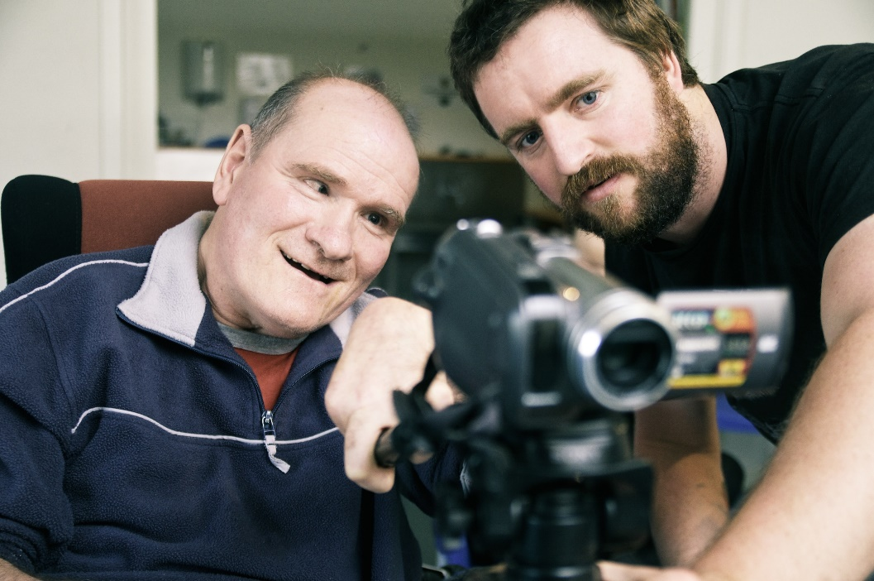
Leon
Late 30’s
Severe intellectual disability, support for most activities
Non-verbal communication, uses wheelchair
Lives in a group home, stays with dad every second weekend
Enjoys watching home videos
Dysphagia, epilepsy
6 years ago: comprehensive evaluation under GA
Referred by GP: – commencing bisphosphonates
- may need extractions
Notes:
S97P Leon - Dentists
Suggested time: 1.5 minutes:
Notes:
Read the case study as it is written.
See the appendix to the Training guide for detailed information about this case and the clinical and practical points it highlights, including appropriate reasonable adjustments.
Bisphosphonates are a type of drug used to treat osteoporosis. They can place a person at a higher risk of adverse effects following tooth extraction.
Suggested script:
Leon is a man in his late 30’s who enjoys watching home videos. He has a severe intellectual disability and requires support for most activities. Leon relies on non-verbal forms of communication. He also has a physical disability and uses a wheelchair.
He lives in a group home and stays with his father every second weekend.
Leon’s medical history includes dysphagia and epilepsy which is not well controlled. He tolerates having someone brush his teeth. His tolerance for dental work is lower – in the past he’s been able to manage small sections of scaling with good suctioning. However, he opens his mouth very wide making it hard to access the buccal surfaces.
His last comprehensive dental evaluation was 6 years ago, under general anaesthetic.
His GP has referred him to you for an assessment and possible extractions prior to commencing bisphosphonates.

Slide 98
Leon – your turn
How would you assess Leon’s oral health?
How would you address his dental needs?
  Risks to manage?
  Adjustments to standard practice?
  Communication?
Notes:
S98P Leon – Dentists – Your turn
Suggested time: 6-7 minutes:
Notes:
An Orthopantomagram is an x-ray of the whole jaw, upper and lower, in one go
This case, and the answers, came from a special care dentist and is based on a real case. If people find it challenging (you will know because small groups will be very quiet), use the answers below to prompt discussion.
Give people about 5 minutes to discuss and 4 to share
Key points:
Focus on what Leon can tolerate – a toothbrush examination
Demonstrate, check in, give breaks
Consider scheduling to suit the person and minimise waiting
Optional script: (what to say when depends on what answers arise, but potential answers to emphasise are below)
In the same small groups, discuss the following questions:
How would you assess Leon’s oral health?
Would you go straight to general anaesthetic?
Is there anything else you could try? How would you work out what to do?
How would you address his dental needs?
Are there risks you need to manage?
Are there any adjustments you could make to your standard practice?
How to do you about communicating with Leon?
Give groups 5 minutes to discuss then bring them together to share with the larger group.
Answers to emphasise include:
Assessment:
Toothbrush examination – work with what he is used to
Leon stays in his wheelchair, with a strap to stay secure
Orthopantomagram (OPG) can be done in a wheelchair but you might need a lifter
Addressing:
Small sections of scaling, good suctioning
Give breaks
Demonstrate on one tooth before doing the rest
Risks:
Dysphagia = risk of gagging
Be aware of how much recline there is – he has
Epilepsy meds = risk of interaction with pre-meds
Also a risk for GA – so you want to avoid it if you can.
If extractions are needed – GA will be needed.
Adjustments:
Suggest he bring distractions with him
Organise pre-meds before a procedure
For someone with intellectual disability it can be really hard to sit in a waiting room. So if they are going to need pre-meds, consider whether it’s something they could take at home, to minimise the wait time
Scheduling appointments:
Minimise wait
A time that works for the person, the group home, etc..
Longer appointment = time to communicate, time to go slow
Communication:
Talk to Leon even though he can’t talk
Tell him that you are going to ask his supporters for information and for them to help you understand him
Ask those supporters how Leon may indicate yes/no or any distress – actively check with them during the procedure, and stop immediately if there is any distress
Show and tell him what you are going to do before you do it
You can demonstrate on your own hand, on a model of teeth, or on his hand so he has an idea of how the tool feels

Slide 99

Leon – pragmatic considerations
Liaise with GP
- Care plan summary
- Optimise general anaesthetic
Referral
  Public hospital
  Private dentist within hospital
  Adjustments
Consent? Payment?
Notes:
S99P Leon – Dentists – Pragmatics
Suggested time: 4 minutes
Notes:
After 2 minutes ask people to share answers
Key points:
For work under GA – liaise with GP early – maximise opportunity
If referring – include info on adjustments that help
Consent and payment may come from another person
Optional script: (what to say when depends on what answers arise, but potential answers to emphasise are below)
There are some other pragmatic considerations in Leon’s case that can only be addressed through having great communication with others involved in his care.
Ask groups to consider what information you need to get from Leon’s doctor and what you should share with the GP
Also discuss what you will do if Leon needs referral for a GA
What are the options and importantly, what can you do to make that process smoother for Leon?
And finally, how are you getting paid for your work with Leon?
Answers to emphasise:
Liaison with GP:
Ask for the care plan summary so you know all the major things going on for Leon
Communicate with the GP that it would be good to get dental done IF Leon is having GA for any other reason.
And if extractions are needed, and this will be done under GA, give the GP sufficient notice to arrange other investigations he is due for. There is any number of preventative and routine checks that he could be overdue for so it makes sense to take full advantage of that GA and get them all done together.
If you refer to a public hospital, ask if there is a process by which a generalist or a rehab physician can arrange these extra investigations.
Referral options:
Public hospital
Private dentist who is able to do this in a well-equipped hospital – Leon is at high risk from a GA so it needs to be in a hospital with sufficient equipment.
Adjustments to the referral process:
Check their accessibility if it’s a practice – Leon is in a wheelchair
If you know of adjustments that assist Leon to cope, tell the person you are referring him to. One of our resources that we’ve shared is a tips sheet focused on communication and reasonable adjustments to optimise health appointments. You could simply asterisk which ones you use and then send it with the referral.
Include the request for other opportunistic evaluations
Another adjustment to make is to check the service’s eligibility before making a referral. In Leon’s case, he clearly has supports around him. But for people with few or no supports, taking this step can help them not fall through cracks.
Ask your staff to make the appointment before they leave your service, and to forward a copy of the referral directly to the practice – it all increases the likelihood that they will actually get there.
Payment?
- In the real life Leon’s case, the dentist phones his parents for consent and payment on the day, for example when the OPG was ordered.

Slide 100

Resources – Special Care Dentistry
www.asscid.org.au/
Notes:
S100P Dentists – Resources special care
Suggested time: 1 minutes
Key point:
Showcase The Association of Special Care Dentistry as a source of information and referral options.
Optional script:
The Association of Special Care Dentistry is a source of information and referral options.
They run professional development for dentists and they can probably also help you find a special care dentist if your patient requires GA or has additional needs that you can’t meet.

Slide 101
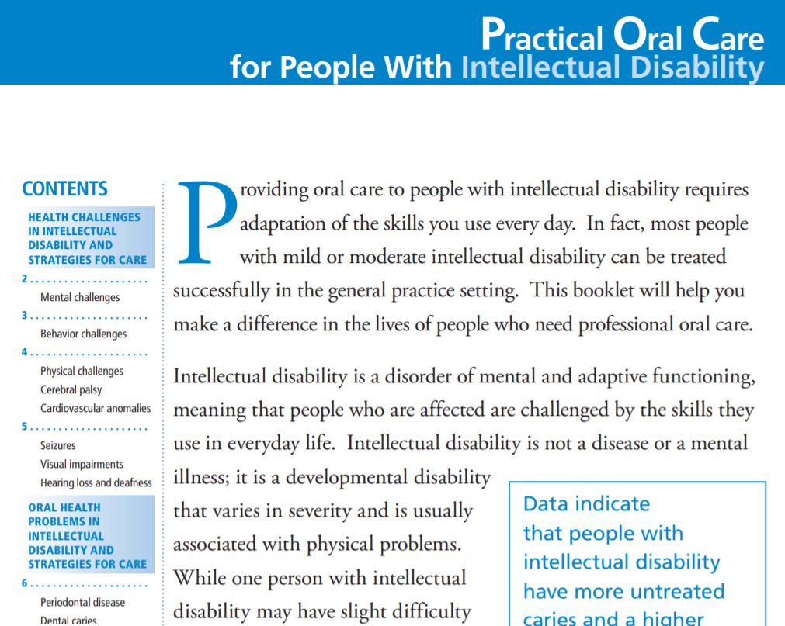

Other resources
https://www.nidcr.nih.gov/sites/default/files/2017-09/practical-oral-care-intellectual-care.pdf
Notes:
S101P Dentists –Resources
Suggested time: 1 minutes
Key point:
Inclusion Australia has produced an excellent resource for dentists.
The NIH paper shown here is one in a series of papers about oral health care and developmental disabilities. They are short and practical.
NICE guidelines from the UK are also available but are specific to people living in residential care settings. The link is on the slide.

Slide 102
Communication aids slides
Dentists
Notes:
S102P Divider Slide – Aids – Dentists
Suggested Time: 1 minute
Notes:
Remove this slide, it is just a divider.
The next two slides are tailored for use at the end of training for dentists.

Slide 103
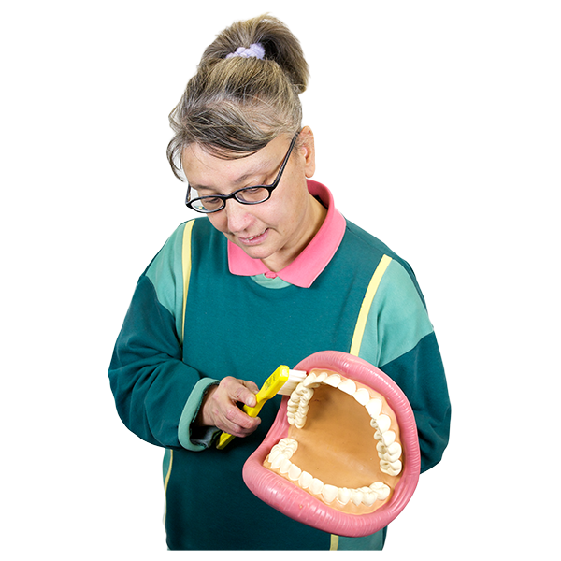
Visual aids
Photo of co-facilitator
3D Models
Show me on your hand
- Then my hand
Notes:
S103P Visual aids
Suggested time: 1 minute
Notes:
This slide can be led by a co-facilitator with intellectual disability. The speaker notes can be adjusted as desired.
This slide is an alternative to the Visual aids slide used with other health professionals. If the co-facilitator with intellectual disability presents this slide, they will need to do additional preparation to create their script for it, or use the optional script below. See the Easy Read co-facilitator guide for this information in easy read so as to support the co-facilitator as needed.
If it is a challenge to use this slide, it is also acceptable to use the script for slide S20C.
Brief Speaker notes:
Models, pointing to self
Optional script:
You can also use visuals to communicate.
Here is an example.
You can use a model to show me.
It does not have to be big.
You can also show me what you will do to my teeth, but on your hand.
Then on my hand so I know what it feels like.
We will send you links to where you can find resources like these.

Slide 104
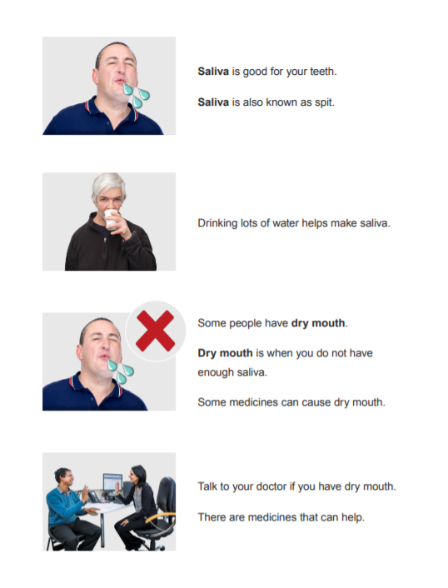
Communication aids
Photo of co-facilitator
Easy read
Social stories
Notes:
S104P Communication aids
Suggested time: 1 minute
Notes:
This slide can be led by a co-facilitator with intellectual disability. The speaker notes can be adjusted as desired. See the Easy Read co-facilitator guide for this information in easy read so as to support the co-facilitator to use their own words.
This slide is an alternative to the communication aids slide used with other health professionals. The script is identical but the image is tailored for dentists.
If it is a challenge to use this slide, it is acceptable to use slide S21C.
Brief Speaker notes:
Easy read
Optional script:
Easy read sheets are terrific.
They use easy-to-understand language.
They have pictures to explain information.
They are a great conversation tool.
This is a picture of a page of easy read.
It is about dry mouth.
Some people also use social stories which are short stories explain a social situation
They can be individualised to a person.

Slide 105
Ending slides
Dentists
Notes:
S105P Divider Slide – Ending slides – Dentists
Suggested Time: 1 minute
Notes:
Remove this slide, it is just a divider.
The next two slides are tailored for use at the end of training for dentists.

Slide 106
6 Key points
Photo of co-facilitator
Talk to me
Ask me what I need
Ask what helps me to cope
Go slow
Communicate with my GP
Be aware of my complex health needs
Notes:
S106P 6 key points: Dentists
Suggested time: 1 minute
Notes:
We suggest this is presented by the co-facilitator with intellectual disability
Brief speaker notes / Optional script:
These are the 6 key points from this training.
Talk to me
Ask me what I need
Ask what helps me to cope
Go slow
Communicate with my GP
Be aware of my complex health needs

Slide 107
Thank you
Photo of co-facilitator
Evaluation survey
Links coming via email:
  NDIS resources
  Medicare item number
  Post-workshop reading – What not to miss
  Easy read health fact sheets and other resources.
Notes:
S107P Dentists - Thank you and wrap-up
Suggested time: 1 – 2 minutes
Notes:
Speaker notes - key point:
Remind participants that links to the evaluation survey and helpful resources will be sent via email following the workshop.
Optional script:
Thank you for being part of this workshop.
Thank you for sharing your ideas.
We are trying to make these workshops as good as they can be.
So we will be emailing you a link to a survey.
Please do the survey.
We will also email you a post-workshop pack.
It has helpful information for you.
It also has links to accessible resources that you can share with people with intellectual disability.

Slide 108
Case examples
For Pharmacists
Notes:
S108P Divider slide – Case examples - Pharmacists
Suggested Time: 1 minute
Notes:
Notes for introducing and describing the case examples are given in full for these slides. It is best to read them as they are written.

Slide 109
Joe
For Pharmacists
Notes:
S109P Divider slide - Joe
You can remove this slide.

Slide 110
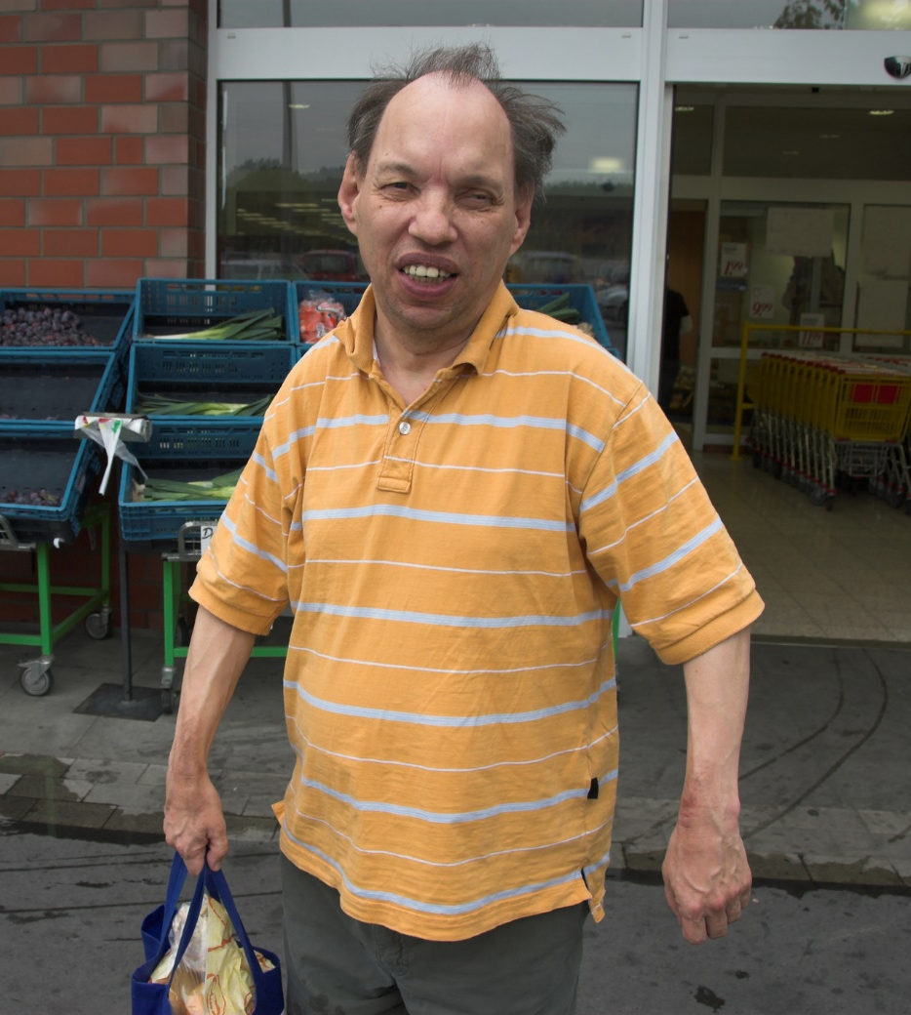
Joe
Late 50’s
Lives alone; ? family ?
Mild intellectual disability.
Speaks. Can read some short words.
Epilepsy – 900 mg sodium valproate daily, 10+ years.
Recent injury - ? topical treatment ?
2 mg Diazepam 21 days.
Constipation - ? time frame.
Change to balance/slower.
Notes:
S110P Joe - Pharmacists
Suggested time: 1.5 minutes:
Notes:
Read the case study as it is written.
See the appendix to the Training guide for detailed information about this case and the clinical and practical points it highlights, including appropriate reasonable adjustments.
Sodium valproate is commonly used to treat epilepsy and also bipolar disorder. It can disrupt metabolism.
Benzodiazepines commonly cause constipation but also can cause vagueness and balance issues.
People with intellectual disability being unsure of time frames is a common practical challenge that health professionals may face.
Suggested script:
Joe is man in his late 50’s who lives alone in a public housing unit. He has a mild intellectual disability. He communicates through speech and can read some simple text. Joe has never mentioned having a family or supports. He has always attended the local pharmacy alone.
Joe has epilepsy for which he takes 900 mg sodium valproate daily in 2 doses. The dose has remained the same for at least the past 10 years.
3 weeks ago, his GP prescribed 2 mg diazepam at night. Joe says this was for an injury. There are 3 repeats on this script.
When questioned, Joe reports that the diazepam helps him sleep. His sleep was compromised recently due to shoulder pain which remained after a fall. It’s unclear from his report whether he fell or slipped. He can’t recall when the injury occurred. He does know that he tried a cream first but it did not help. He does not know what the cream was called. He already owned it before the injury, having used it for an injury some years ago. He reports the tube has now run out.
Today Joe is at the local pharmacy, asking for a repeat of the sodium valproate. The script is on file. He also asks if he can get another box of diazepam while he’s here, he is not sure how many pills are left. It’s not due to be refilled for another week.
Joe also asks if you can recommend a product to help with constipation. When asked, he says he has been feeling blocked up for a while but he is not sure how long.
You note that Joe is holding on to the counter and appears generally slower than typical for him.
When asked, Joe can’t remember the last time he went to the doctor. He thinks he has not been since the script for diazepam was issued (4 weeks ago).

Slide 111
Joe – your turn
What are your initial thoughts?
  Risks?
What other information do you need at this stage?
What should you communicate with Joe? How?
Notes:
S111P Joe – Pharmacists – Your turn
Suggested time: 10-12 minutes:
Notes:
Give people around 6-8 minutes to discuss in small groups (2 – 4 people) with a 1 minute warning of when you will end the groups.
Then ask the groups to share some of the insights they shared. (4 minutes).
The next slide is about communication and reasonable adjustments. If groups raise these topics in response here, encourage it and simply summarise additional points in the next slide.
Key points:
Need to send Joe back to his doctor and also communicate your concerns with the doctor
Adjustments to communication are important
Optional script: (what to say when depends on what answers arise, but potential answers to emphasise are below)
Ask people to get into small groups (2 – 4 people) to discuss their initial thoughts – by this we mean clinical impressions. What are some of the things that might be going on for Joe? Are there any risks from his medications?
What other information do you need at this stage? How are you going to get it? What would you communicate with Joe? How would you do that?
Answers to emphasise include the following:
Clinical impressions and risks:
Why do you think he is constipated?
Injury = reduced exercise. You could ask him what part of his body he injured. Has it affected his walking? Activity levels?
Could be a side-effect of medications:
Benzodiazepines = increase risk of constipation.
Could also reflect metabolism changes, which could be due to sodium valproate. They could also reflect age-related changes in pharmacokinetics. Even in their late 50’s, a person with intellectual disability may experience frailty.
The fall itself could also be a sign of medication problems.
Seizure is possible.
There is some data on an increased falls risk from sodium valproate - though it’s not as high as for other anti-epileptics
The addition of diazepam is a further risk for falls AND his slowness and holding the counter gives a strong indication that this needs review.
It’s also possible he just plain slipped.
Other information to gather:
You might want to check his blood pressure.
Can you be confident that Joe is reliable in taking his meds on time?
A benzodiazepine could change this considerably
Ask Joe if his Epilim pills have ran out yet (and when)? Check the date of the last time he filled the script and the number dispensed.
What would you do if the dates on the script suggest Joe has not been reliable in taking the Epilim? (Discuss it with him, give him a Webster pack & reminder app, ensure the GP knows if pills seem to be skipped).
Ask Joe if he knows when or how he is to stop the diazepam? Does he plan to see his doctor for a review?
Ask him how he has been feeling lately? Has he noted any changes? Dizziness? Tiredness?
What to tell Joe:
It might be that his constipation is due to his medicine.
He needs to see his doctor to review the need for diazepam and to talk about how and when to stop.
He can bring old medications and creams in to check with you if they are still OK to use for a problem he is having. He can also take them to his doctor.
Topical treatments are still drugs.
How to communicate:
Suggest Joe sits down - this is not needed for every person with intellectual disability but it makes sense when someone is gripping the counter.
Speak slowly using plain language.
Tell him why you want more information from him – to work out how to help him. This includes asking personal questions, e.g. about his poo.
Reassure him that it is OK if he does not know the answers to your questions.
Ask only one question at a time and wait for an answer – give Joe thinking time.
Give Joe time to think about whether he has questions for you.
Write down things for him in steps, e.g. seeing his doctor.
It may not be practical to communicate ALL the information in the time Joe is in your pharmacy. He also appears to be vague and slow so he may not retain the information. Encourage participants to think about alternatives. Examples are home based meds review; communicating the same info to the doctor.
Would you communicate with the doctor, too? It is a good idea because:
He may be experiencing a side effect of the diazepam which would leave him at an increased risk of falls.
The constipation could also be a side effect of his medications and may need investigation.
There are several indicators that Joe may not remember to see his doctor despite your conversation.
Joe could benefit from a home-based medication review to check what is still in his cupboard and identify unused or expired pills. This would also be a chance to ask the doctor for recent blood results to check metabolism and side effects.
Before doing this, tell Joe that you are going to call his doctor to get more information and to talk to the doctor about the plan for his pills.

Slide 112
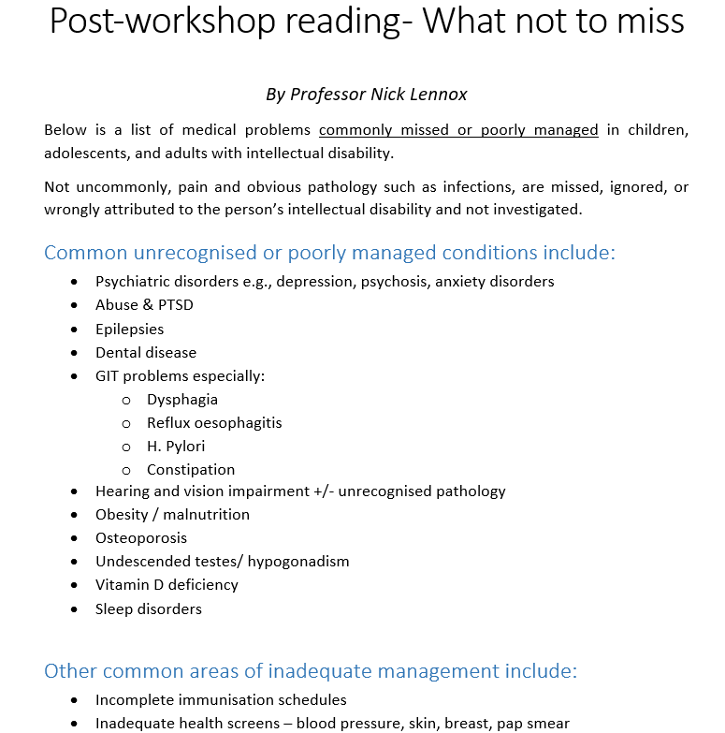
Joe – further considerations
Clinical complexity:
  Frailty risk
  Missed conditions
Incomplete reports
  Scripts on file; check dates
  Touch base with the doctor
Home-based medication reviews
tg.org.au
Notes:
S112P Joe – Pharmacists – Further considerations
Suggested time: 6 minutes:
Notes:
Many of these suggestions may have already emerged from the previous discussion and group feedback. If so, acknowledge this and just summarise.
If you are turning off animations, use the next slide instead as this one will appear odd.
Key points:
People with intellectual disability can present with much complexity due to:
Increased frailty risk
Missed conditions
Incomplete reports are common. To help:
Keep scripts on file; check dates
Touch base with the doctor
Home-based medication reviews are possible for people with intellectual disability. GP referral is needed.
The Therapeutic Guidelines are an excellent resource - chapter on Developmental Disability and chapter on psychotropic prescribing (not specific to people with intellectual disability). They have recently been updated and are available online as a subscription service.
Optional script: (what to say when depends on what answers arise, but potential answers to emphasise are below)
- Summarise from the slides
Joe’s case highlights some common clinical and practical concerns that can apply to anyone but are much more common in people with intellectual disability.
Constipation is a really common side effect of many medications but it’s also already extremely common and commonly missed in people with intellectual disability.
Pharmacists can assist by communicating with their patients to look out for changes in their poo if a medicine is known to have that side effect.
The good old Bristol stool chart can be a great visual to aid a conversation.
There are a bunch of other conditions which also tend to be missed or under-managed in people with intellectual disability and these are summarised within the handouts.
The Therapeutic Guidelines are an excellent resource. There is a chapter on Developmental Disability which includes tips for communicating with people with intellectual disability, as well as covering common health problems including epilepsy and its management. There is also a chapter on psychotropic prescribing which is not specific to people with intellectual disability but it is a great resource nonetheless and applicable to this group because so many people with intellectual disability are prescribed psychotropics. They have recently been updated and are available online as a subscription service.
Early frailty is also much more common in people with intellectual disability. So for middle aged or older adults, always open to the possibility of new side effects, even if they’ve been on a medication for some time.
Incomplete reports and not being clear of time frames is also a common scenario.
Touch base with the doctor if you have concerns. For someone like Joe, who essentially has no supports, adopt a low threshold for doing this. The side effects of his benzodiazepine may have a large impact on his function and capacity to be independent – yet he has no supports. He is extremely vulnerable. It’s easy to see how the side effects of the benzodiazepines could mean he ceases regular contact with his doctor but is still in contact with the pharmacy. So your contact with the doctor could trigger a falls risk assessment for Joe and prevent him having further injury.
Offering to keep scripts on file is sensible.
Checking dates. If the person is able to, ask them photograph the remaining medication before coming in to see you for the repeat.
Home-based medication reviews are a great way to gauge how reliable someone is in taking their medication. It also gives you an opportunity to see what over-the-counter products they have. It gives you time in a comfortable environment for them to communicate more fully. And, because they require a GP referral, it is a chance to ask the doctor what the intended use of each medication is.

Slide 113
Joe – further considerations
Clinical complexity:
  Frailty risk
  Missed conditions
Incomplete reports
  Scripts on file; check dates
  Touch base with the doctor
Home-based medication reviews
  See POMPIDA
tg.org.au
Notes:
S113P Joe – Pharmacists – Further considerations – No animations
Suggested time: 6 minutes:
Notes:
Only use this slide if you are turning off animations. To unhide it, right click on the slide in the left hand menu and select unhide.
Many of these suggestions may have already emerged from the previous discussion and group feedback. If so, acknowledge this and just summarise.
Key points:
People with intellectual disability can present with much complexity due to:
Increased frailty risk
Missed conditions
Incomplete reports are common. To help:
Keep scripts on file; check dates
Touch base with the doctor
Home-based medication reviews are possible for people with intellectual disability. GP referral is needed.
The Therapeutic Guidelines are an excellent resource - chapter on Developmental Disability and chapter on psychotropic prescribing (not specific to people with intellectual disability). They have recently been updated and are available online as a subscription service.
Optional script: (what to say when depends on what answers arise, but potential answers to emphasise are below)
- Summarise from the slides
Joe’s case highlights some common clinical and practical concerns that can apply to anyone but are much more common in people with intellectual disability.
Constipation is a really common side effect of many medications but it’s also already extremely common and commonly missed in people with intellectual disability.
Pharmacists can assist by communicating with their patients to look out for changes in their poo if a medicine is known to have that side effect.
The good old Bristol stool chart can be a great visual to aid a conversation.
There are a bunch of other conditions which also tend to be missed or under-managed in people with intellectual disability and these are summarised within the handouts.
The Therapeutic Guidelines are an excellent resource. There is a chapter on Developmental Disability which includes tips for communicating with people with intellectual disability, as well as covering common health problems including epilepsy and its management. There is also a chapter on psychotropic prescribing which is not specific to people with intellectual disability but it is a great resource nonetheless and applicable to this group because so many people with intellectual disability are prescribed psychotropics. They have recently been updated and are available online as a subscription service.
Early frailty is also much more common in people with intellectual disability. So for middle aged or older adults, always open to the possibility of new side effects, even if they’ve been on a medication for some time.
Incomplete reports and not being clear of time frames is also a common scenario.
Touch base with the doctor if you have concerns. For someone like Joe, who essentially has no supports, adopt a low threshold for doing this. The side effects of his benzodiazepine may have a large impact on his function and capacity to be independent – yet he has no supports. He is extremely vulnerable. It’s easy to see how the side effects of the benzodiazepines could mean he ceases regular contact with his doctor but is still in contact with the pharmacy. So your contact with the doctor could trigger a falls risk assessment for Joe and prevent him having further injury.
Offering to keep scripts on file is sensible.
Checking dates. If the person is able to, ask them photograph the remaining medication before coming in to see you for the repeat.
Home-based medication reviews are a great way to gauge how reliable someone is in taking their medication. It also gives you an opportunity to see what over-the-counter products they have. It gives you time in a comfortable environment for them to communicate more fully. And, because they require a GP referral, it is a chance to ask the doctor what the intended use of each medication is.

Slide 114
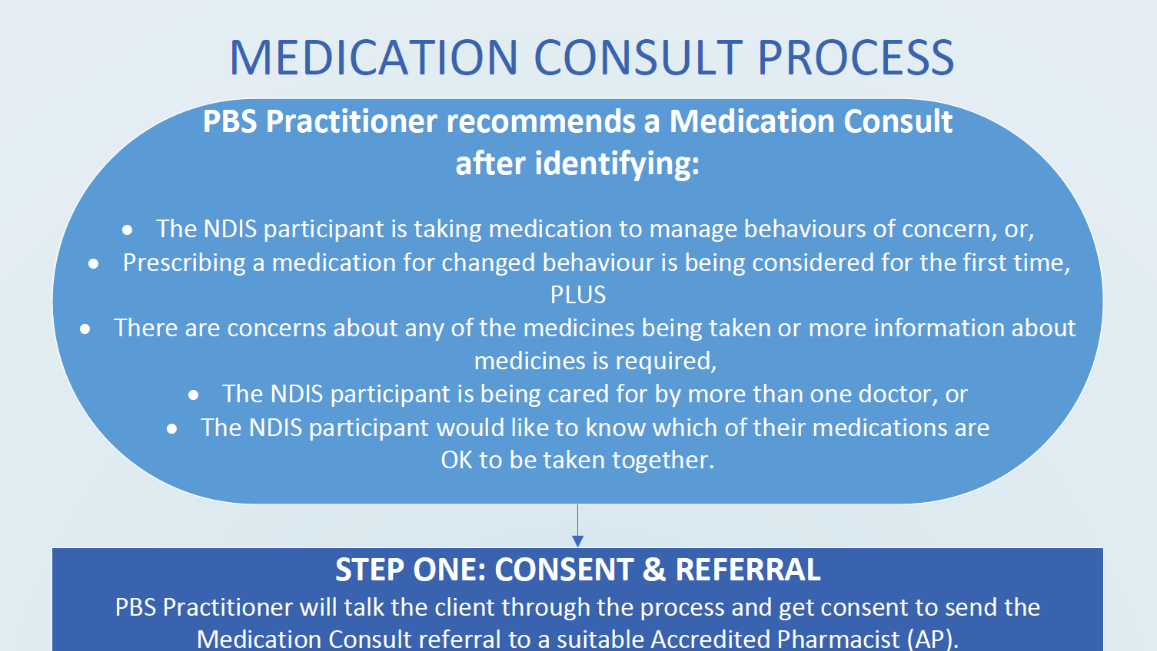
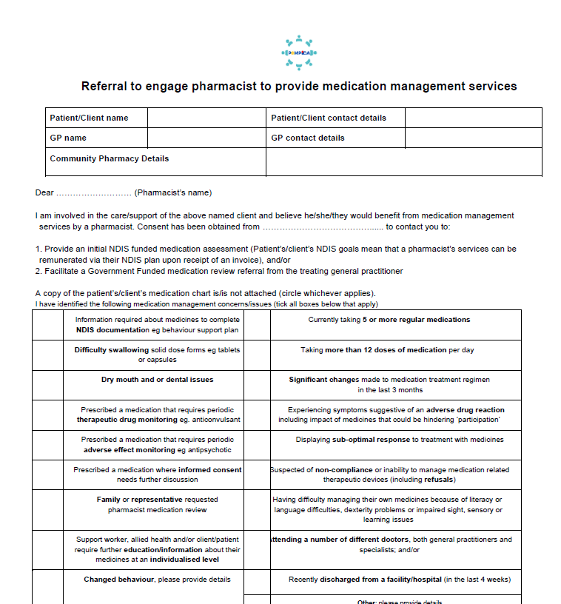
Resources - POMPIDA
Notes:
S114P Pharmacists – POMPIDA resources
Suggested time: 1 minutes
Notes:
Check if the POMPIDA website is active before running the training. If so, you need only include a link to it.
Key point:
The POMPIDA (Pharmacists Optimising Medication for People with Intellectual Disability and Autism) is a source of information, including forms for Home medication review and information about how to charge for it.
A GP can provide a referral under Medicare and pharmacists can charge through Medicare.
Another option is to provide 1 hour of clinical supervision to a Positive Behaviour Support practitioner, at the person’s home, and have this include a medication review. This is billed to their NDIS plan. You can treat this like an initial review and then ask the GP for a referral for a fuller review. The POMPIDA alliance has compiled resources on this, including referral forms. We will send you those after the training.
Optional script:
One of the handouts we have sent to you is a resource developed POMPIDA (Pharmacists Optimising Medication for People with Intellectual Disability and Autism which includes a template for a home-based medication review for someone with intellectual disability, as well as information on how to bill for it, and a referral form.
A GP can provide a referral under Medicare and pharmacists can charge through Medicare.
Another option is to provide 1 hour of clinical supervision to a Positive Behaviour Support practitioner, at the person’s home, and have this include a medication review. This is billed to their NDIS plan. You can treat this like an initial review and then ask the GP for a referral for a fuller review. The POMPIDA alliance has compiled resources on this, including referral forms. We will send you those after the training.

Slide 115
Daryan
For Pharmacists
Notes:
S115P Daryan divider slide
You can remove this slide.

Slide 116
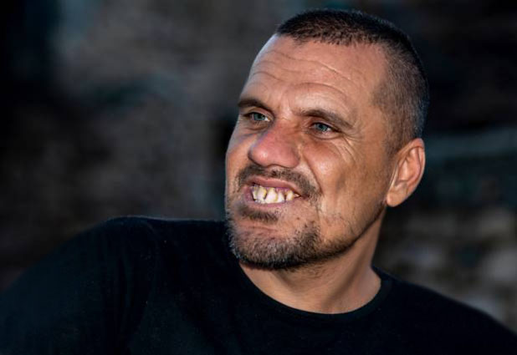
Daryan
- 25 years old
- Loves being outdoors, music
- Enjoys sensory stimulation
- Lives alone with 2:1 support in a regional town
- intellectual disability, autism, bipolar disorder, challenging behaviours
- 11 medications including 2 antipsychotics daily and 1 PRN
Notes:
S116P Daryan - Pharmacists
Suggested time: 1.5 minutes:
Notes:
Read the case study as it is written.
See the appendix to the Training guide for detailed information about this case and the clinical and practical points it highlights, including appropriate reasonable adjustments.
A slightly different approach is used for this case study. Not all medications are listed below – there are too many. Give participants time to read through this at the start of group discussion (get them to read it simultaneously and allow them to react and discuss in their small groups as they do).
The handout has space for notes.
Direct participants to find the chart of Daryan’s medications in their handouts
The case study is based on a real case. However, it is an extreme example of polypharmacy and includes elements of chemical restraint. Participants may express surprise. Pause to allow for reactions.
Suggested script:
Daryan is a man in his mid-20’s who enjoys nature shares a close bond with his mum. He has lived in supported accommodation since the age of 16, and currently receives 2:1 care in a unit on his own.
He is obese and has a family history of cardiovascular disease
Daryan has intellectual disability, autism, bipolar disorder, and “challenging behaviours”. These include noise and property destruction, inappropriate urination and smearing faeces, and spitting. He paces often and has a poor attention span.
However, he loves nature – his support workers report that Daryan is always calmer when they take him to a bushwalk or the beach – both of which are a 15 minute drive from his home.
Daryan sees a psychiatrist and also engages a psychologist and OT via the NDIS. He consulted a senior psychologist as part of a review of his Positive Behaviour Support plan. The psychologist requested the GP make a referral for a Home Medications Review.
Daryan is currently prescribed 11 medications; this includes 2 daily antipsychotics and a third on a PRN basis.

Slide 117
Daryan – your turn
What are the major risks for Daryan?
What recommendations would you make?
- to whom?
What else could you recommend?
- Non-pharmacological
Notes:
S117P Daryan – Pharmacists – Your turn
Suggested time: 10 - 12 minutes:
Notes:
Give groups time to digest the case study and the degree of polypharmacy in Daryan’s case
Their post-workshop activity is a chance to take more detailed notes and do necessary research to complete the medication review for Daryan.
For full clinical answers refer to the chart provided in the Training guide appendix.
Key points:
Emphasise the point is not to discuss the detail of every medication (it would take too long) but to discuss the major alarm bells
Key things to emphasise:
Huge dose of antipsychotics
Restrictive practice
Imposes cardiovascular risk
Metabolic side effects are already present – obesity for example
Increases likelihood of constipation which worsens behaviour
Benztropine can mask tardive dyskinesia
Stopping both antipsychotics and benztropine together can induce irreversible tardive dyskinesia
Non-pharmacological:
Move closer to nature
Address sensory needs, especially as he has autism.

Slide 118
Polypharmacy and restrictive practices
Common in people with intellectual disability
Consider anti-cholinergic burden:
  Especially people with Down syndrome
What do you do?
NHS England » Stopping over medication of people with a learning disability, autism or both (STOMP)
Notes:
S118P Daryan – Pharmacists – Polypharmacy
Suggested time: 2 minutes
Notes:
Click the mouse again to reveal the text “What do you do?” and then give people a chance to answer
This slide has animations.
Please check if the POMPIDA website is live before running the workshop. It was planned at the time of writing. If possible, insert the link and their logo into the slide.
Key points:
Polypharmacy is common in people with intellectual disability and is of major concern due to:
Cumulative and compounding side effects and long term health risks
Anticholinergics are of particular concern
Polypharmacy can be a restrictive practice
STOMP protocol is a resource from UK about de-prescribing.
For complex cases, seek a senior pharmacist’s advice
Optional script:
Daryan’s case highlights the risks associated with polypharmacy:
Drugs with anticholinergic effects can severely impact the health outcomes of people with intellectual disability:
Cardiovascular effects compound lifestyle factors, and diet and exercise in people with intellectual disability is often really poor
There is also an increased dementia risk arising from overuse of these drugs. Which is why we have a note here about the importance of considering anticholinergic burden for people with Down syndrome because they are at really high risk of early onset Alzheimer’s disease
Use of an antipsychotic drug to address challenging behaviour in the absence of a mental health diagnosis is a restrictive practice. It is only appropriate in the case of behaviours of concern which are so severe they pose a risk to the safety of the person or those around them, and where non-pharmacological treatments have failed.
Using drugs for challenging behaviours requires a person to have in place a Positive Behaviour Support plan, which is regularly reviewed. But the dose should also be regularly reviewed.
However, in some states (e.g. NSW), if a person’s treatment for a diagnosed mental health disorder involves the administration of 1 or more psychotropics and the dosage levels, combinations or numbers of restricted substances used, or the duration of the treatment, are outside the accepted mode of treatment for such a patient, this requires consent from a tribunal rather than a person responsible. Depending on the specific drugs used and their reason, polypharmacy may fall into this category of treatment.
So, if your patient is currently on a less-than-ideal drug or a mix of drugs, what do you do?
Answers to encourage:
Home based medicines review
Advise the best order in which to de-prescribe
Check out the POMPIDA resources on how a Positive Behaviour Support specialist can request a mini review, through supervision of themselves, from a pharmacist. A GP may then be asked for a referral to do the full, Medicare-funded review.
Same principles as for safe prescribing apply:
Review reasons for prescribing
Ensure close supervision throughout
Ensure the person and their supporters knows what to do, and what side effects to watch for
Go slow
Check out the STOMP website which we have shared in your handouts, focused on de-prescribing.

Slide 119
Ending slides
Pharmacists
Notes:
S119P Divider Slide – Ending slides - Pharmacists
Suggested Time: 1 minute
Notes:
Remove this slide, it is just a divider.
The next two slides are tailored for use at the end of training for pharmacists.

Slide 120
6 Key points
Photo of co-facilitator
Talk to me
Ask me what I need
Look at my personal health record
Check dates, offer Webster pack
Suggest home-based medicine reviews
Talk to my doctor
Notes:
S120P Pharmacists - 6 key points:
Suggested time: 1 minute
Notes:
We suggest this is presented by the co-facilitator with intellectual disability
What you can say:
These are the 6 key points from this training.
Talk to me
Ask me what I need
Look at my personal health record
Don’t assume something is because of my disability
Help me stay healthy by suggesting yearly assessments & preventative health checks
Keep in mind that ANY time there is a change in how I act or what I can do you should check things in this order.
physical health
Then mental health
Then what else has been happening lately
Only after all that is done, consider if it is a behaviour.

Slide 121
Thank you
Photo of co-facilitator
Evaluation survey
Links coming via email:
  POMPIDA links
  Post-workshop reading – What not to miss
  Links to Easy Read health fact sheets and other resources.
Notes:
S121P Pharmacists - Thank you and wrap-up
Suggested time: 1 – 2 minutes
Notes:
Speaker notes - key point:
Remind participants that links to the evaluation survey and helpful resources will be sent via email following the workshop.
What you can say:
Thank you for being part of this workshop.
Thank you for sharing your ideas.
We are trying to make these workshops as good as they can be.
So we will be emailing you a link to a survey.
Please do the survey.
We will also email you a post-workshop pack.
It has helpful information for you.
It also has links to accessible resources that you can share with people with intellectual disability.

